Slide 1
Literacy Tasks: Phase 5
This pack will help you learn your sounds and continue to learn to read.
Practise saying all of the sounds using the sound mat.
Practise reading the tricky words.
Use YouTube song ‘Phase 5 Tricky words’
Write sentences that include your words using cursive handwriting.
Read a part of the book every day.
Play phonics games online or use a practical activity to practise your skills.
BBC bitesize phonics
Teach your monster to read
Phonics play

Slide 2
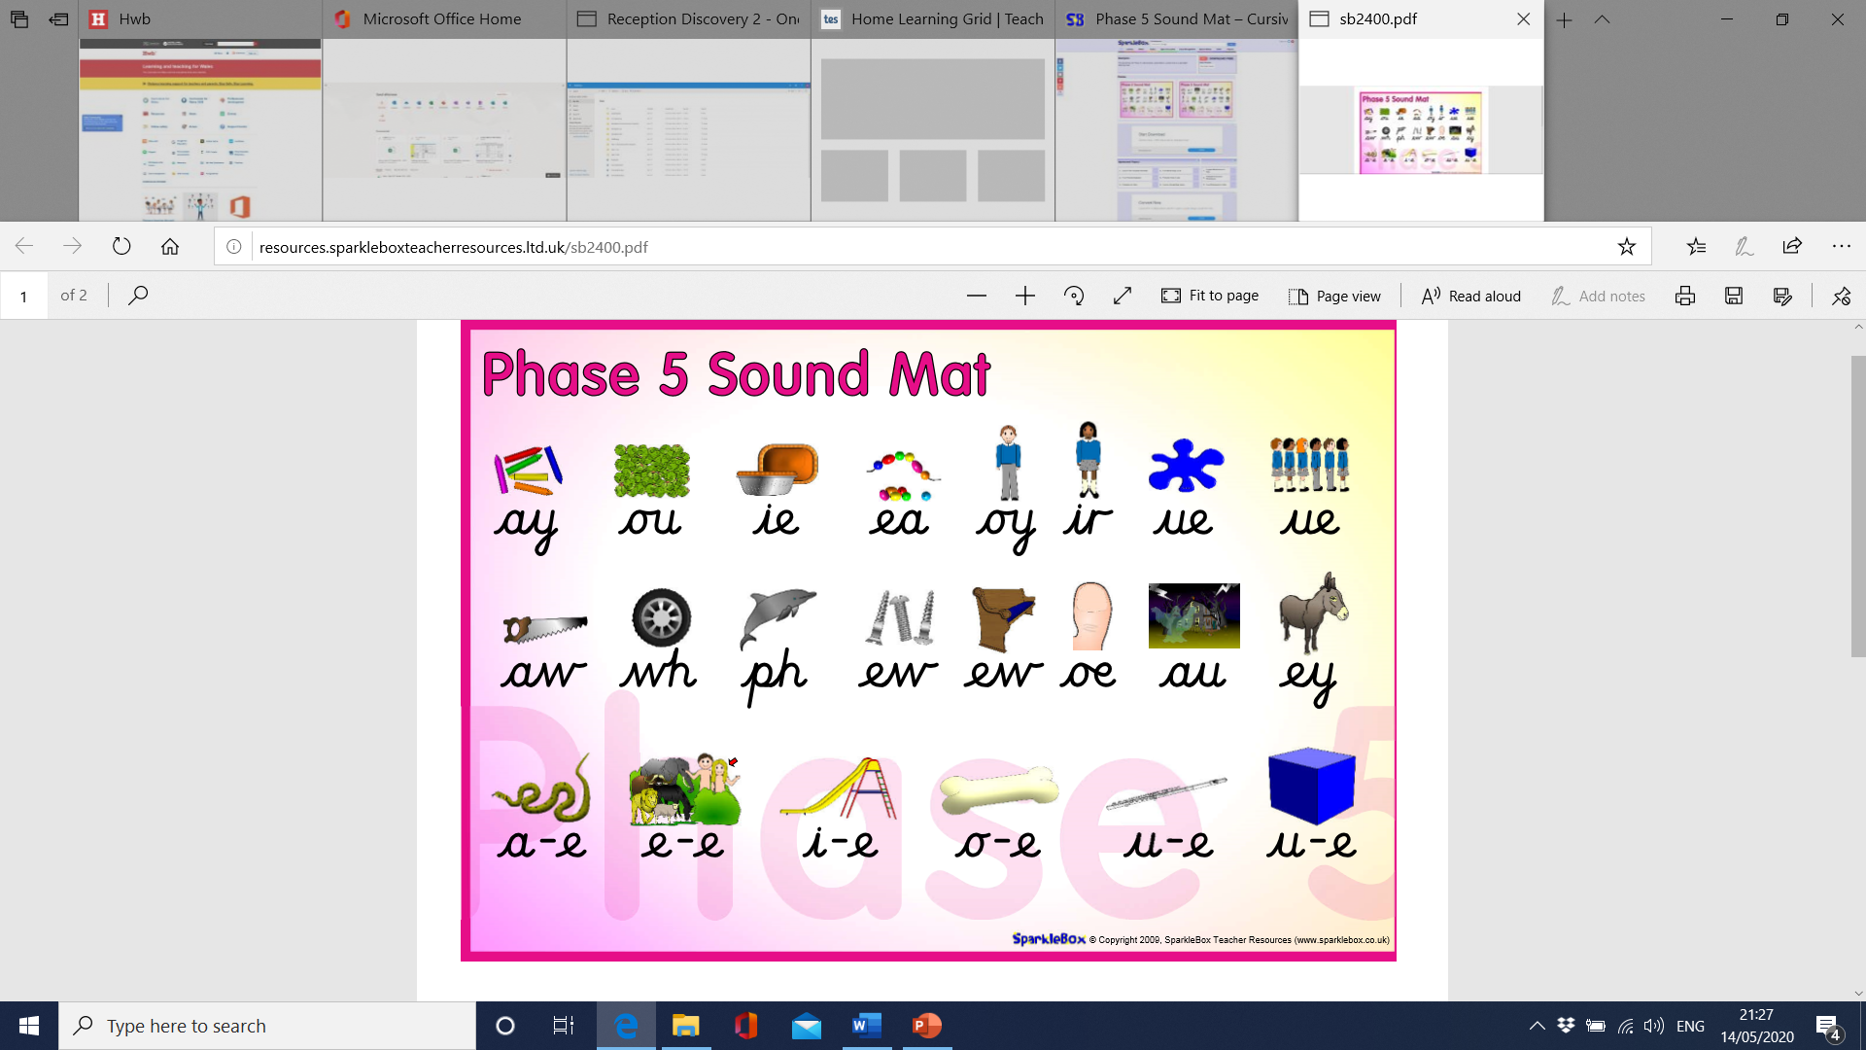

Slide 3
Tricky Words
said have like so do
some come were there
little one when out what
oh their people Mr Mrs
looked called asked could

Slide 4

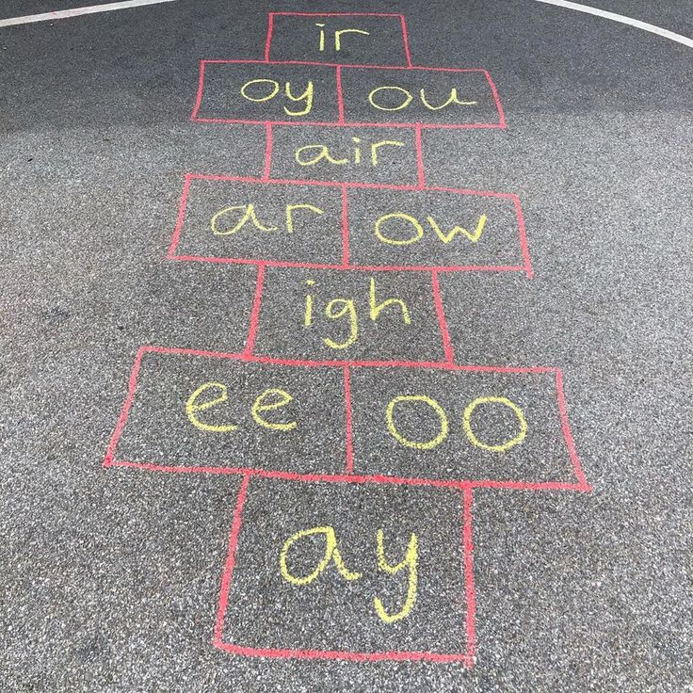
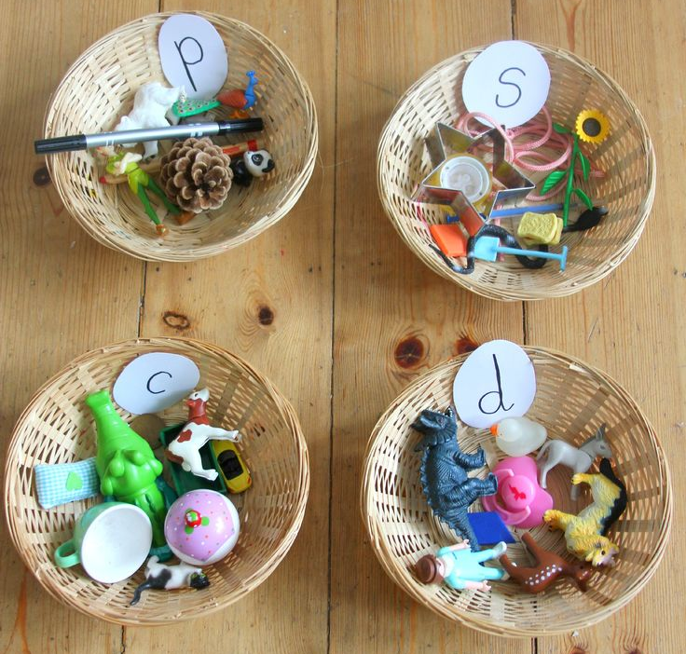
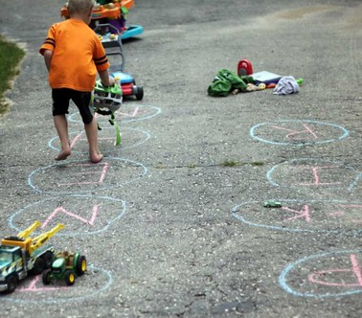
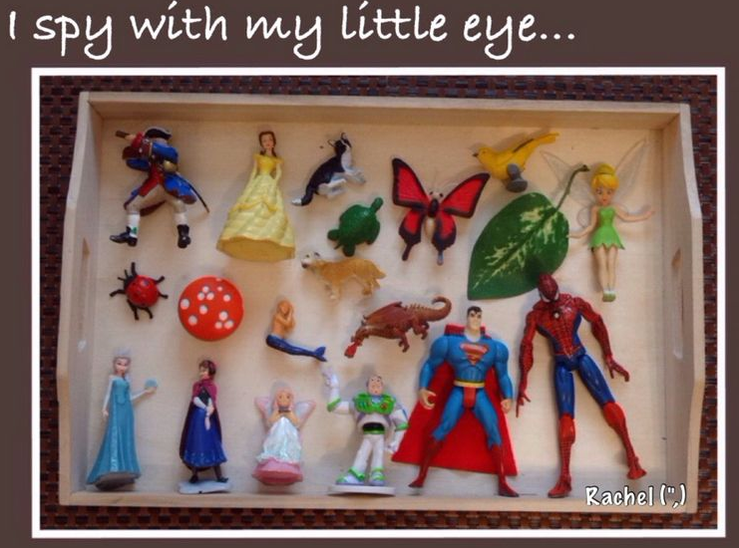
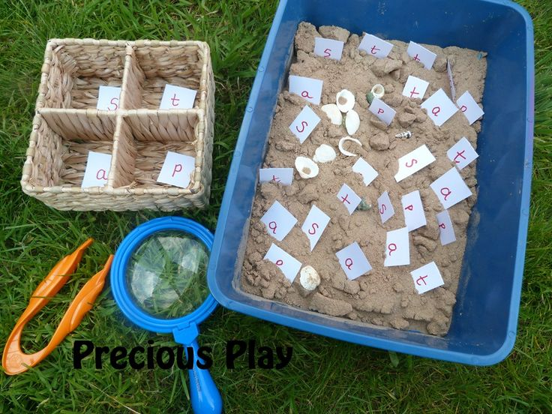
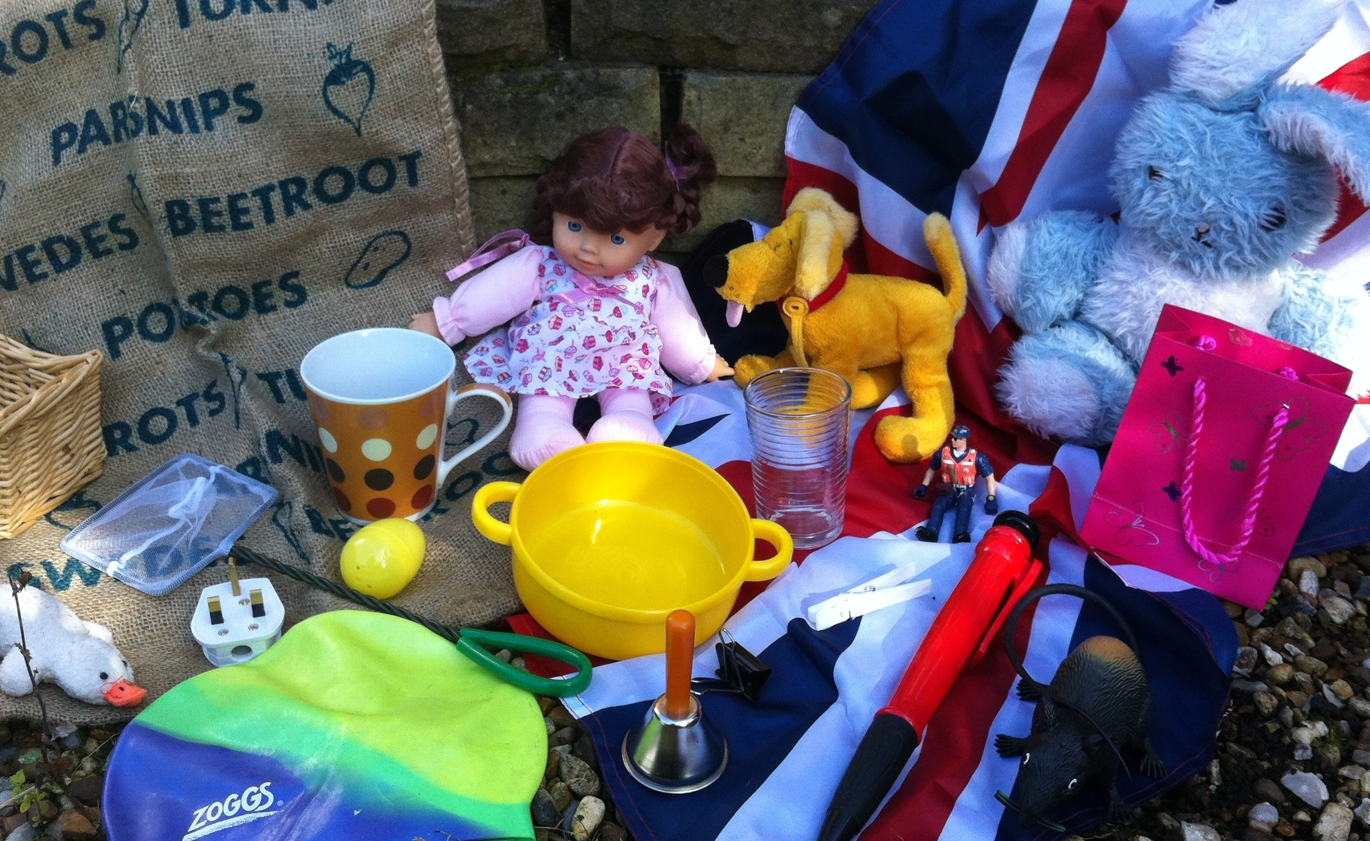
Example of practical ideas…
Go on a sound hunt around the house and outdoors. What objects can you find that starts with the sound ___?
Have a box of objects. Can you say initial and end sound of the objects? Play eye spy.
Practise writing your words and sound in messy play- sand, paint, flour, water, mud, sticks, chalk etc.
Write sounds using chalk on the floor. Play hopscotch on the sound's.
Play board games like scrabble, hangman and sound bingo.
Sing songs and rhymes. Use YouTube videos to learn your words.

Slide 5
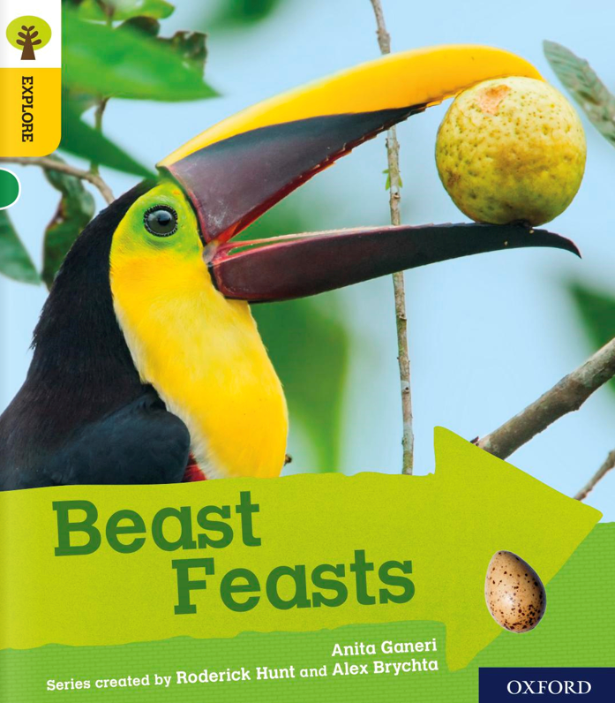

Slide 6
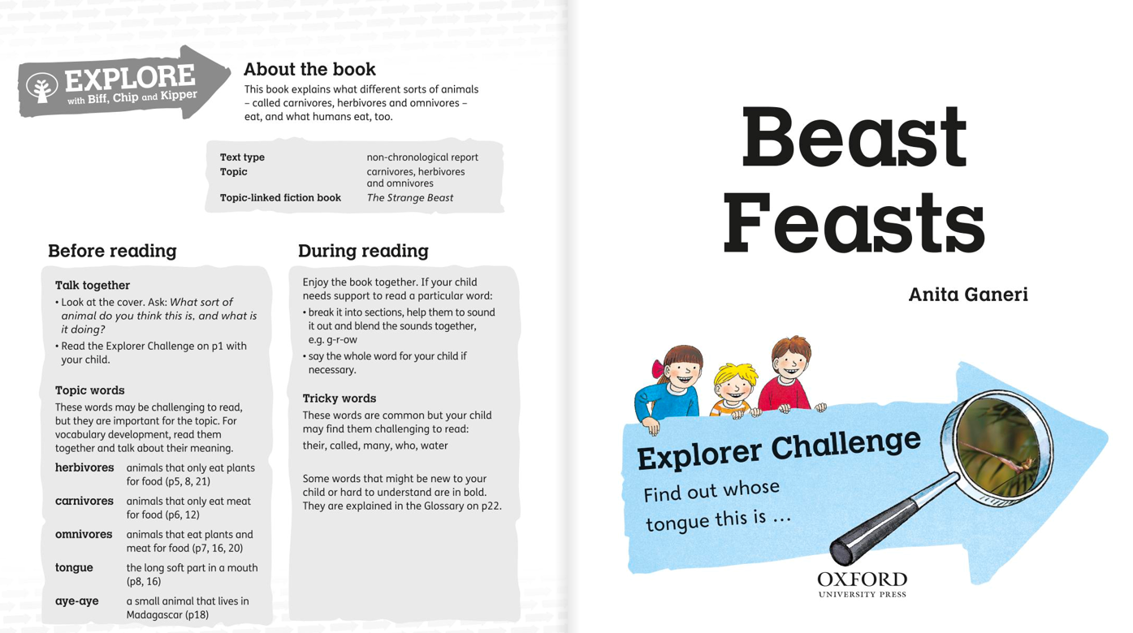

Slide 7
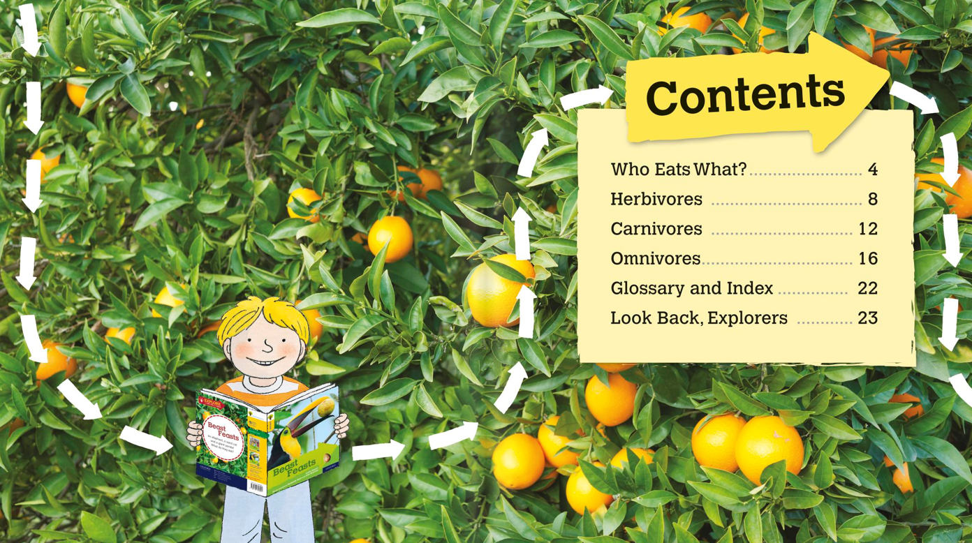

Slide 8
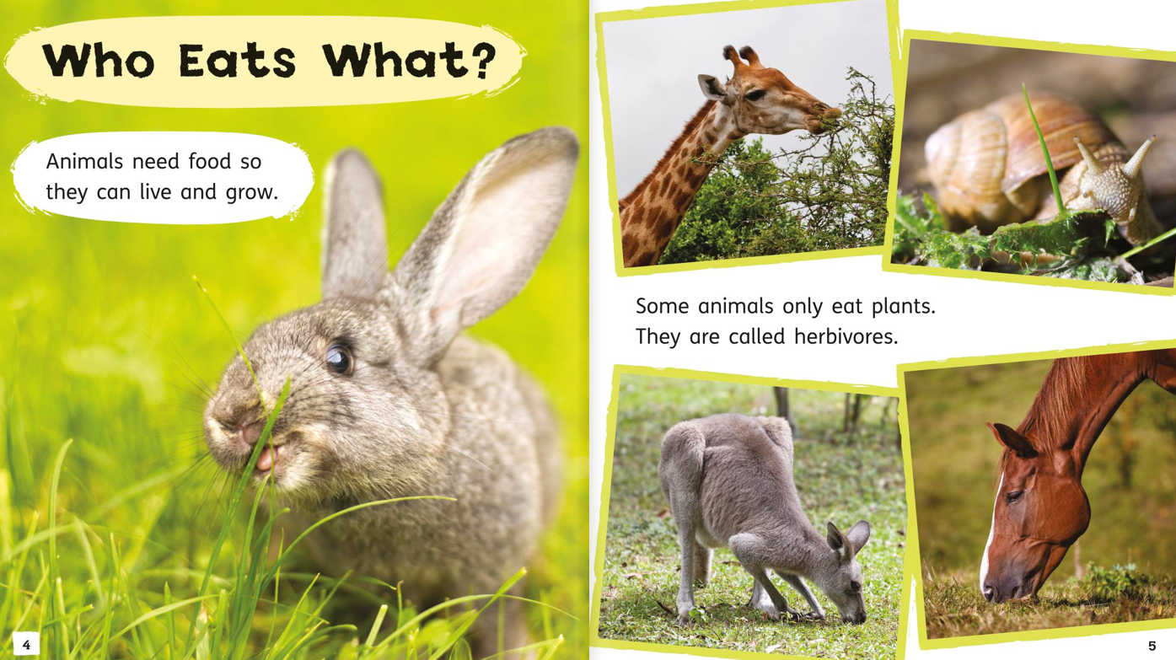

Slide 9
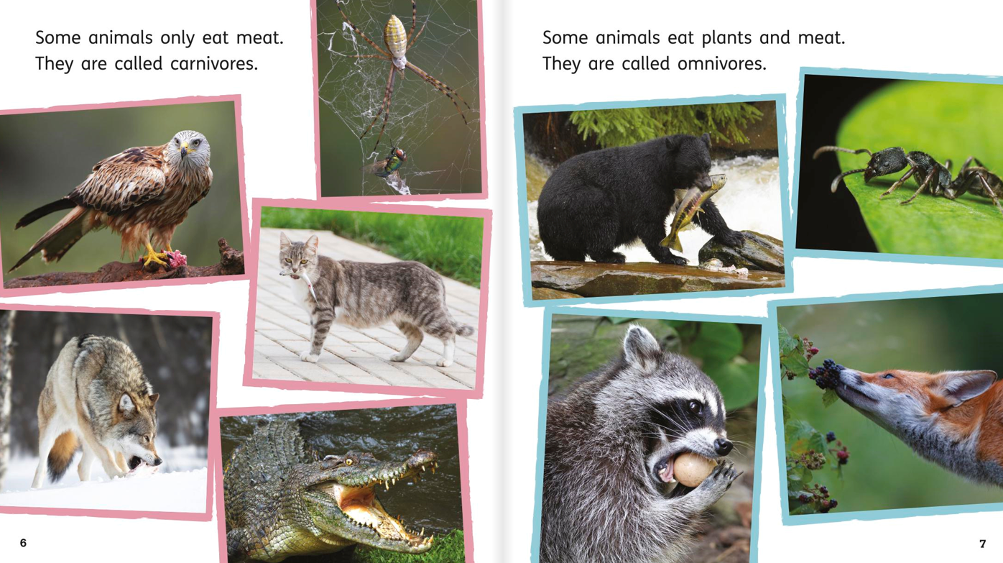

Slide 10
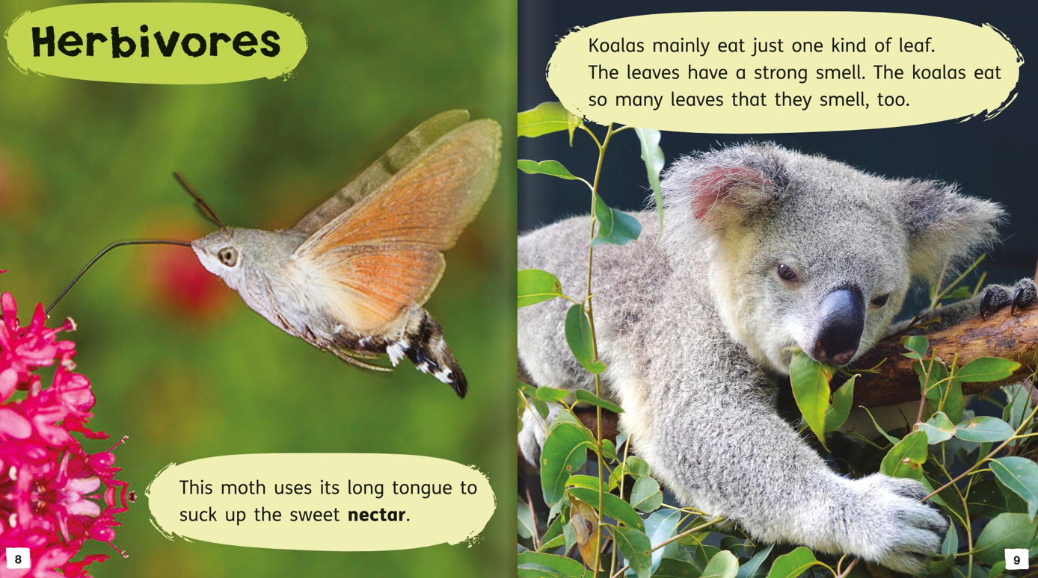

Slide 11
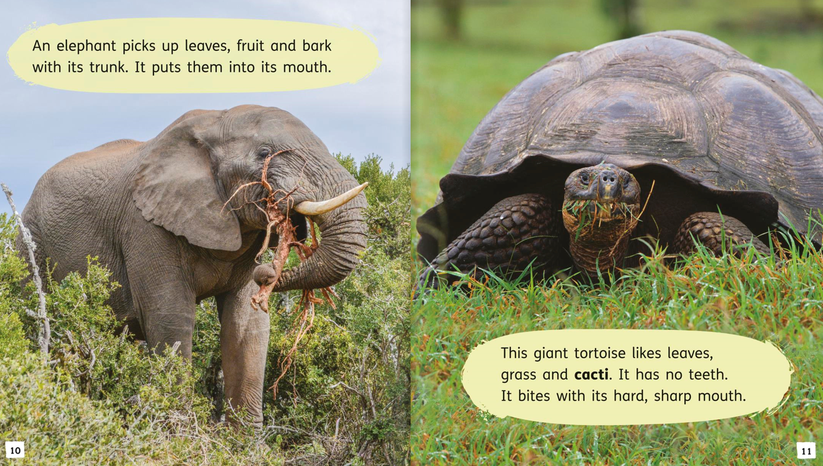

Slide 12
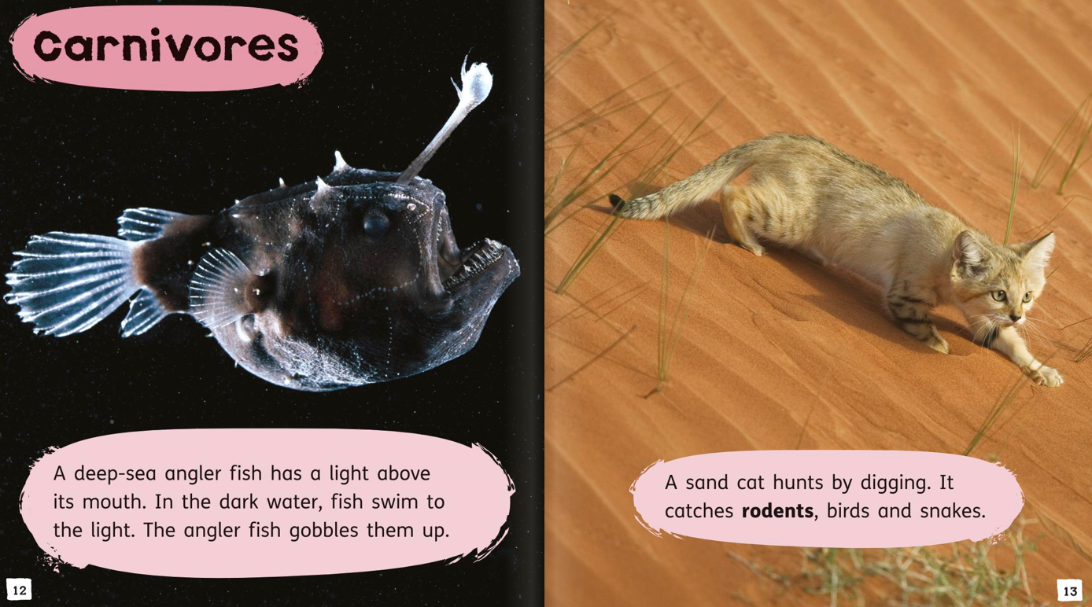

Slide 13
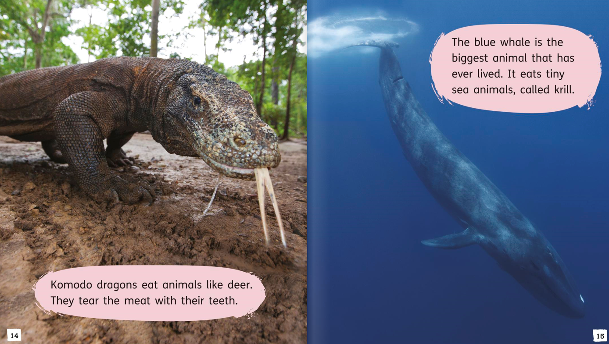

Slide 14
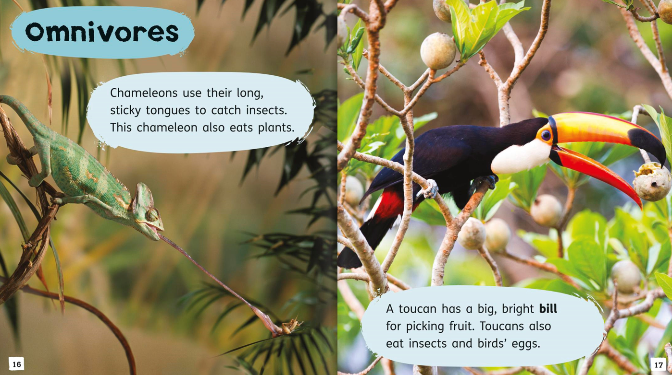

Slide 15
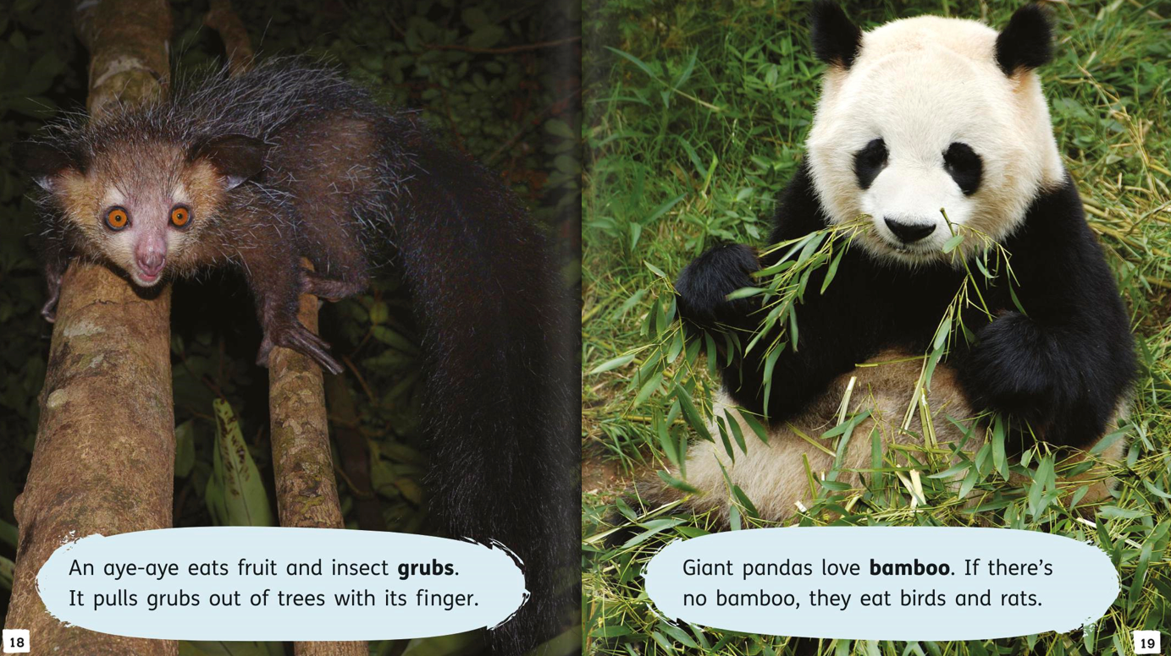

Slide 16
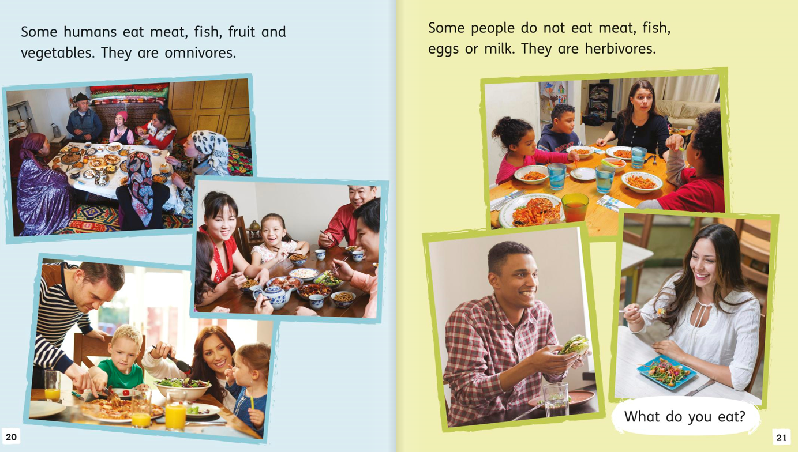

Slide 17
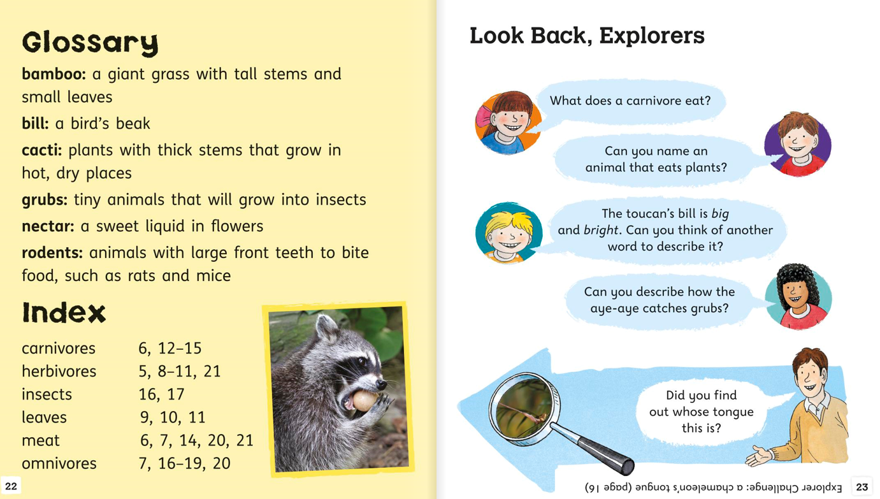

Slide 18
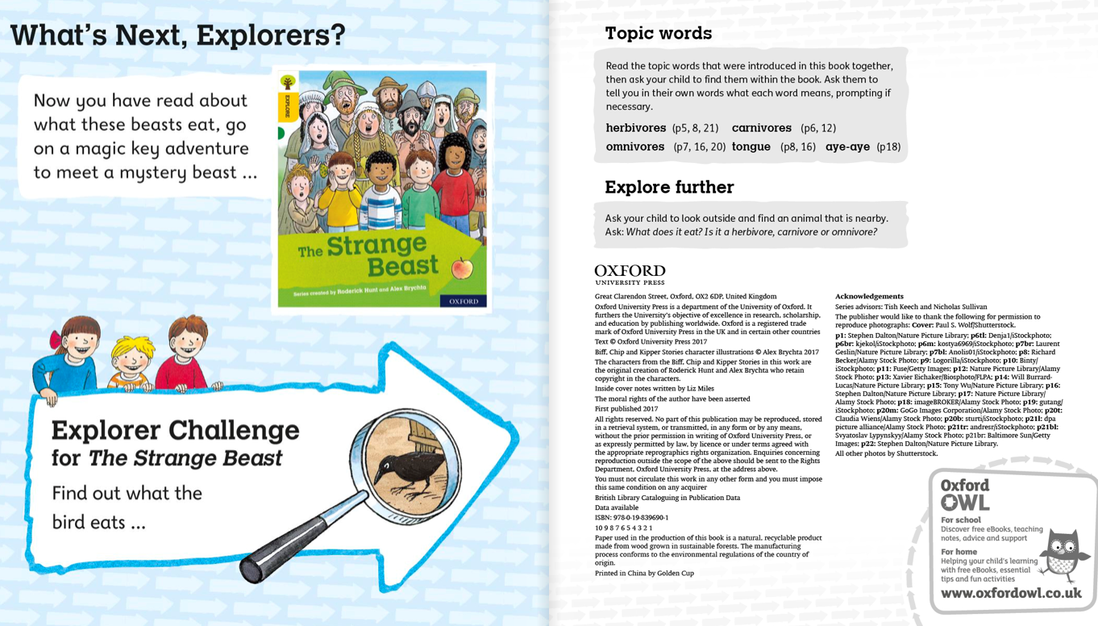

Slide 19
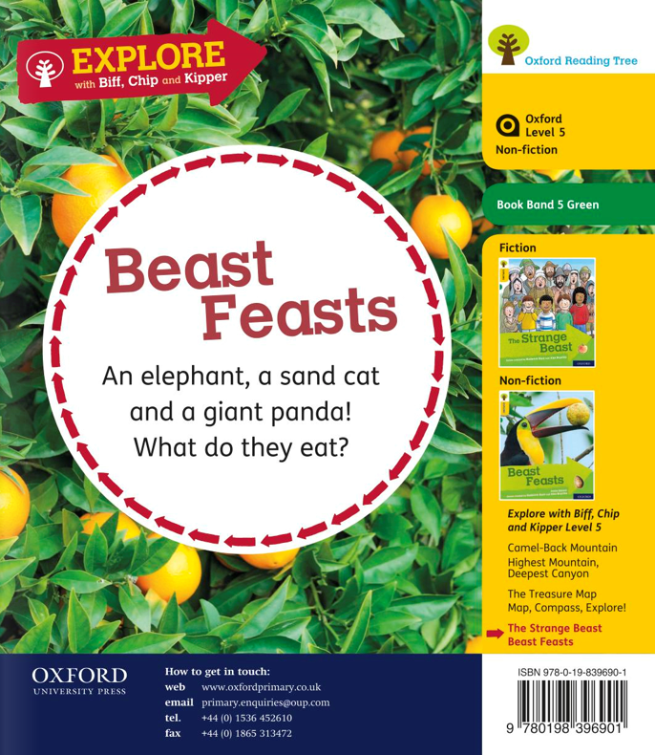

Slide 20
Challenging activities to follow a text.
Research your favourite topic online.
Create you own non fiction book.
Create a glossary with topic words.
Create a story map to show what happened in the story.
Create a character fact file.
Draw the characters in the story.
Re-write the speech bubbles.
Re-write the ending of the story.
Create your own story.
Practise writing cursively.

