Slide 1
Topic: Science based
Growing and living things
You will learn how things grow and learn about a traditional tale ‘Jack and the Beanstalk. We will learn to re-tell stories and write a traditional tale.

Slide 2
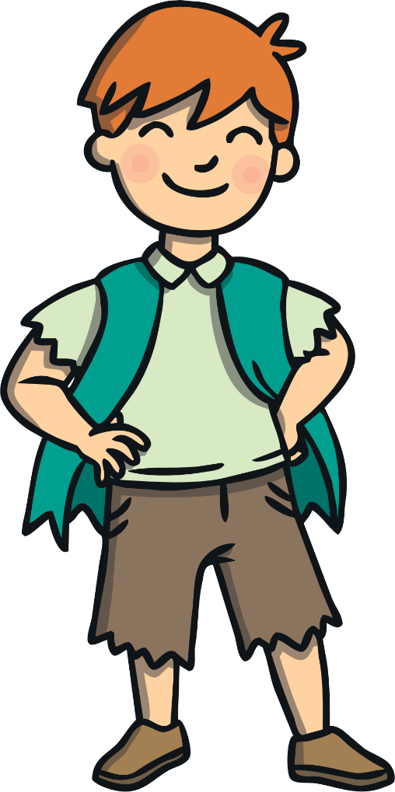
Once upon a time there was a boy called Jack.

Slide 3
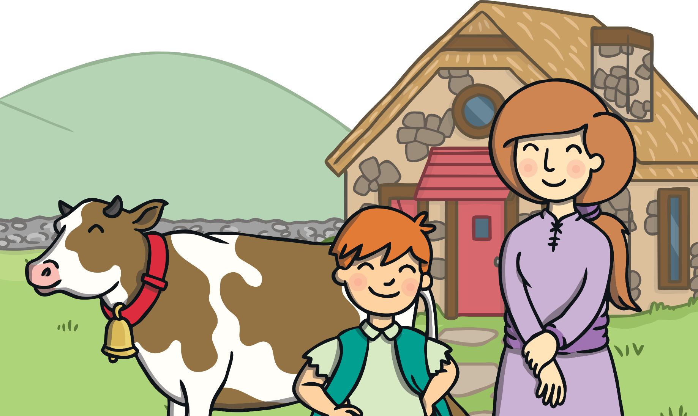
Jack lived in a cottage with his mother.
They were very poor and their most valuable possession was a cow.

Slide 4
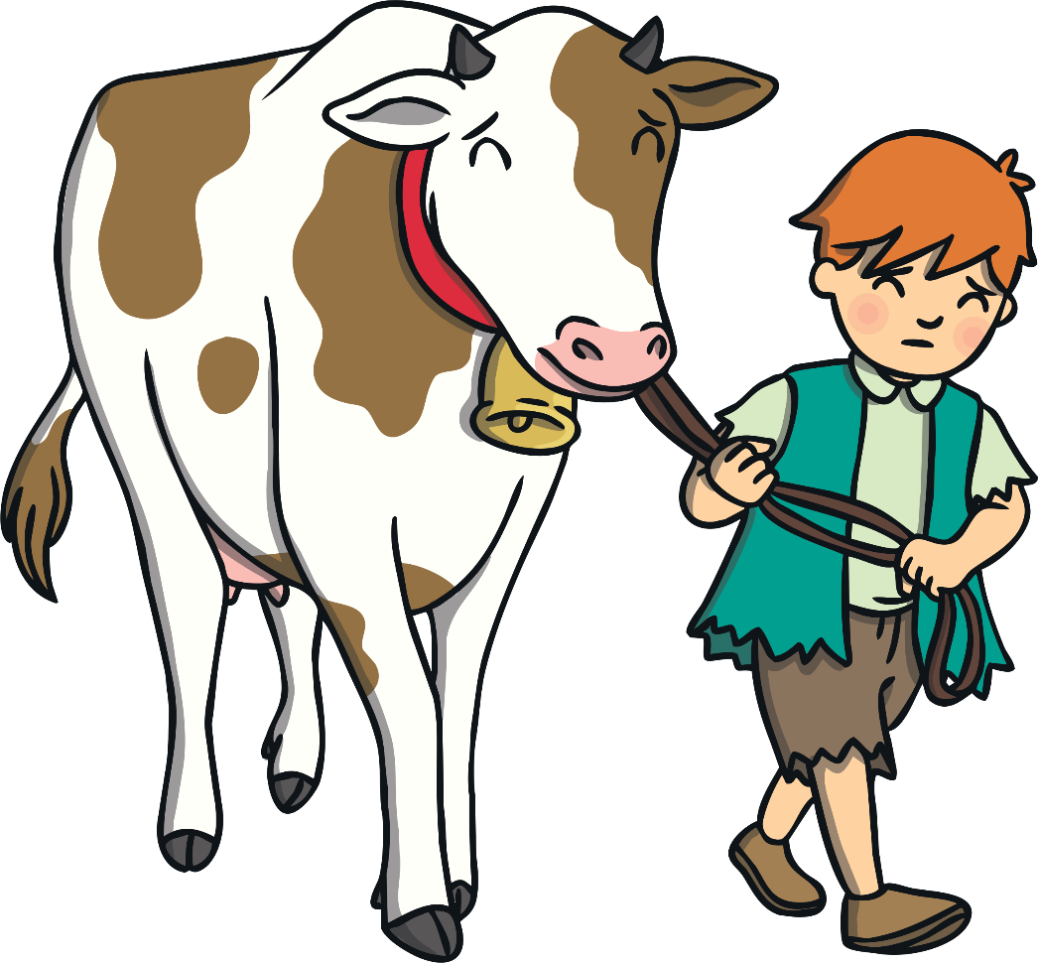
One day, Jack’s mother asked him to take the cow to market to sell.

Slide 5
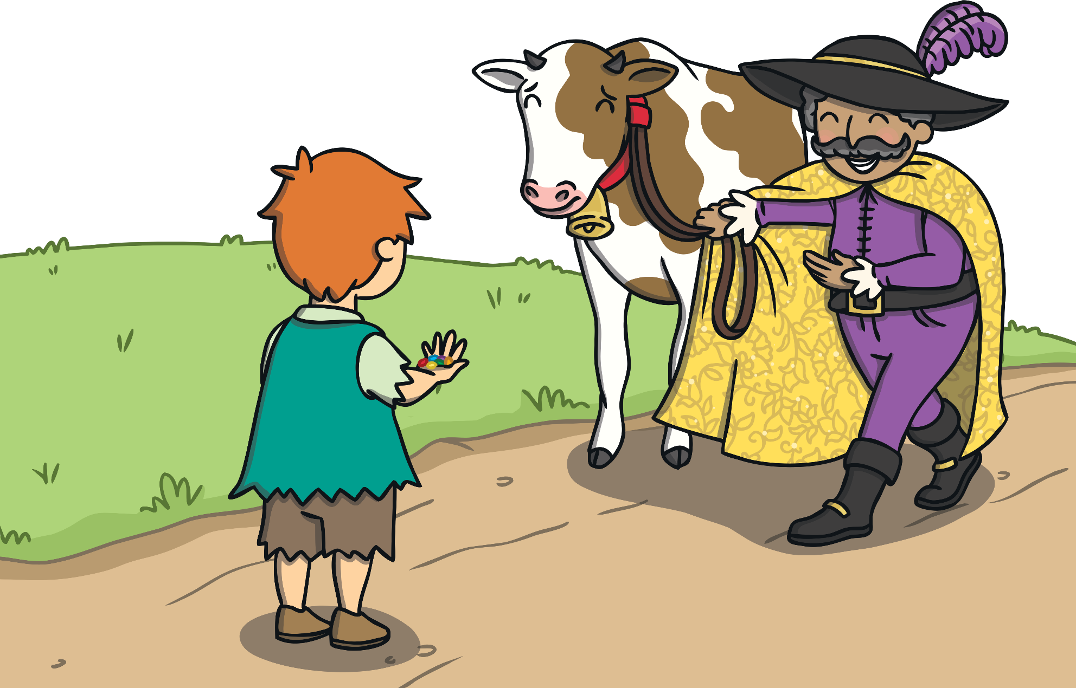
After that, Jack met a man who gave him some magic beans
in exchange for the cow.

Slide 6
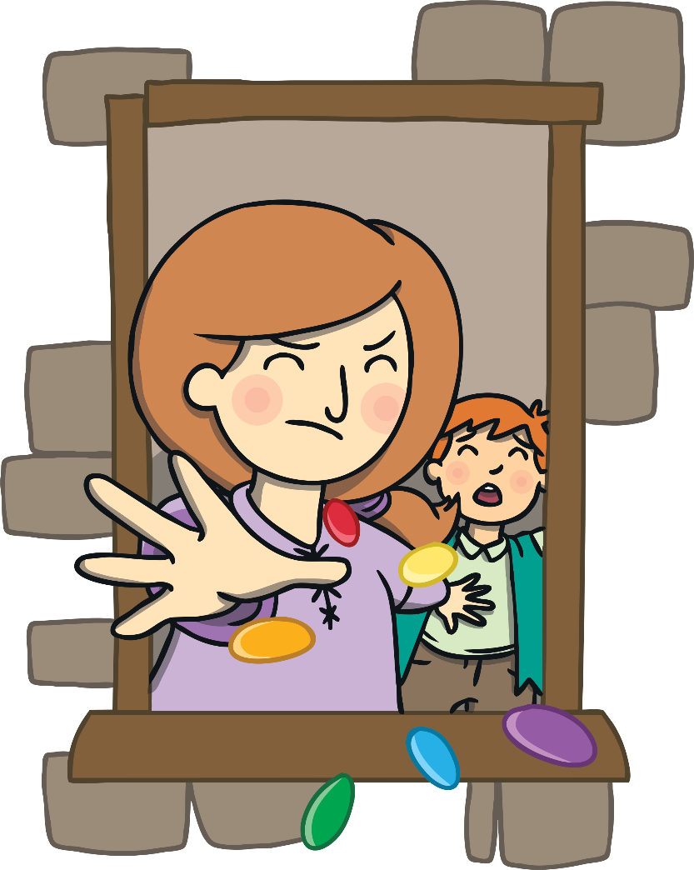
When Jack came home with the beans his mother was furious!
She threw the beans out of the window and sent him to bed.

Slide 7
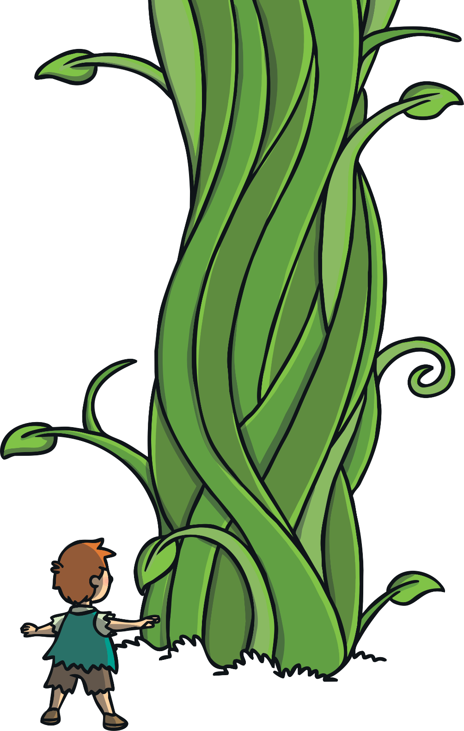
The next morning, Jack looked out of the window.
A giant beanstalk had grown in the garden!

Slide 8
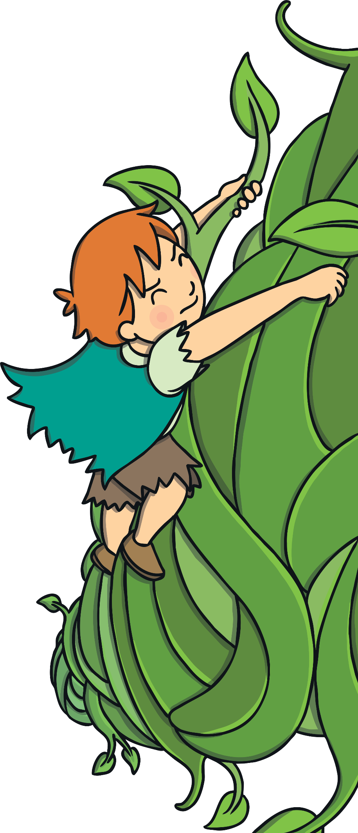
Jack decided to climb the beanstalk. It was so tall it went right up to the sky and through the clouds.

Slide 9
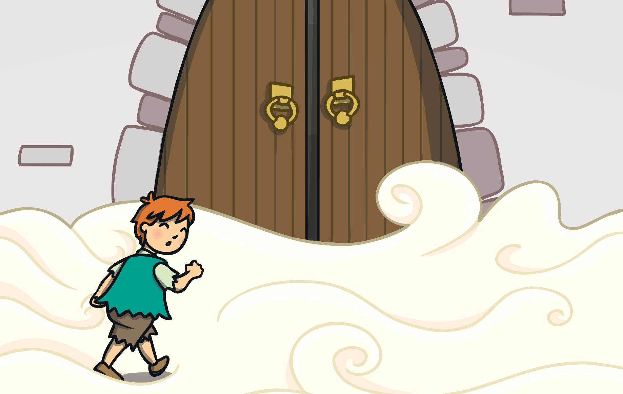
When Jack finally reached the top, he saw an enormous castle.

Slide 10
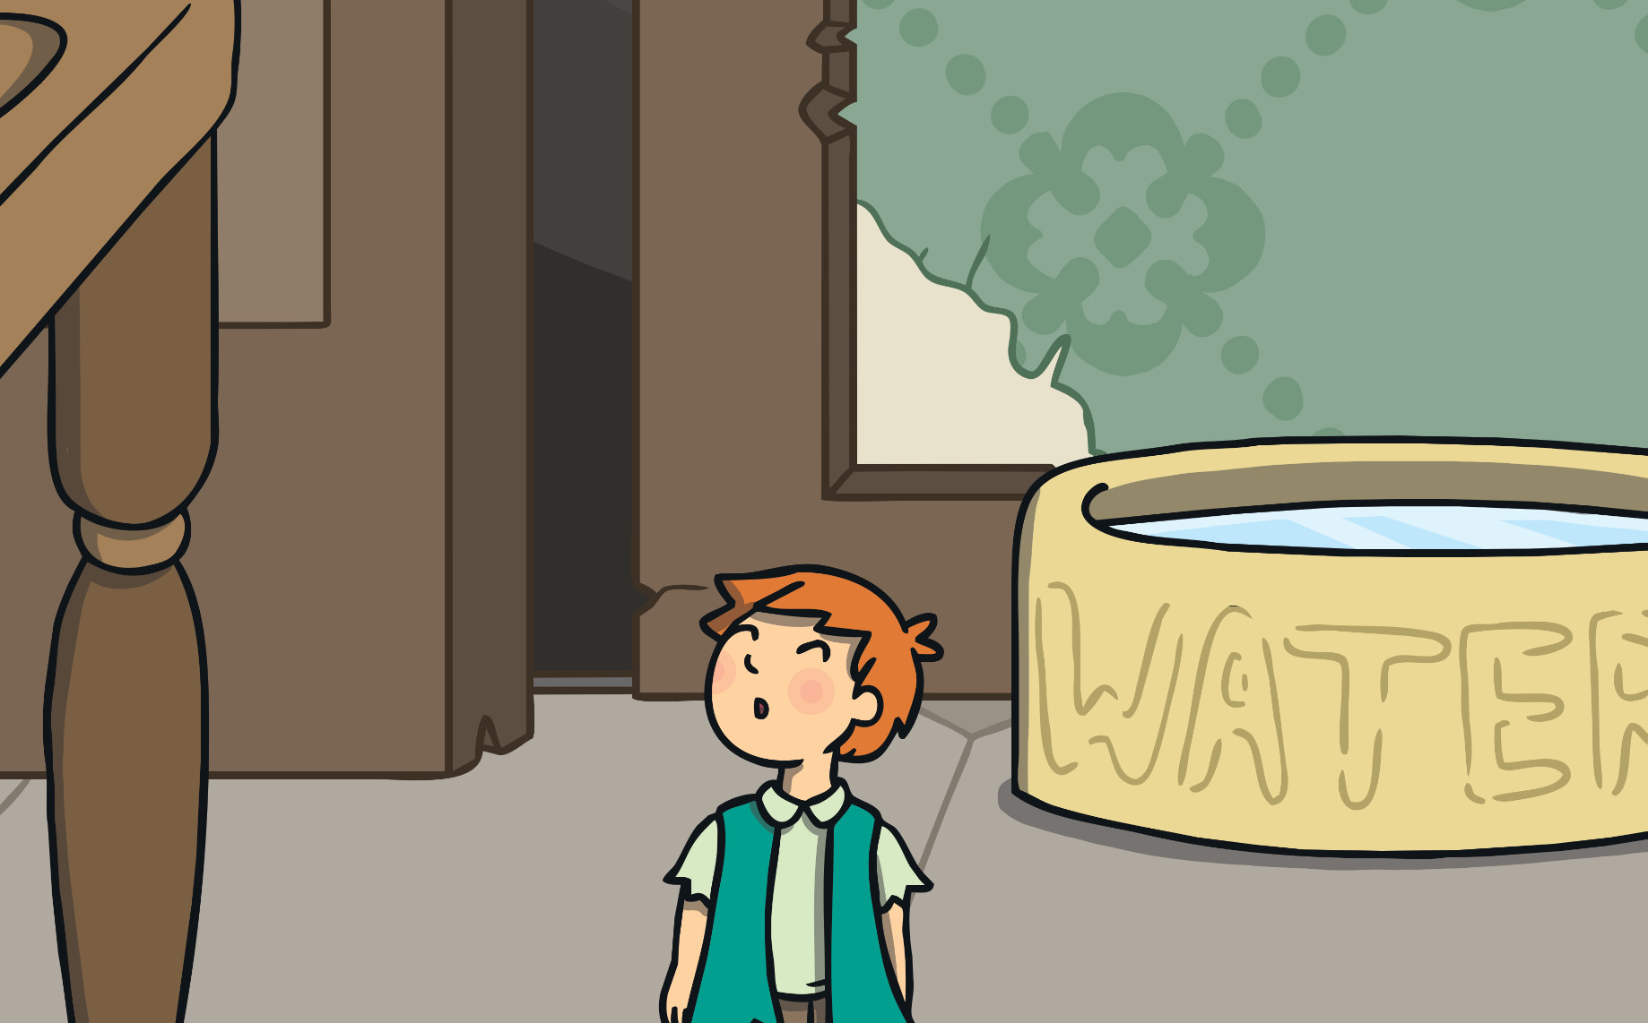
Jack decided to go inside; all the furniture was huge!

Slide 11
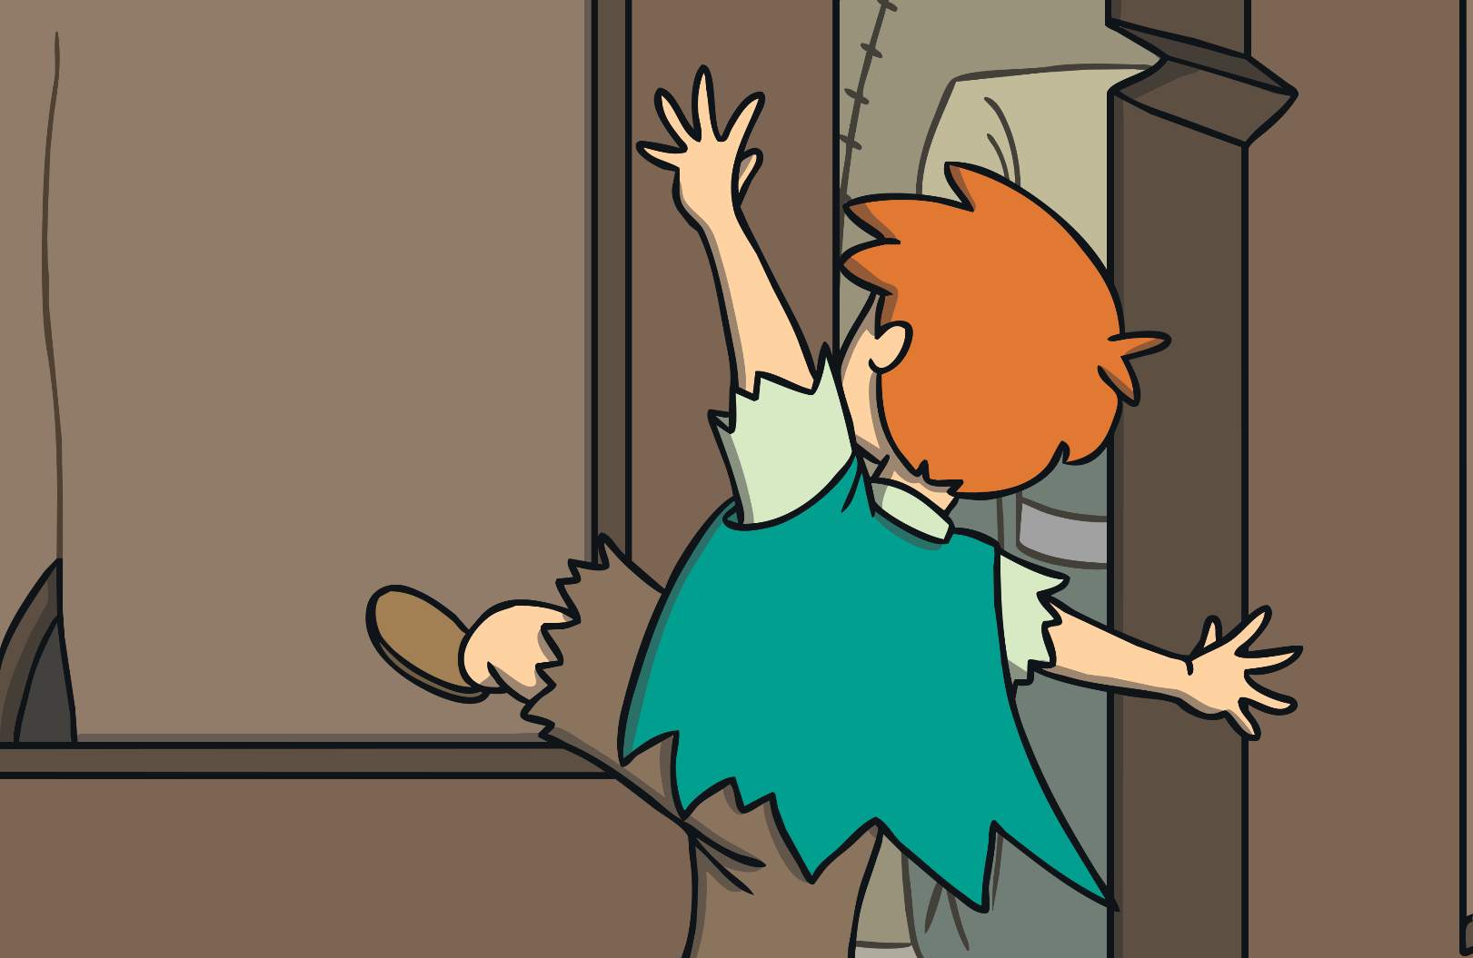
Suddenly, Jack heard a loud noise.
He ran into a cupboard to hide.

Slide 12
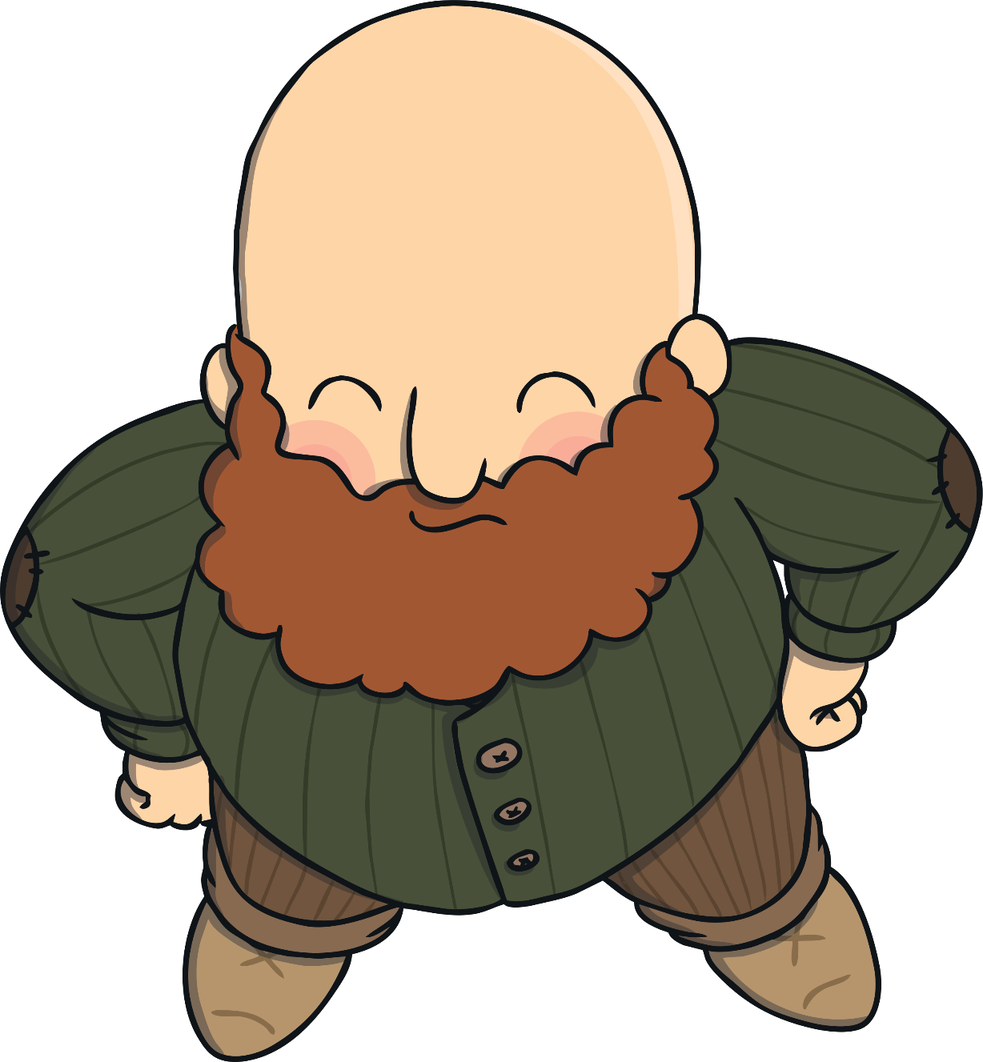
An enormous giant came into the room.
“Fee, Fi, Fo, Fum, I smell the blood of an Englishman!” he bellowed.

Slide 13
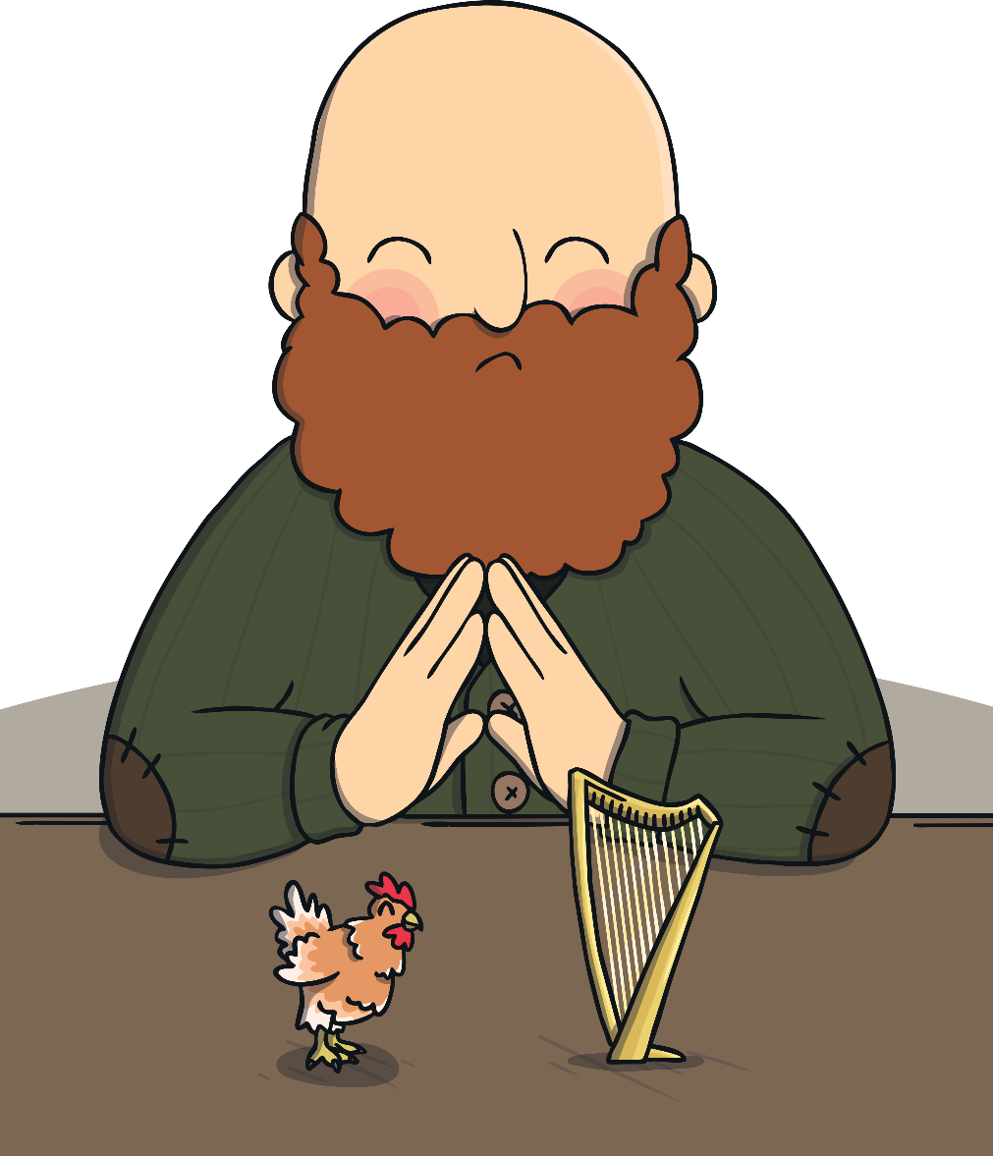
The giant sat down at the table.
On the table was a hen and a golden harp.

Slide 14
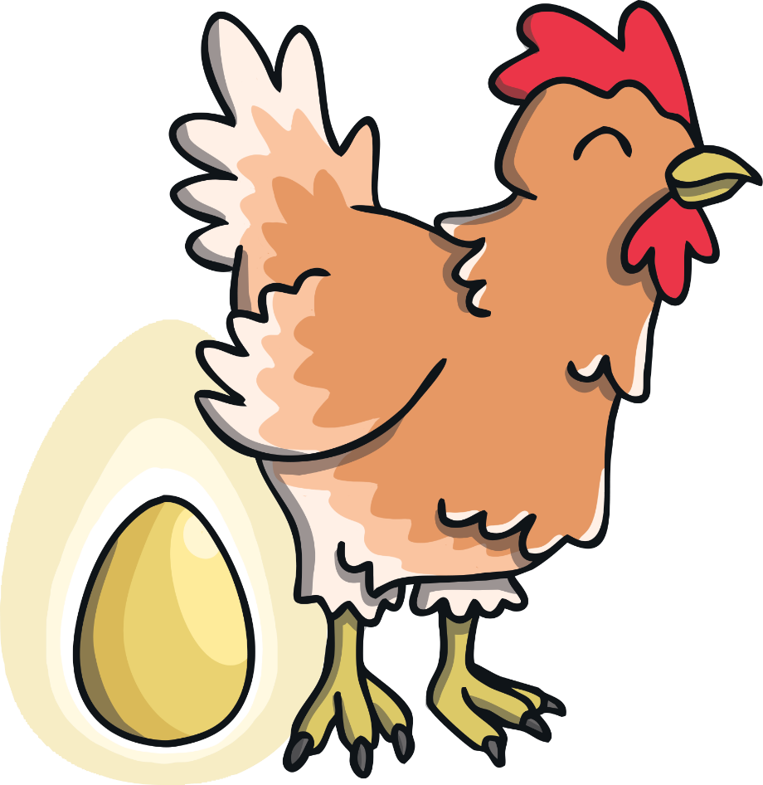
“Lay!” said the giant.
The hen laid an egg; it was made out of solid gold.

Slide 15
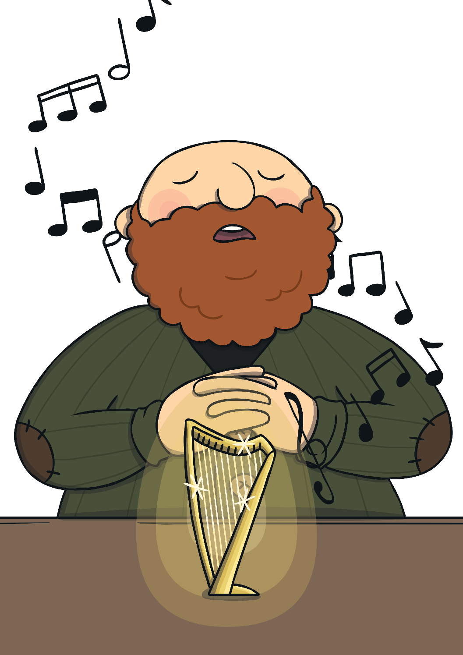
“Sing!” said the giant.
The harp sang; the giant fell asleep.

Slide 16
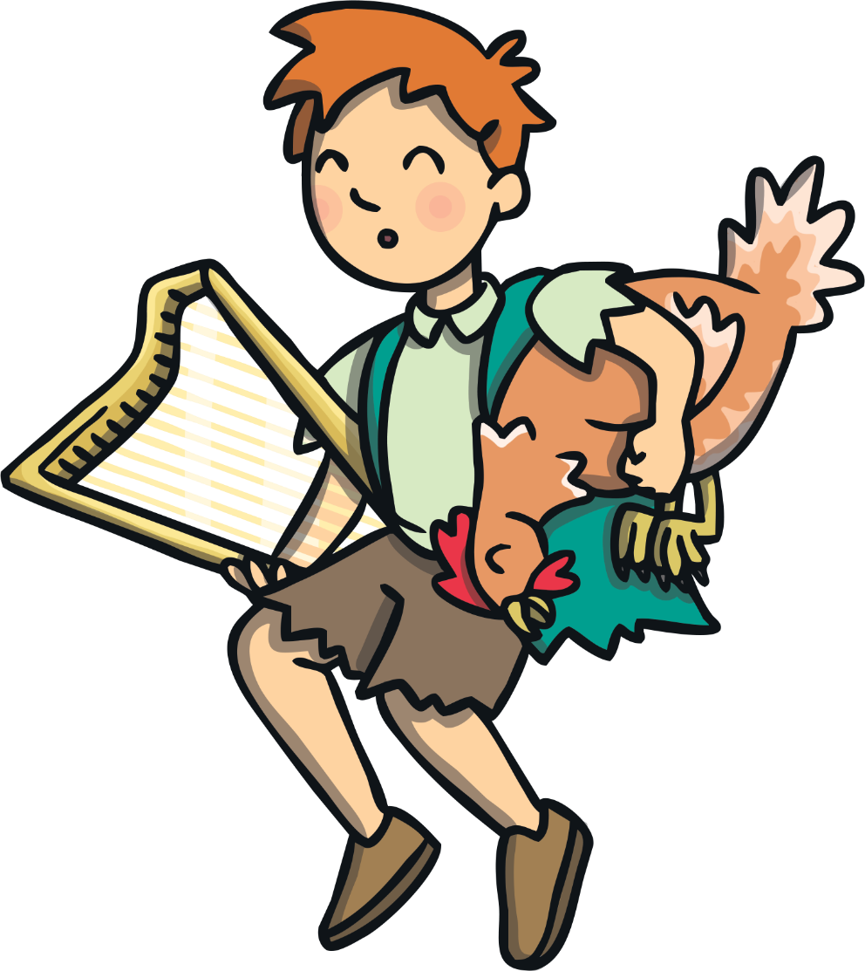
Jack jumped out of the cupboard and took the hen and the harp.

Slide 17
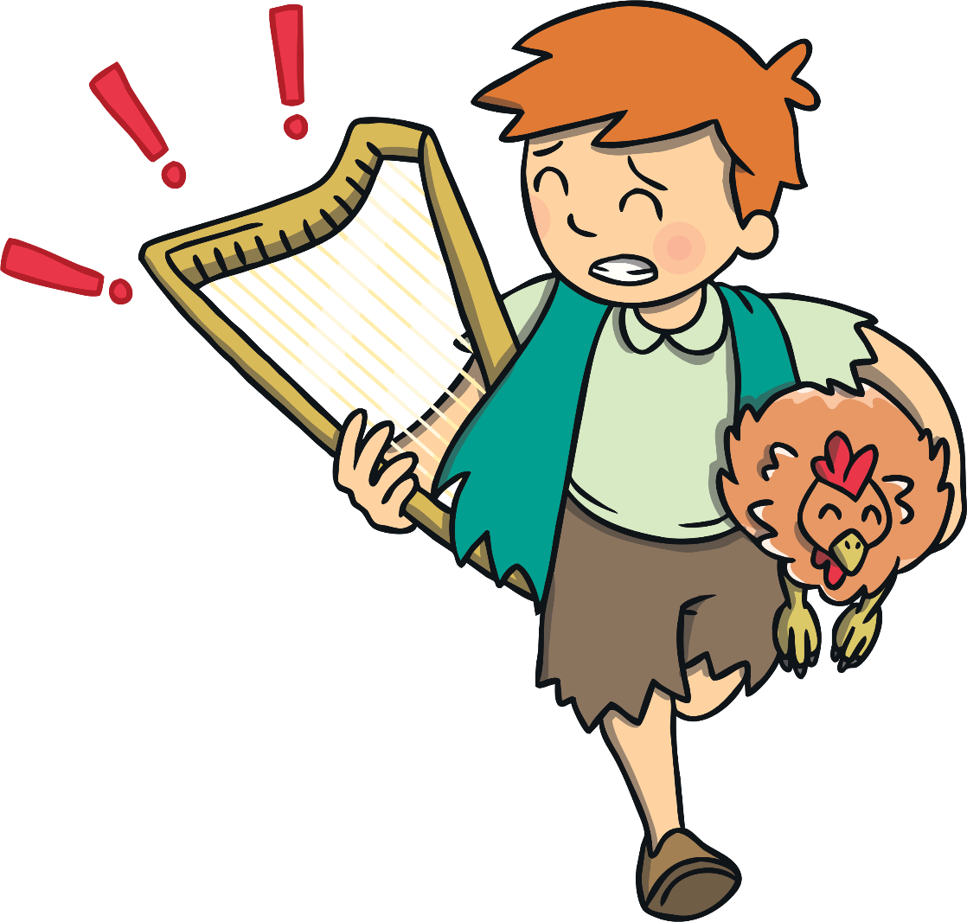
As Jack ran the harp cried, “Help, master!”

Slide 18
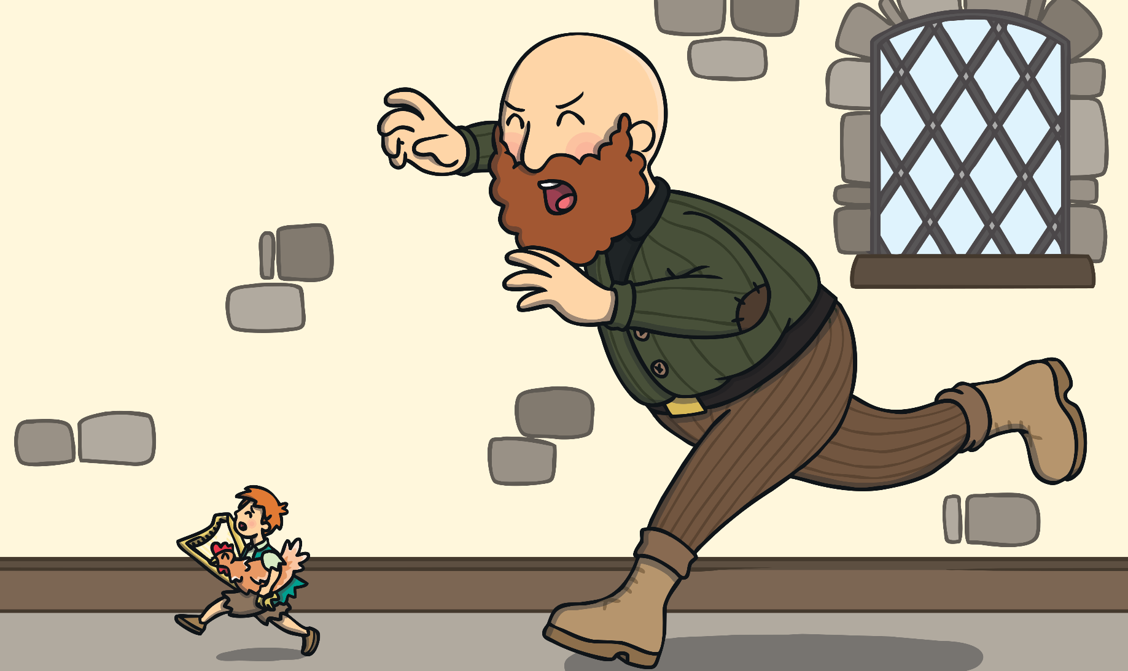
The giant woke up and called, “Fee, Fi, Fo, Fum, I smell the blood of an Englishman!” He chased Jack to the top of the beanstalk.

Slide 19
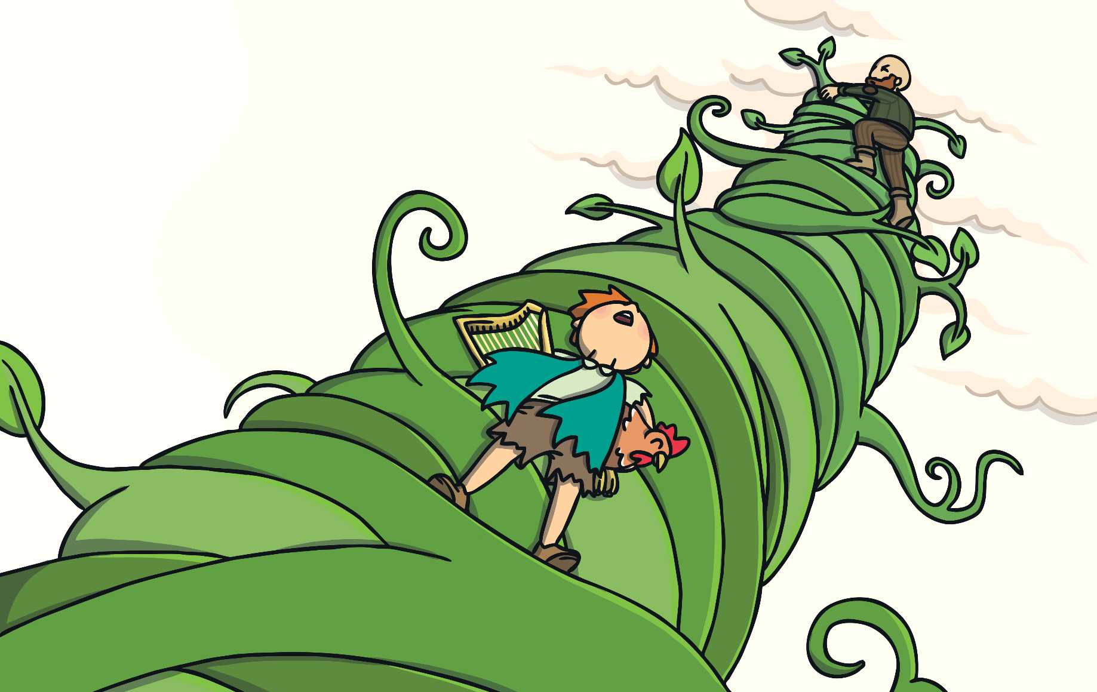
Jack climbed down the beanstalk and the giant followed him.

Slide 20
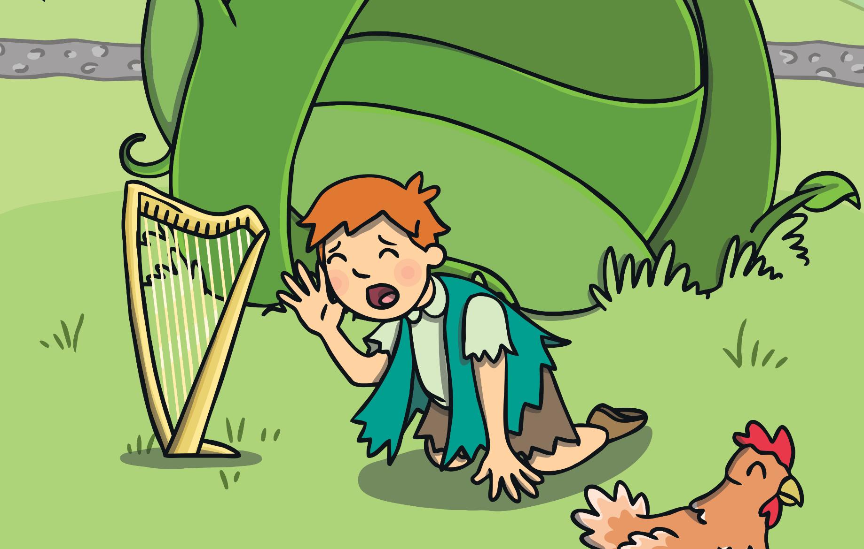
As Jack got to the bottom of the beanstalk he shouted, “Help!”

Slide 21
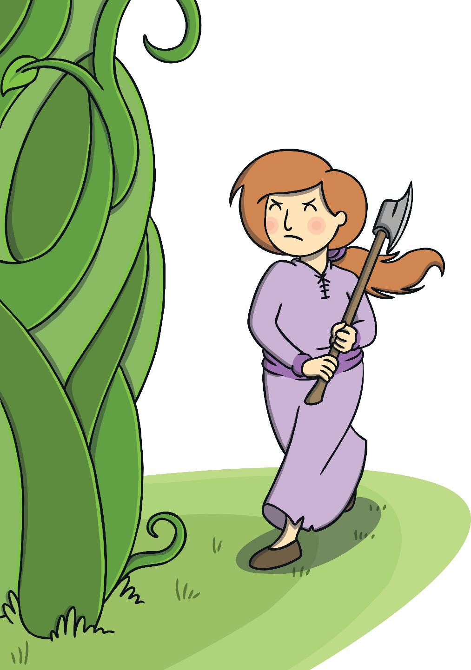
Jack’s mother came out with an axe.
She used it to chop the bottom of the beanstalk.

Slide 22
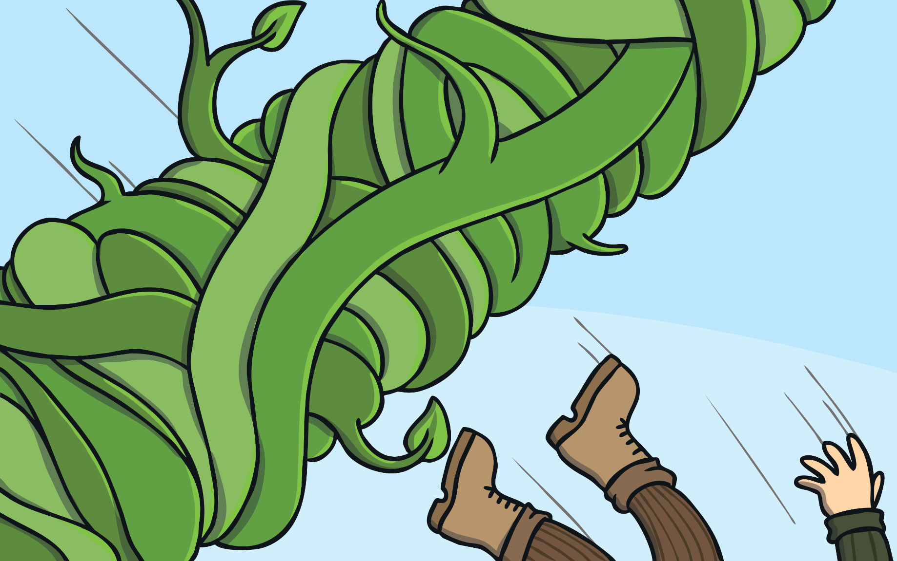
The giant fell and crashed to the ground.
He was never seen again.

Slide 23
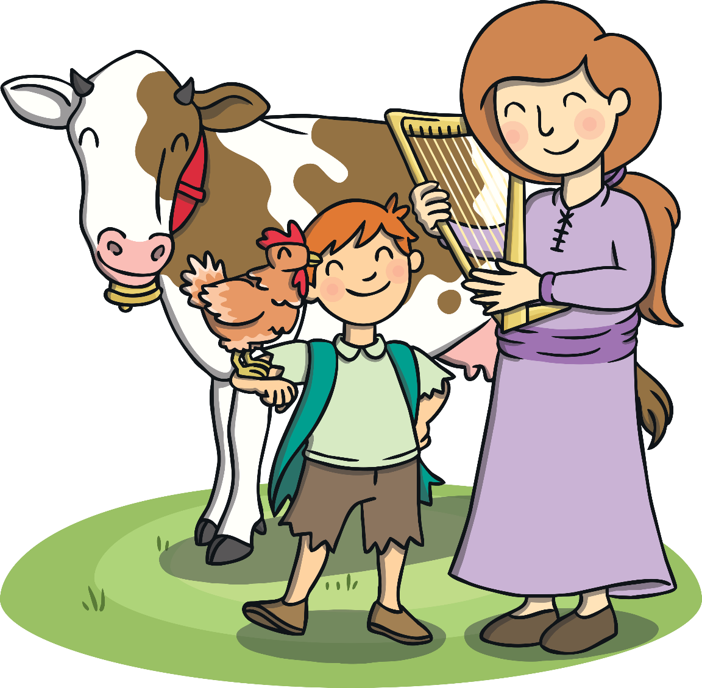
With the golden eggs and the magic harp,
Jack and his mother lived happily ever after.

Slide 24
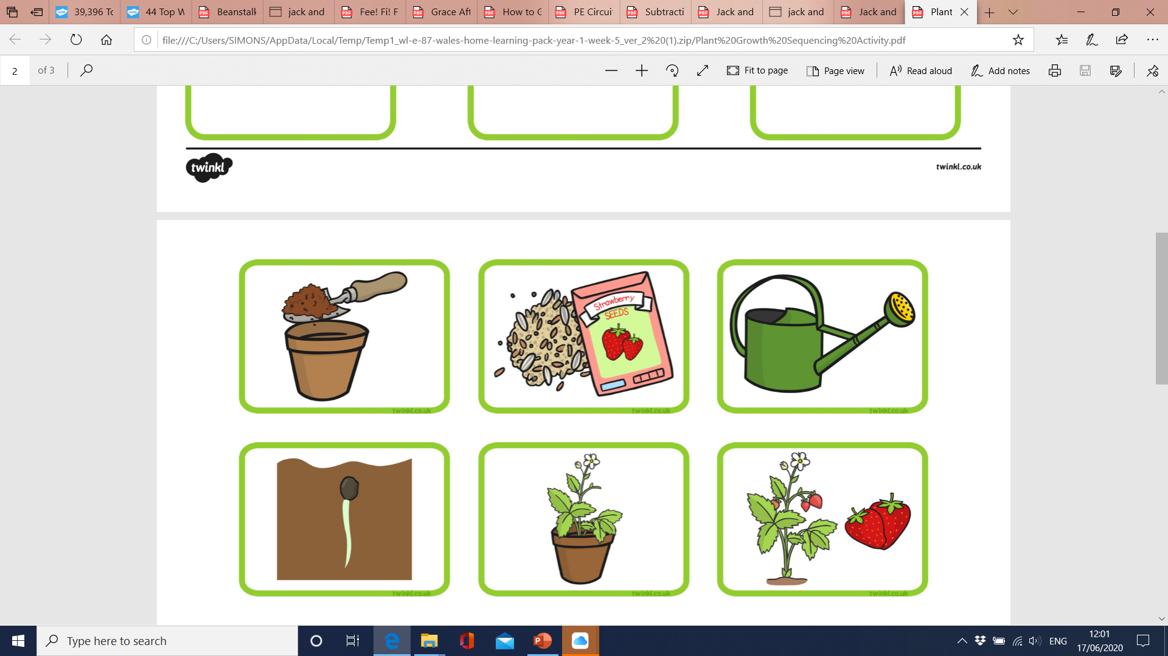
Science
WALT: know how things grow.
Learn about plants and how they grow. Plant seeds, flowers or fruit in the garden. Watch the plant grow.
Can you say what plants need?
Can you create a flowchart to show what happens to a plant?
Can you record the growth and measure the height of your plant each week?.

Slide 25

Science
WALT: know if something is living or non-living.
How do we know if something is living?
Can you sort things from the story into these categories: living non-living? Create a table to help you sort them.
Mum Jack chicken cow harp
house Giant egg house
Living | Non-living

Slide 26
Science
WALT: search for living things in my home.
Can you go on a hunt for living things in your home? How do we know that they are living?
Can you find any minibeast in you garden?
Can you record how many different minibeast you can find using a tally chart? Can you record using Hwb2data?
 | Number of minibeast
Spiders
Woodlouse
Flies
Butterflies

Slide 27
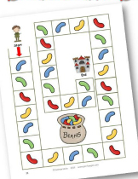
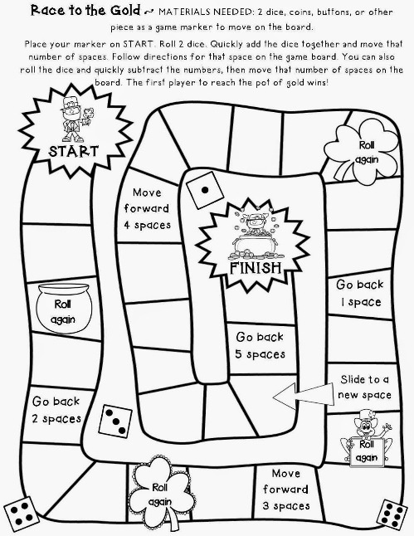
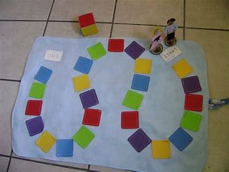
Numeracy
WALT: Design a board game for Jack to play with his mum.
Can you write a set of instructions to play the game?
Can you explain how to play the game?
Can you play the game?

Slide 28
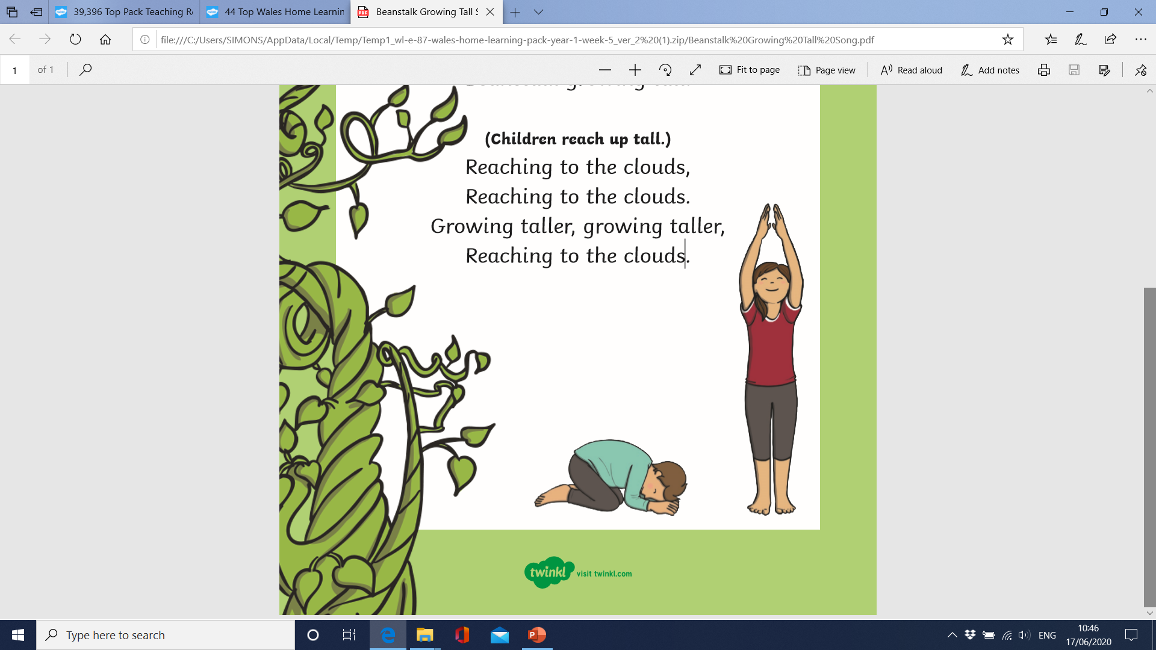
Expressive Arts
WALT: Memorise a song and perform a dance to the song.
Beanstalk Growing Tall
(Say as a spoken rhyme or sing to your own tune.)
(Children start curled up in a ball and start growing.)
Beanstalk growing tall, Beanstalk growing tall. Swishy, swashy, swishy, swashy, Beanstalk growing tall.
(Children reach up tall.)
Reaching to the clouds, Reaching to the clouds. Growing taller, growing taller, Reaching to the clouds.

Slide 29
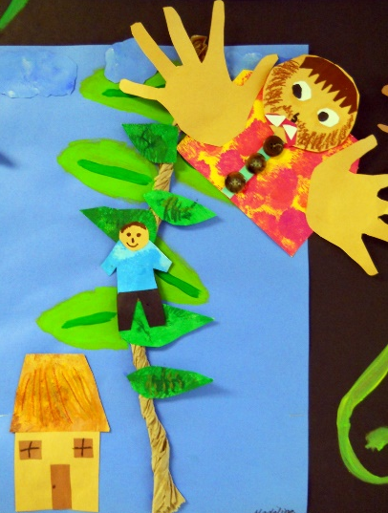
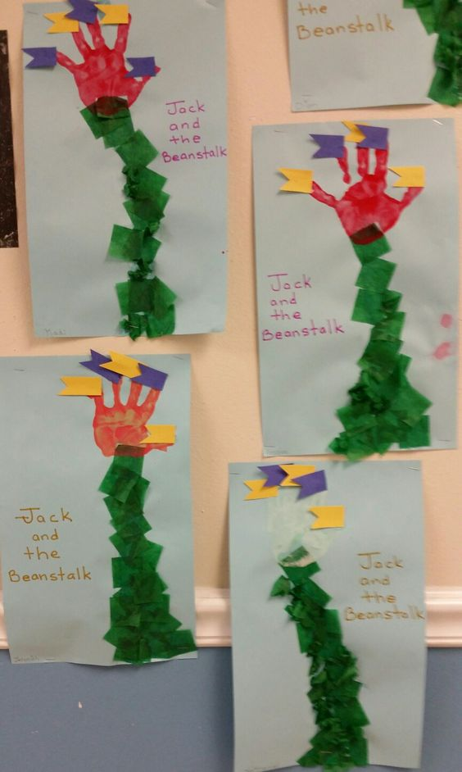
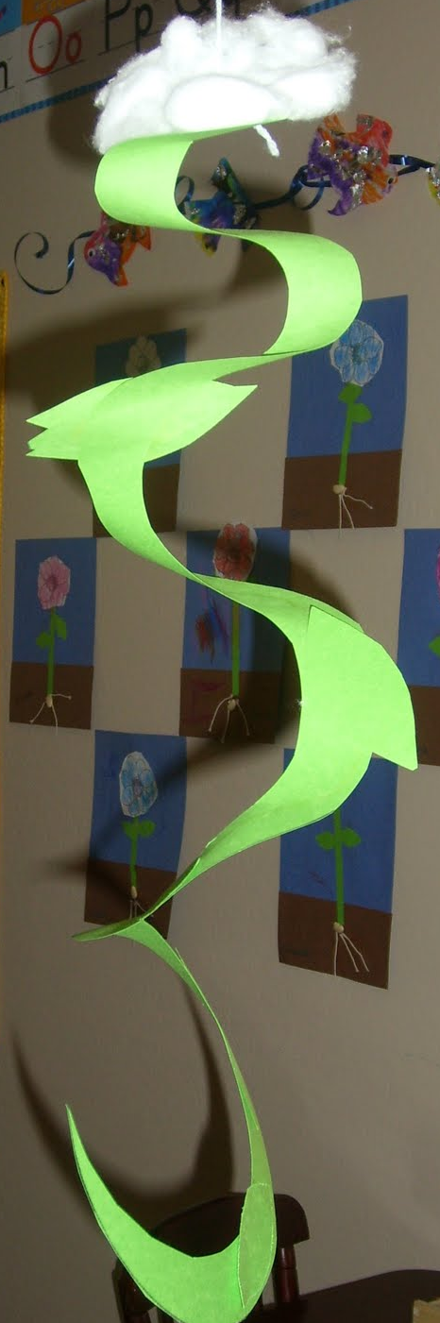
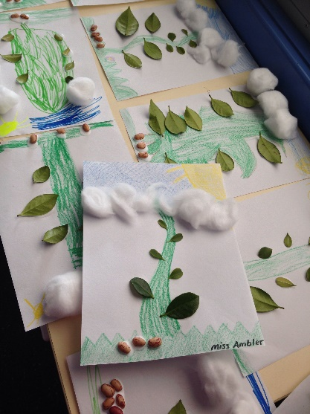
Expressive Arts
WALT: experiment with materials
Create a piece of artwork to represent the story of ‘Jack and the beanstalk’.

Slide 30
RE
WALT: Write a prayer to show that we are thankful for the world that we live in.
Can you choose words that rhyme?
Thank you, God, for the plants and trees,
Thank you, God, for all the birds and bees,
Thank you, God, for everything,
Thank you, God for things you bring.
Amen.
.

Slide 31
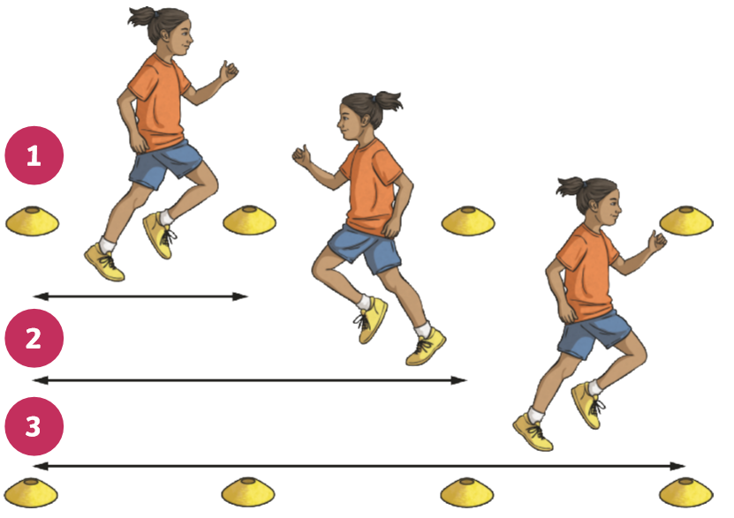
Health
WALT: keep fit and healthy.
Raise your heart level and improve your stamina with shuttle runs. Place 4 objects from around the house in a line. Run to each object.
Can you time yourself?
Can you record your times in a table?
Can you beat your time?

Slide 32
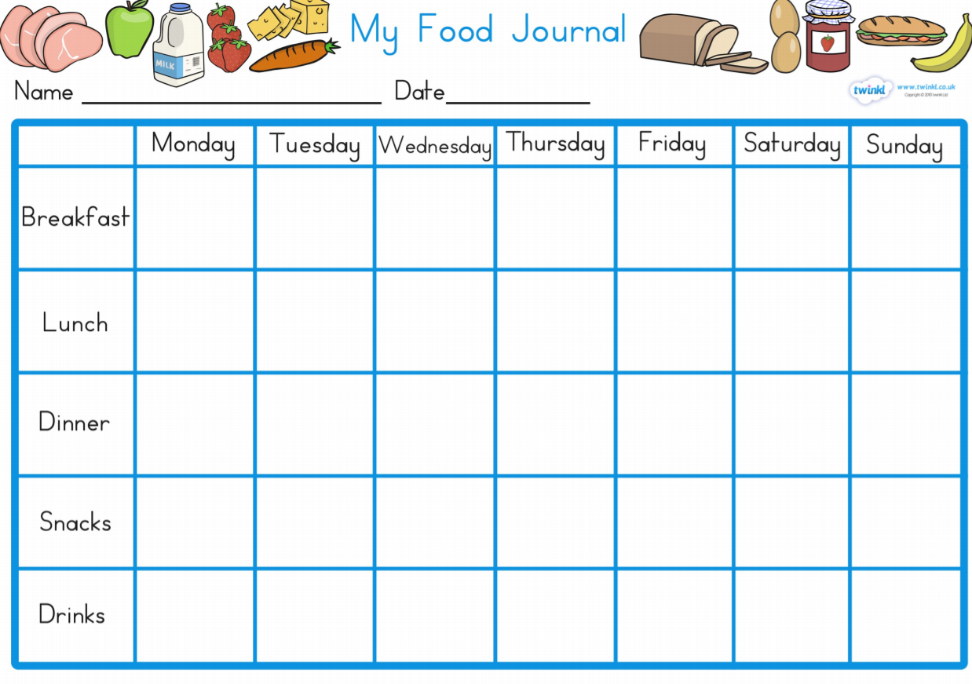
Health
WALT: eat healthily
Can you keep a food journal?

Slide 33
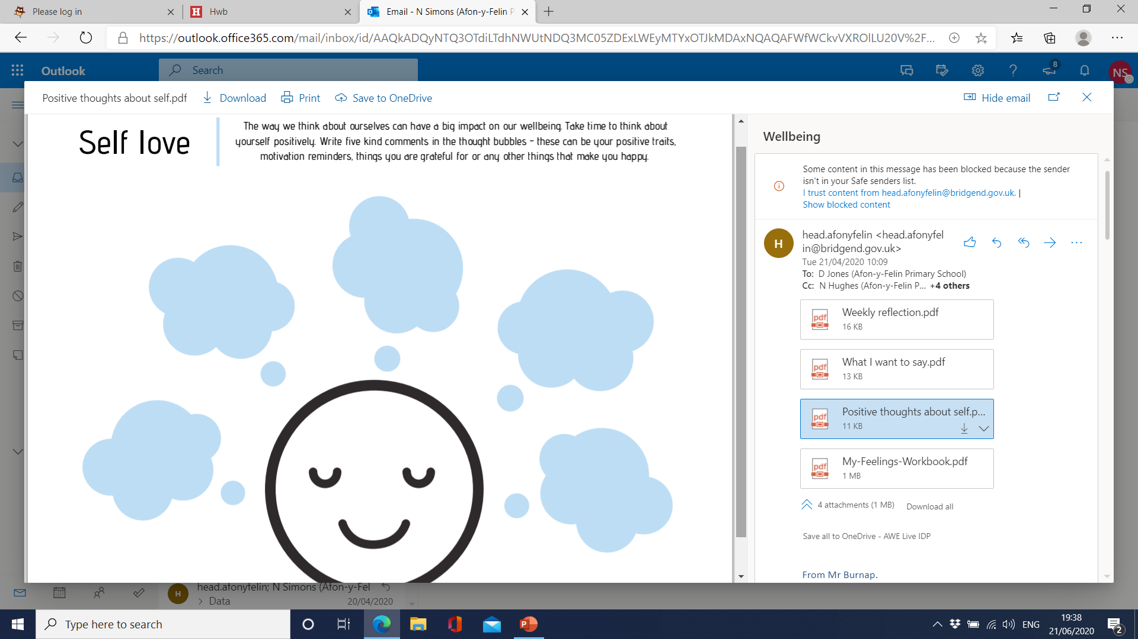
Wellbeing
WALT: be positive about yourself.
Write down five kind comments about your self, things your grateful for or things that make you happy.k about ourselves can have a big impact on our wellbeing. Take time to think about yourself positively. Write five kind comments inThe way we think about ourselves can have a big impact on our wellbeing. Take time to think about yourself positively. Write five kind comments in the thought bubbles - these can be your positive traits, motivation reminders, things you are grateful for or any other things that the thought bubbles - these can be your positive traits, motivation reminders, things you are grateful for or any other things that make you happy.

Slide 34
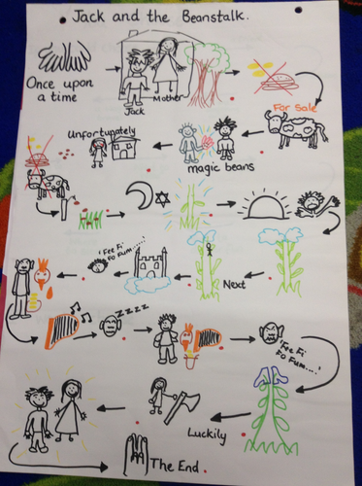
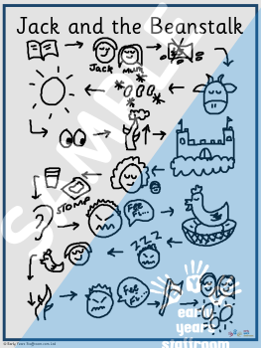
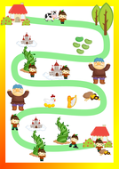
Language and Communication
WALT: Retell a story
Retell the story of Jack and the bean stalk in the correct order. Create your own story map to help you. You could create a set of puppets or drawing to help you retell the story.
Can you retell the story in the correct order?
Can you use different voices for each character?
Can you include the story language?
Once upon a time,
The next morning,
After that,
One day,
Suddenly,
.

Slide 35
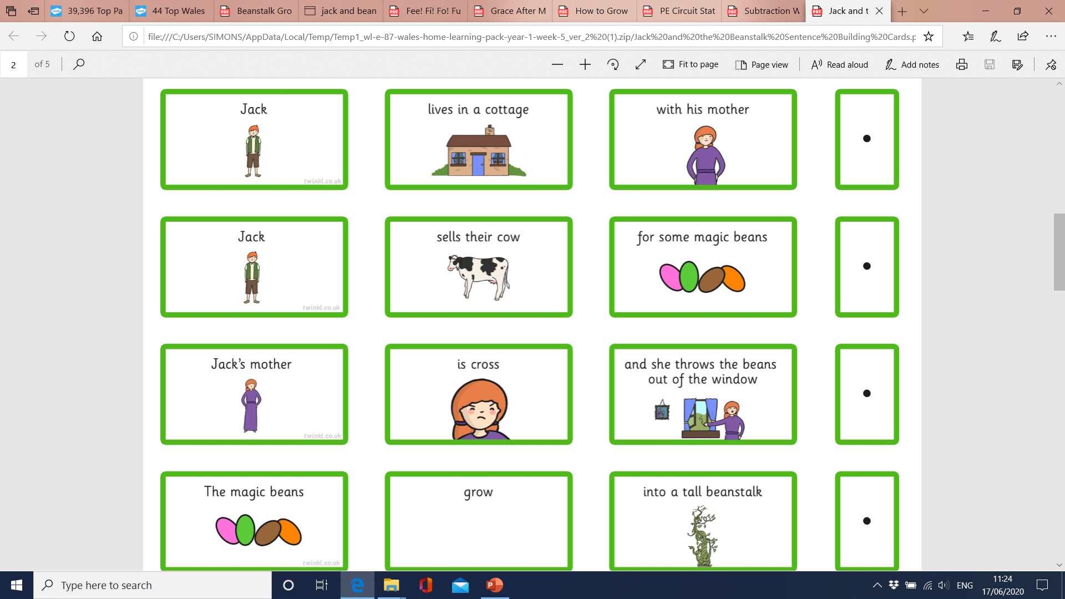
Language and Communication
WALT: build sentences
Make a set of cards using anything you have around the house- paper, card, carboard and posits. Select a card to make you own sentence. Write the sentence correctly.
Can you use a capital letter to start and for names?
Can you use a full stop correctly?
Can you read back your sentence?
.

Slide 36
Language and Communication
WALT: write a traditional tale
Can you write a traditional tale? You could use you story map to write ‘Jack and the beanstalk. You could change the character names or even the setting to make it your own tale!
Can you use a capital letter to start and for names?
Can you use a full stop correctly?
Can you read back your sentences?
.

Slide 37
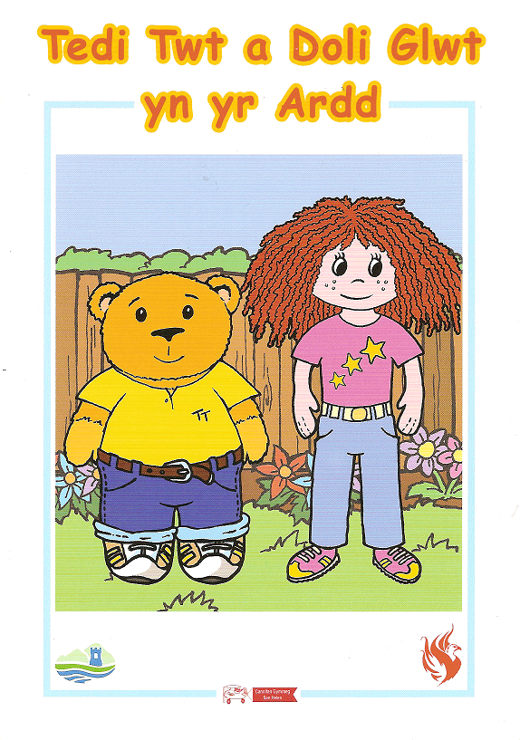
Language and Communication
WALT: read Tedi Twt
(PP separate link)
Can you draw your garden?
Can you label the minibeasts?
Can you create your
own short story about your garden?
.

Slide 38
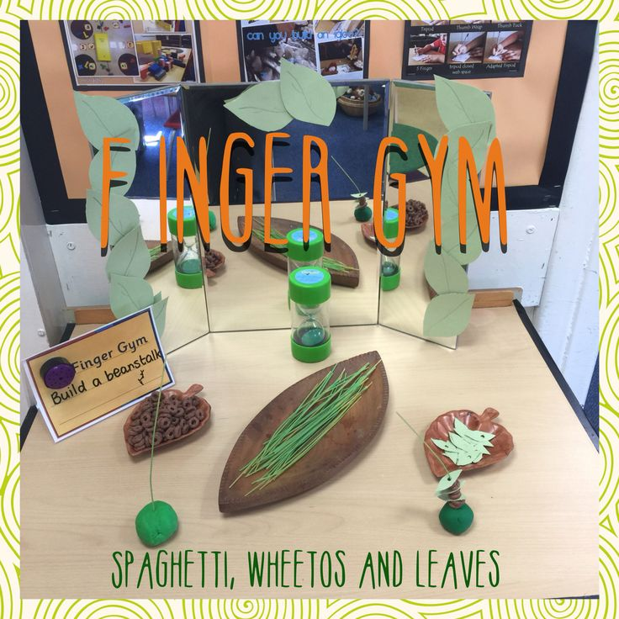
Language and Communication
WALT: strengthen our fingers
Can you thread small hoops
onto the spaghetti?
Can you estimate how you
will thread?
How many can you thread
in 30 Seconds?
.

Slide 39
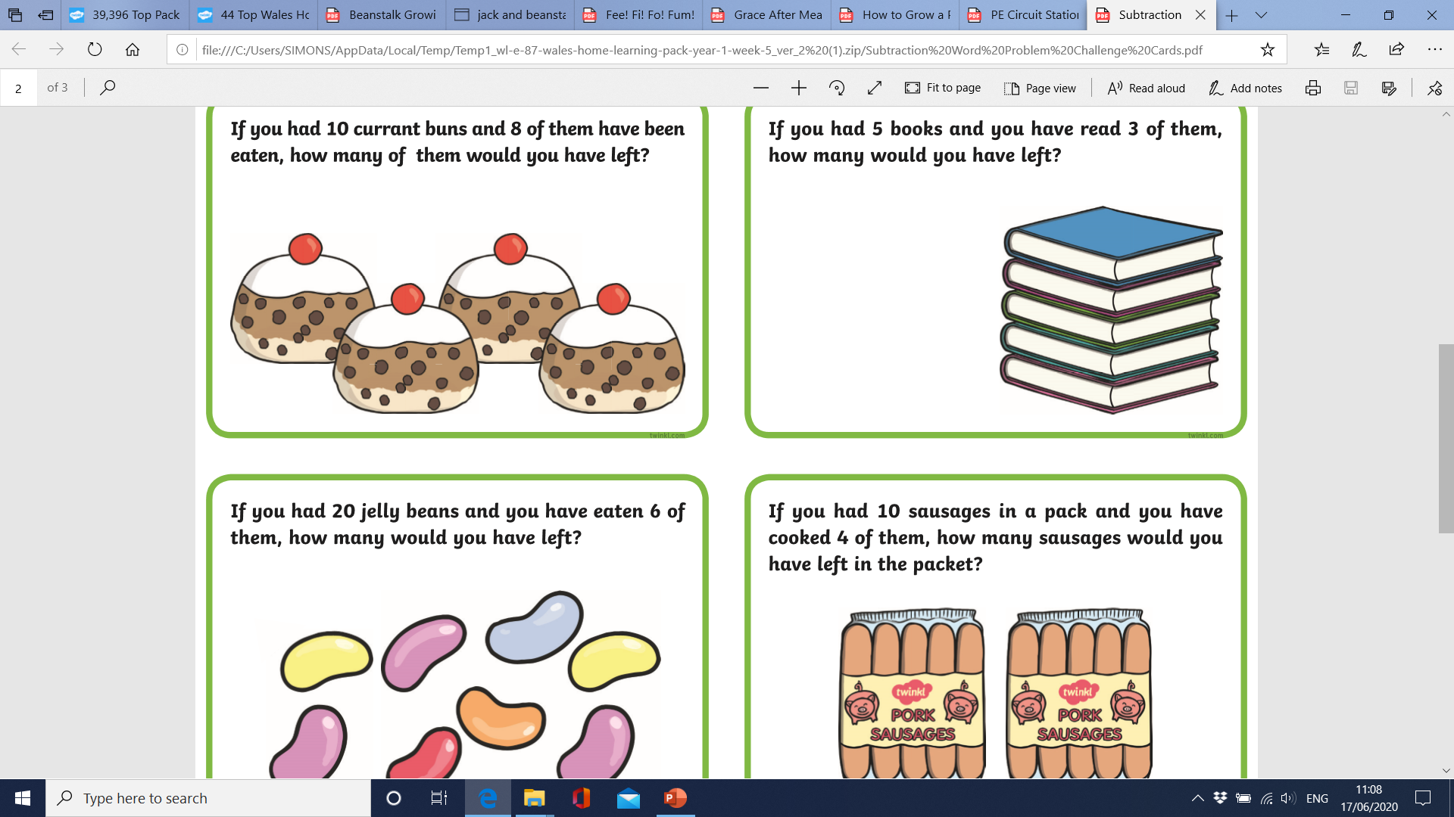
Mathematics
WALT: solve problems.
Can you solve these problems?
You can use items around the house to help you add and subtract.
Can you make your own problems using the Jack and the beanstalk theme?
You can use toys and items around the house to help you.
.

Slide 40
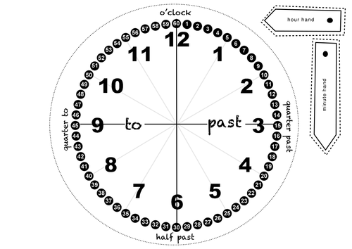
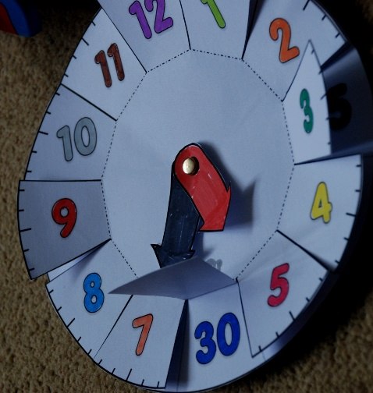
Mathematics
WALT: tell the time.
Can you make a clock for Jack’s house? Make your own clock and practise reading the time.
Watch YouTube songs about telling the time.
.

Slide 41
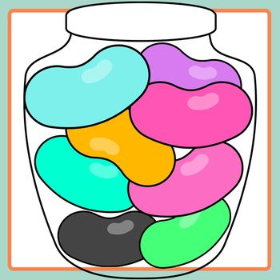
Mathematics
WALT: make sensible estimations and check my answers.
Jack was given these magic beans. I wonder how many he was given? Can you make a sensible estimation then count them to check?
Can you solve the estimation cards?
Can you select a group of object from around the house and practise estimating and counting them?
.

Slide 42
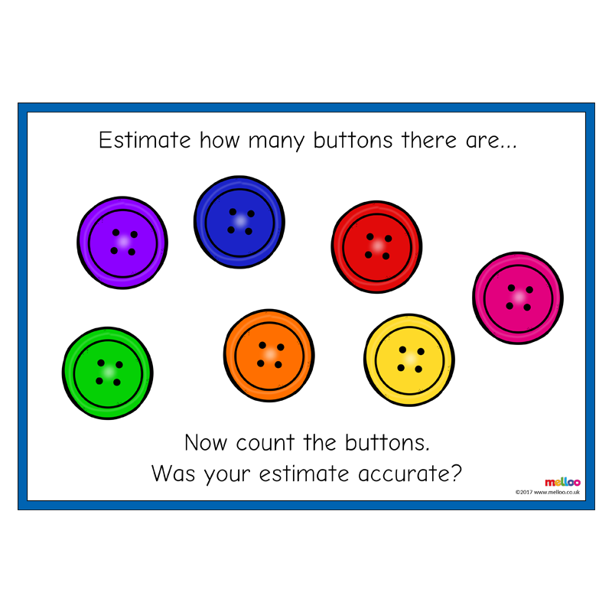

Slide 43
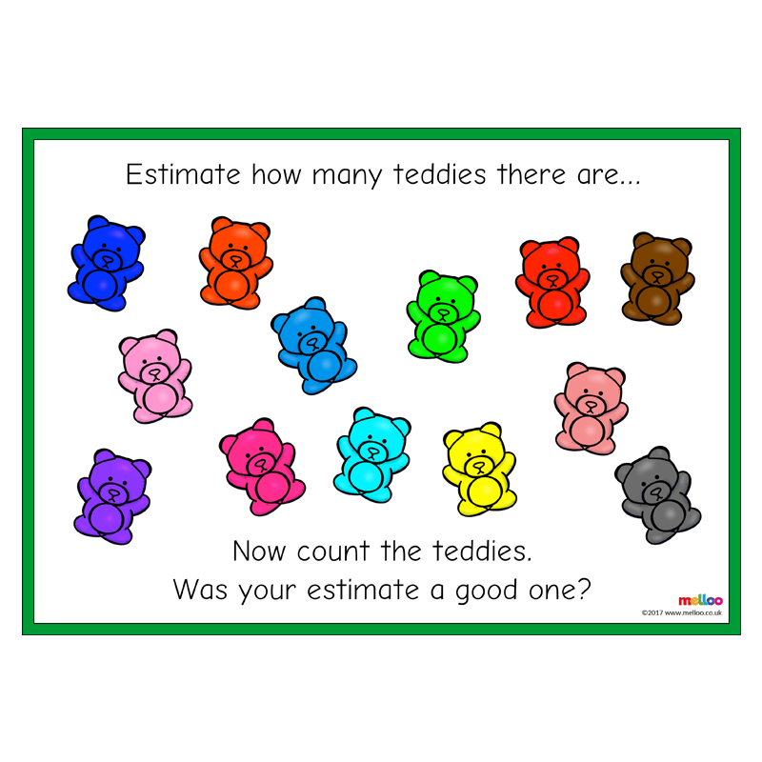

Slide 44
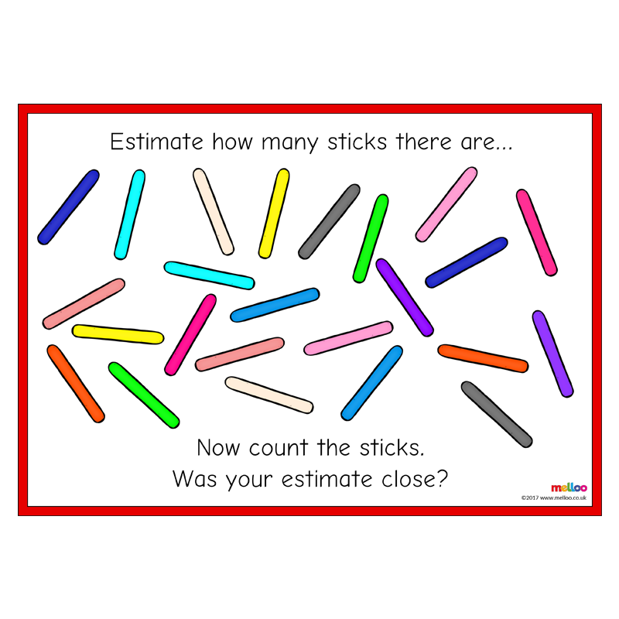

Slide 45
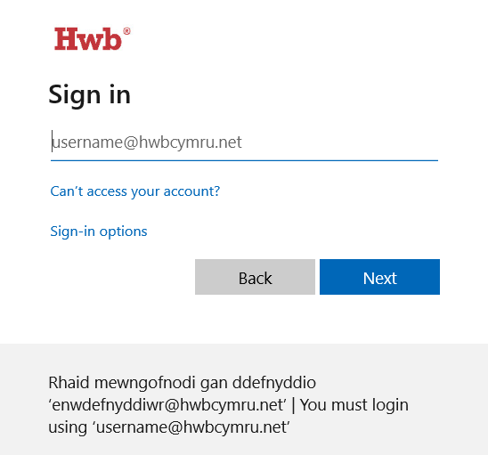
Technology/ICT
WALT: Use HWB to create.
Practice logging into Hwb and using the Just2easy resources. Create a Jack and the Beanstalk eBook story using the paint and write feature on HWB JIT5.
Step 1. Find HWB website: https://hwb.gov.wales/
Step 2. Sign in using your own username and password.

Slide 46
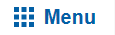
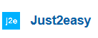




Step 3. Click on menu, then click Just2easy
Step 4. Click Jit- Jt5

Slide 47


Remember to keep safe online and remember the rules...

