Slide 1
Phase 2
Practise saying all the sounds using the sound mat. ​
Practise reading the tricky words. ​
Practise writing the sounds cursively.​
Complete a fine motor activity from the practical ideas pack.​
Read a part of the book. ​
Complete a follow up activity on the book.​
Play phonics games online.​
​
BBC bitesize phonics ​
Teach your monster to read​
Phonics play phase

Slide 2


Slide 3
Tricky Words​
the​
to​
I​
no​
go​
into

Slide 4
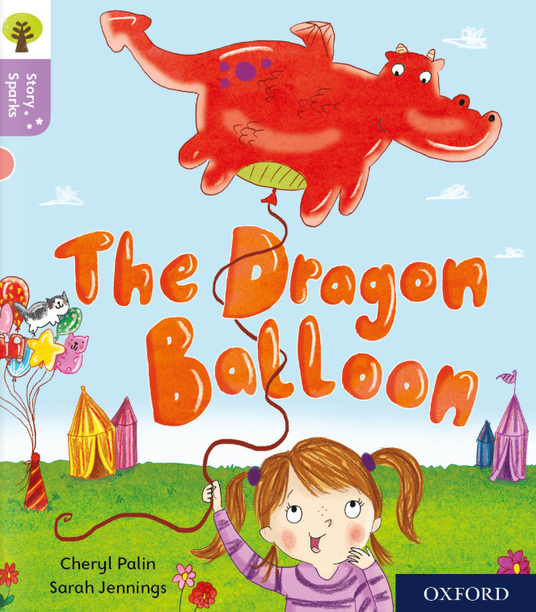

Slide 5
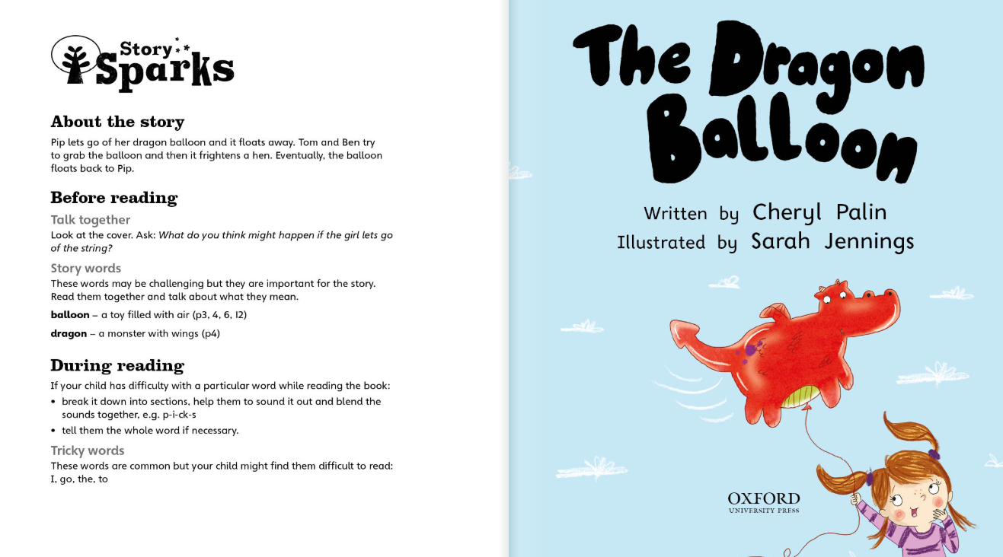

Slide 6
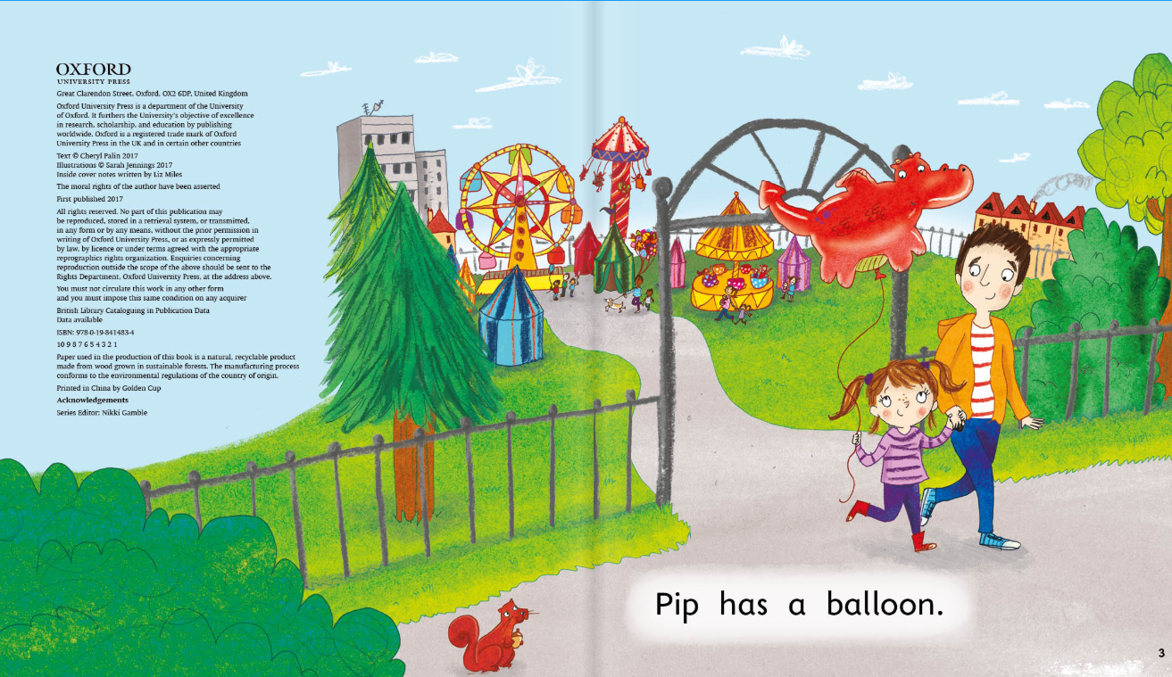

Slide 7
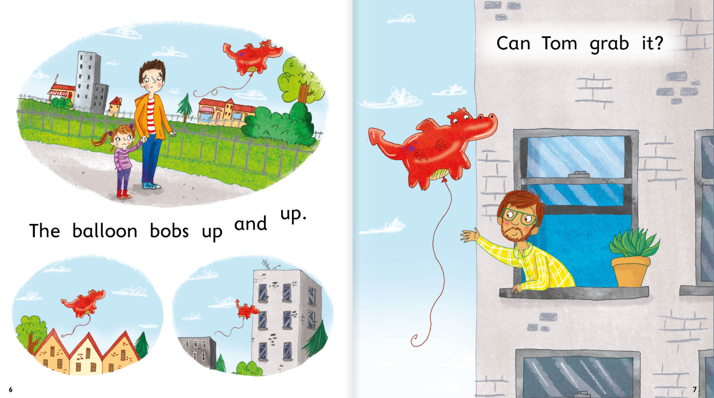

Slide 8
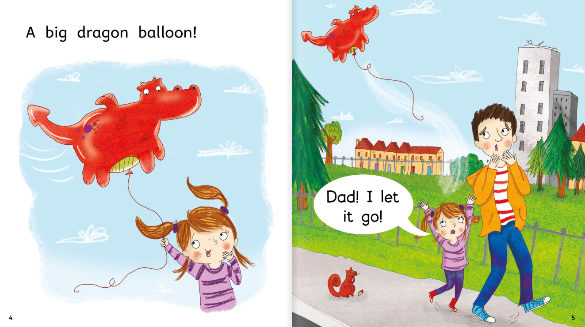

Slide 9
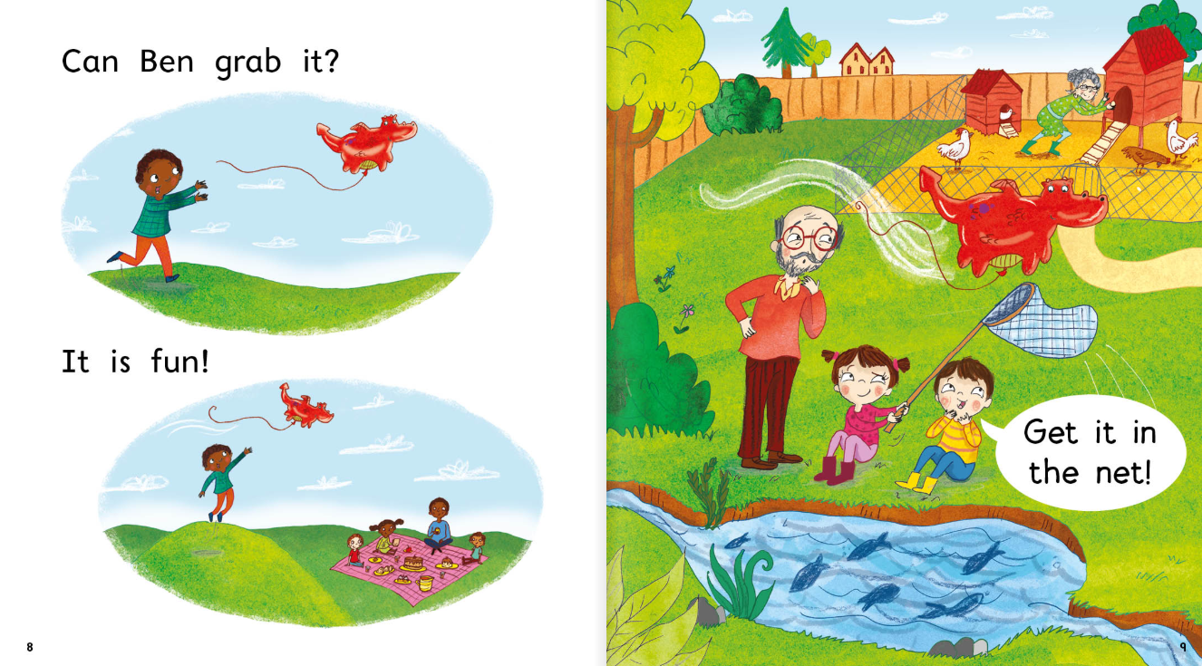

Slide 10
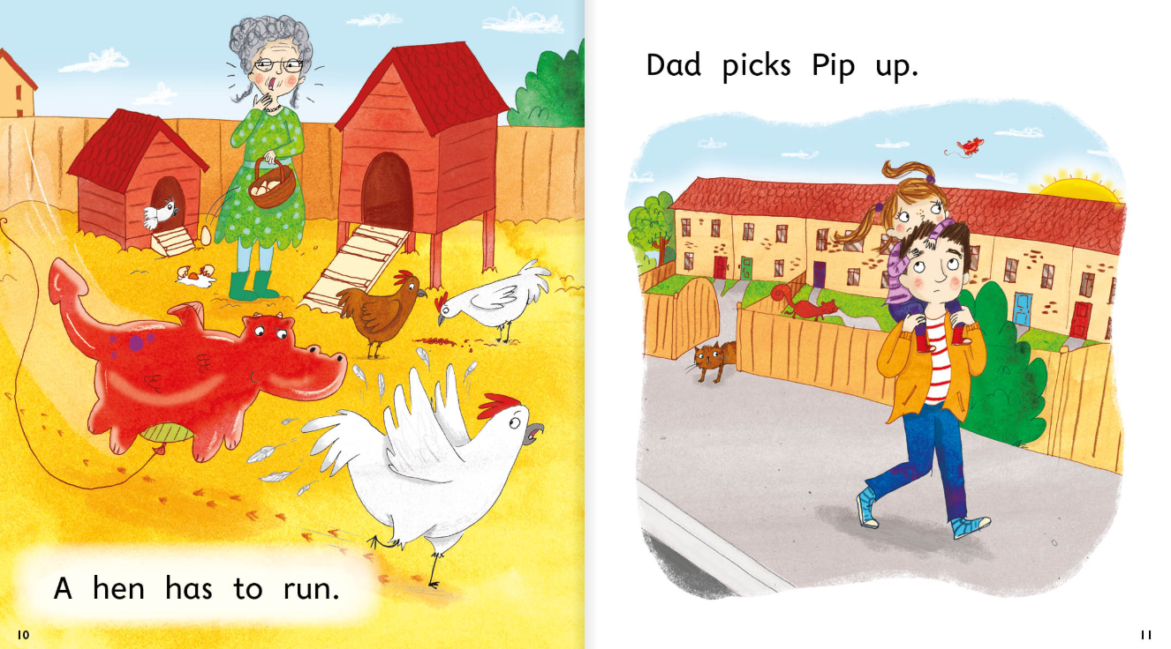

Slide 11
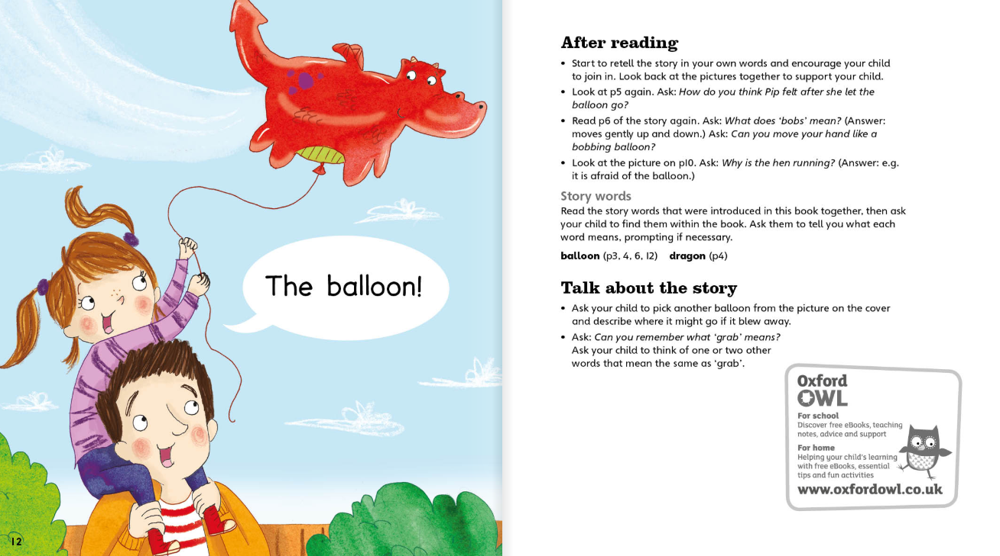

Slide 12
