Slide 1
Phase 5​
This pack will help you learn your sounds and continue to learn to read.​
Practise saying all of the sounds using the sound mat.​
Practise reading the tricky words. ​
Use YouTube song ‘Phase 5 Tricky words’​
Write sentences that include your words using cursive handwriting.​
Read a part of the book every day.​
Play phonics games online or use a practical activity to practise your skills.​
BBC bitesize phonics ​
Teach your monster to read​
Phonics play

Slide 2


Slide 3
Tricky Words​
said have like so do ​
some come were there ​
little one when out what ​
oh their people Mr Mrs ​
looked called asked could

Slide 4
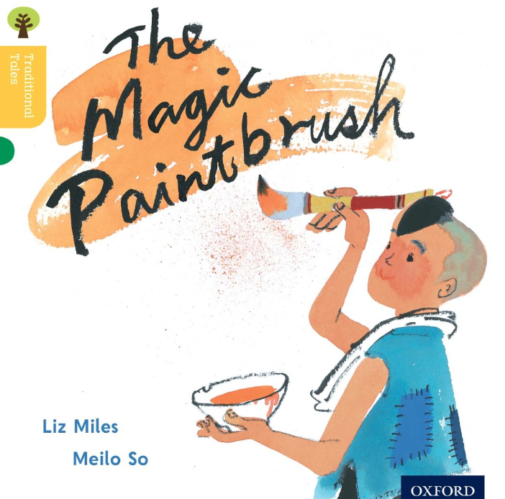

Slide 5
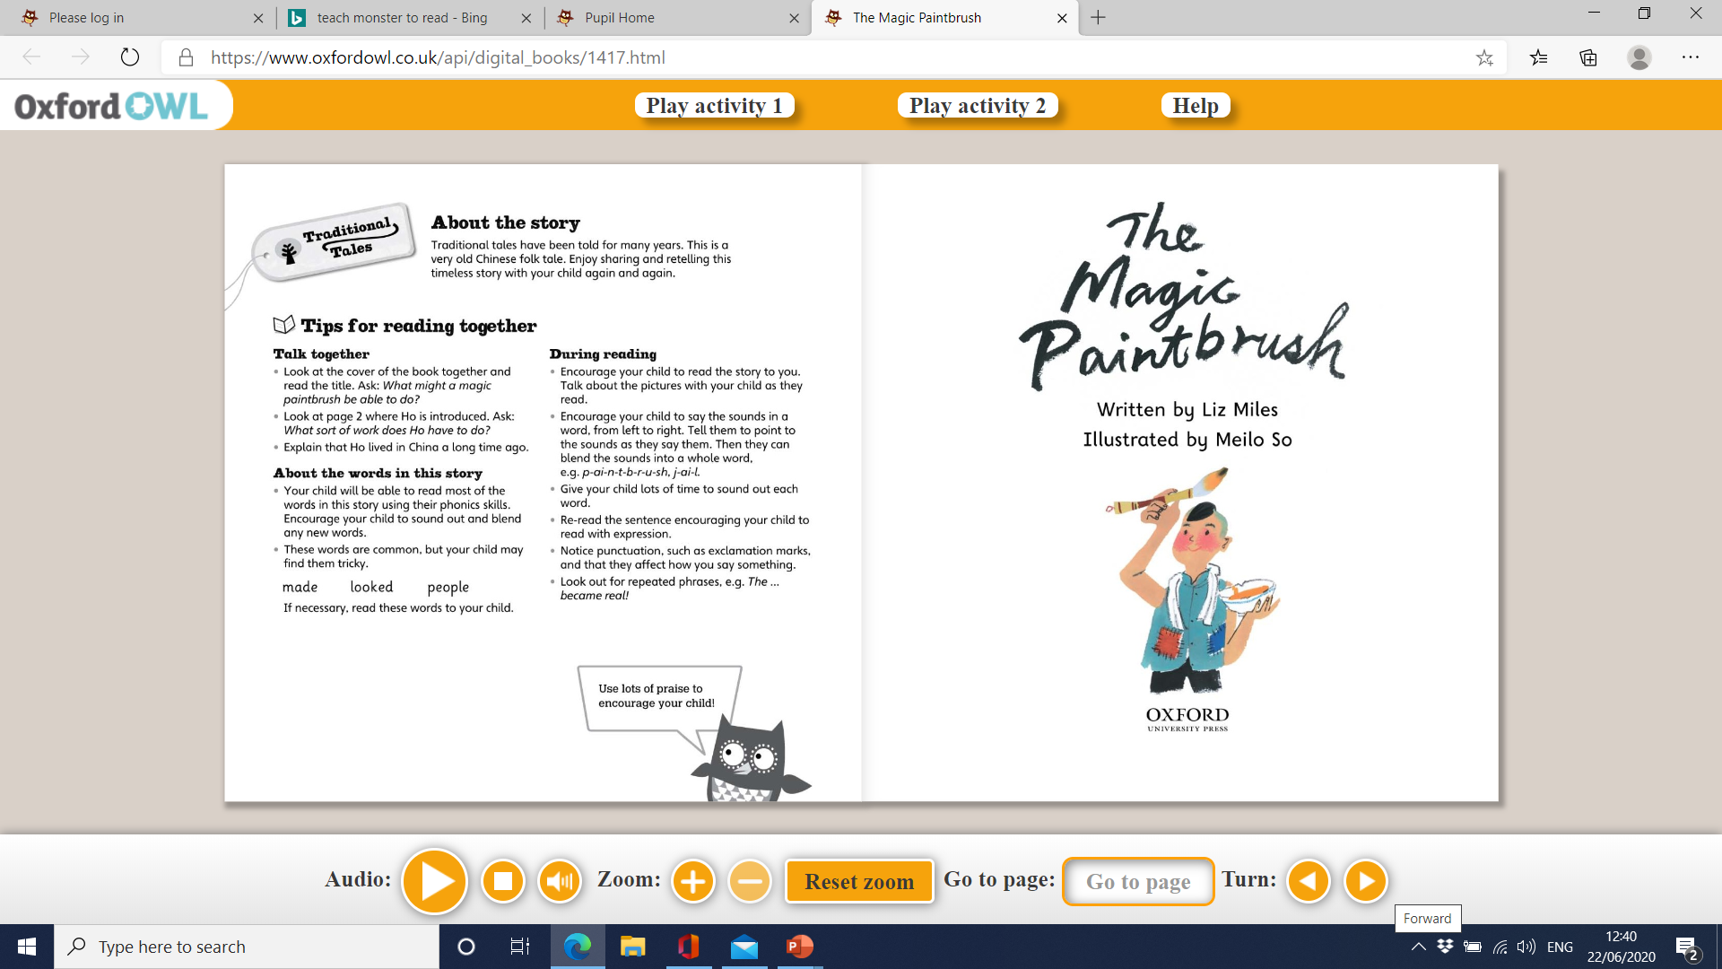

Slide 6
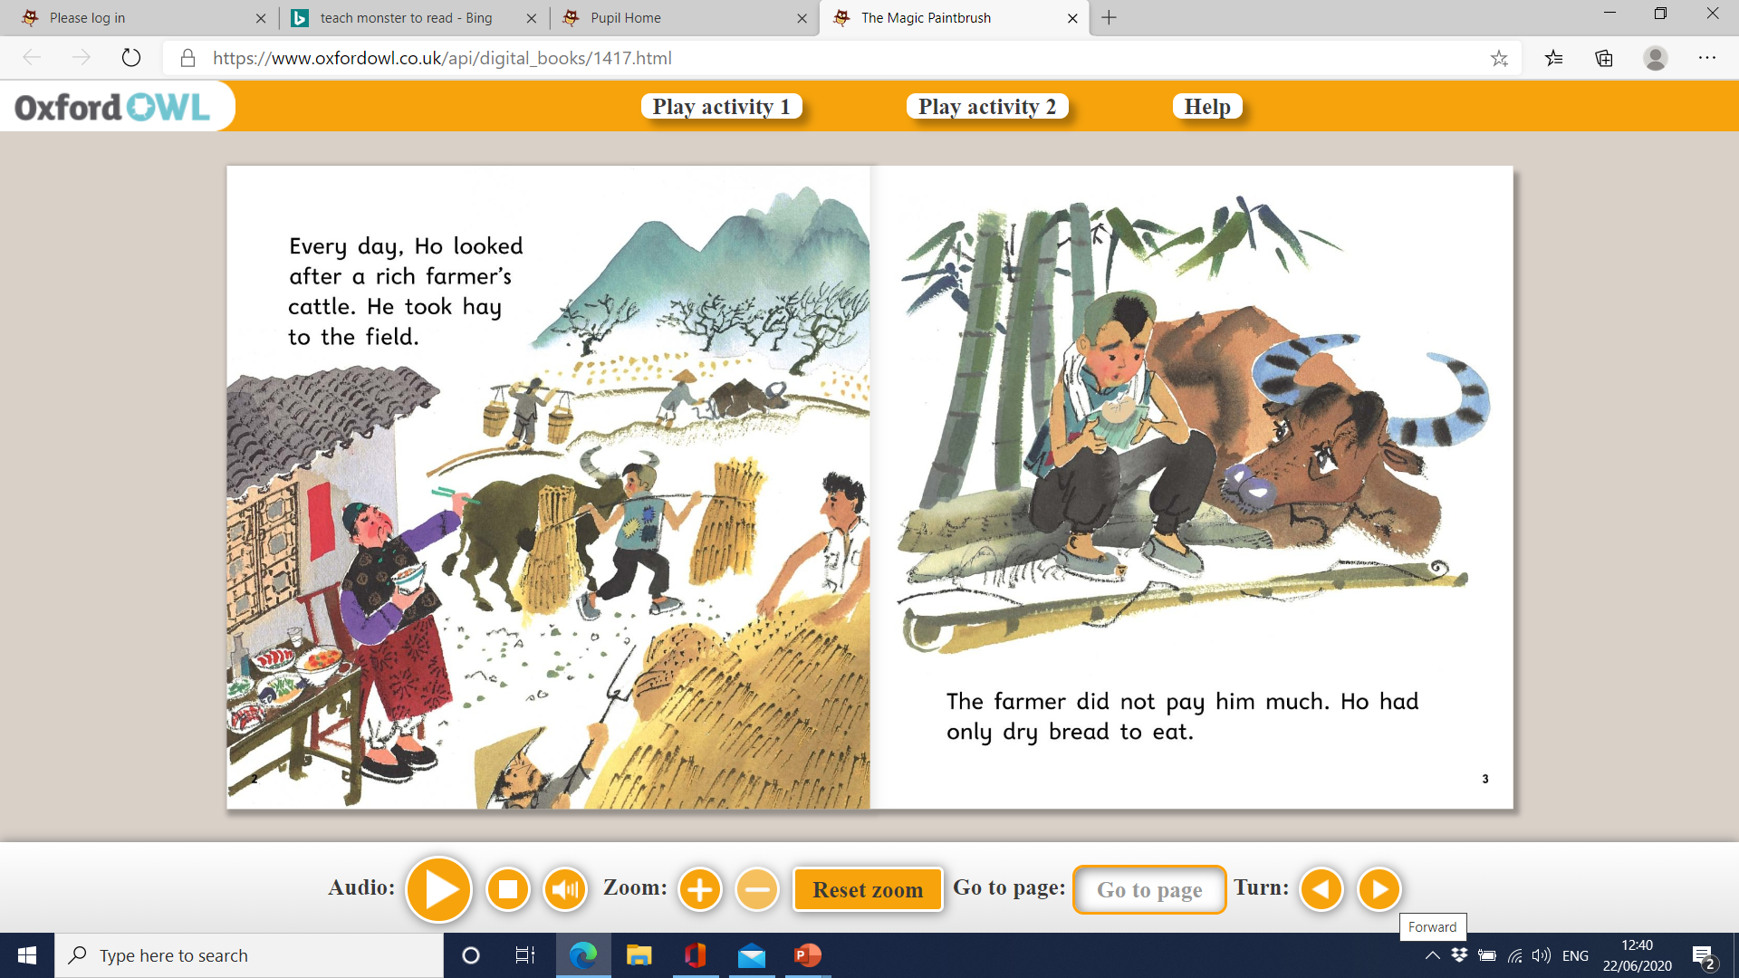

Slide 7
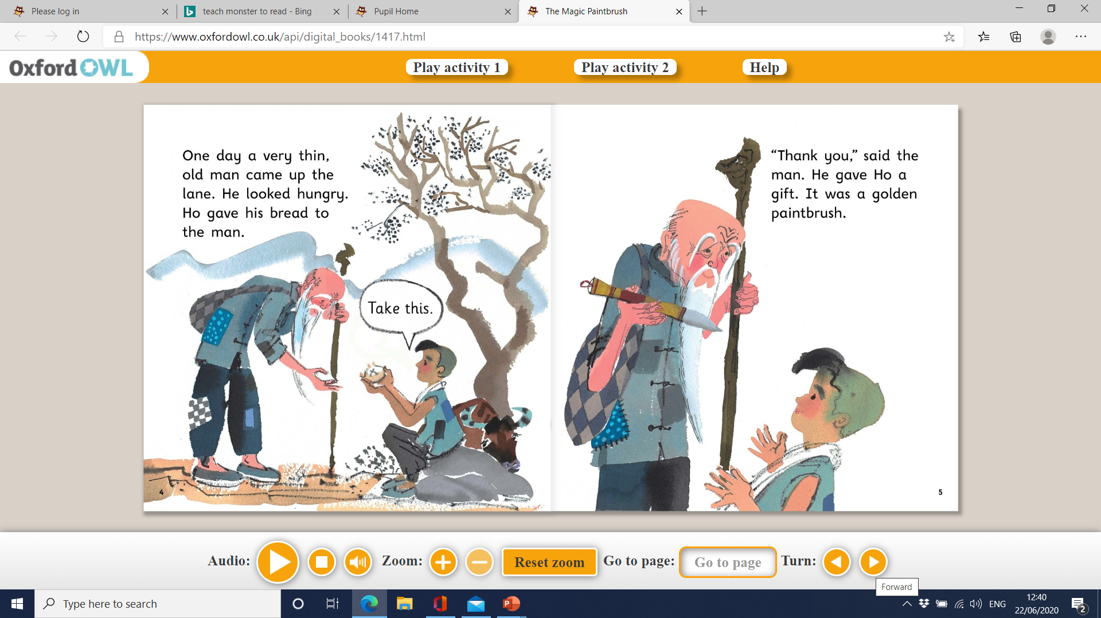

Slide 8
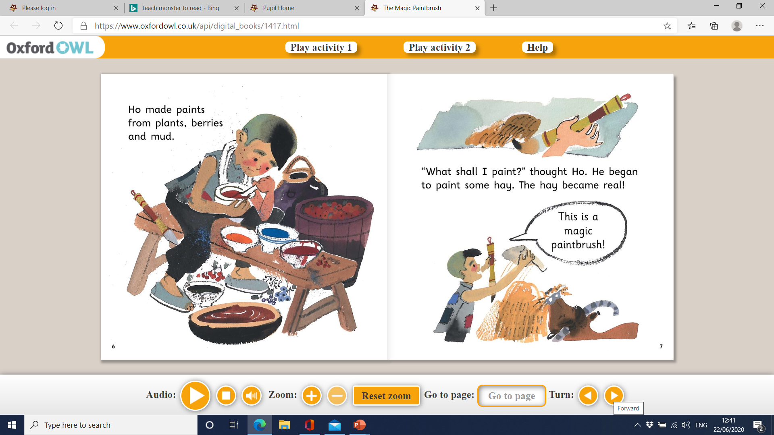

Slide 9
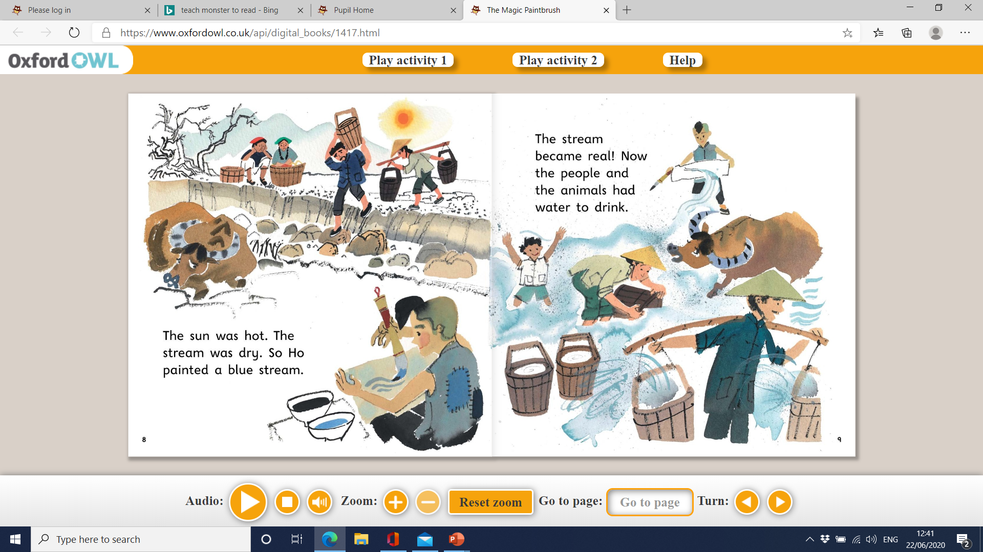

Slide 10
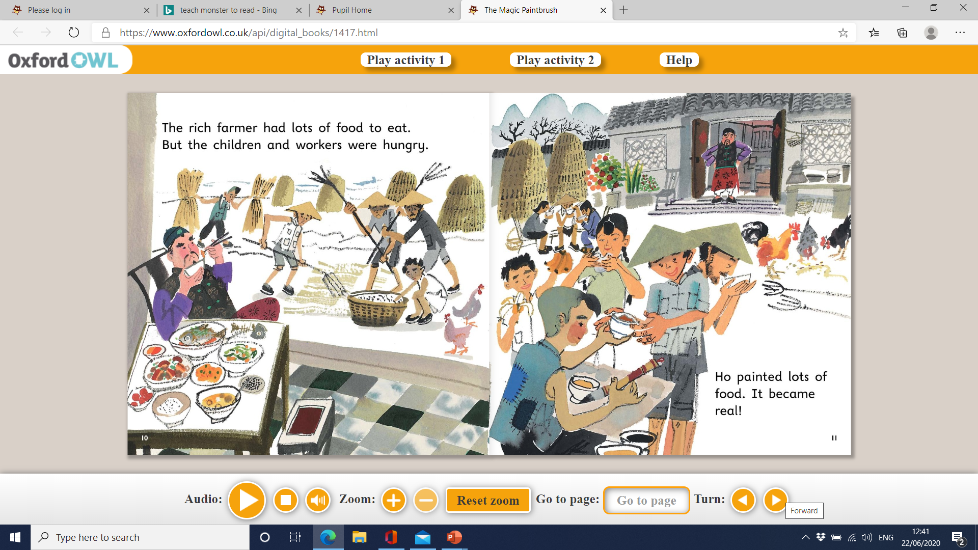

Slide 11
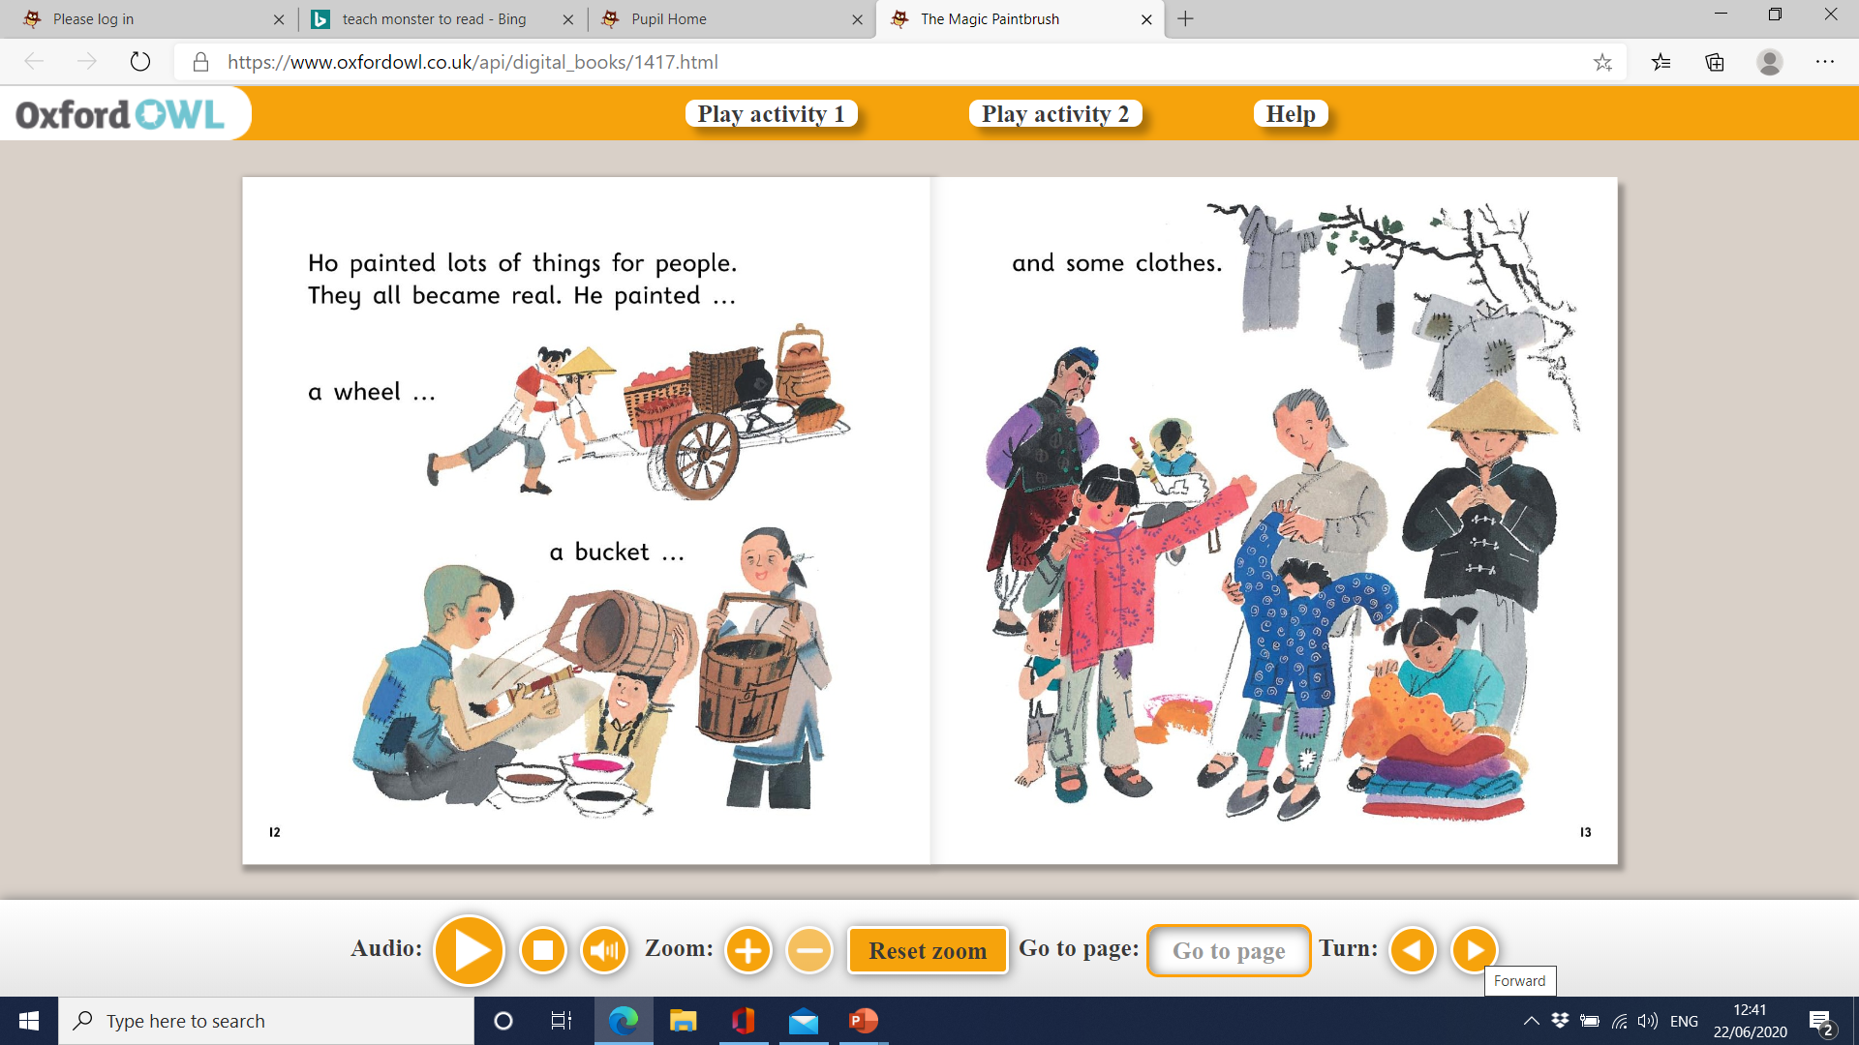

Slide 12
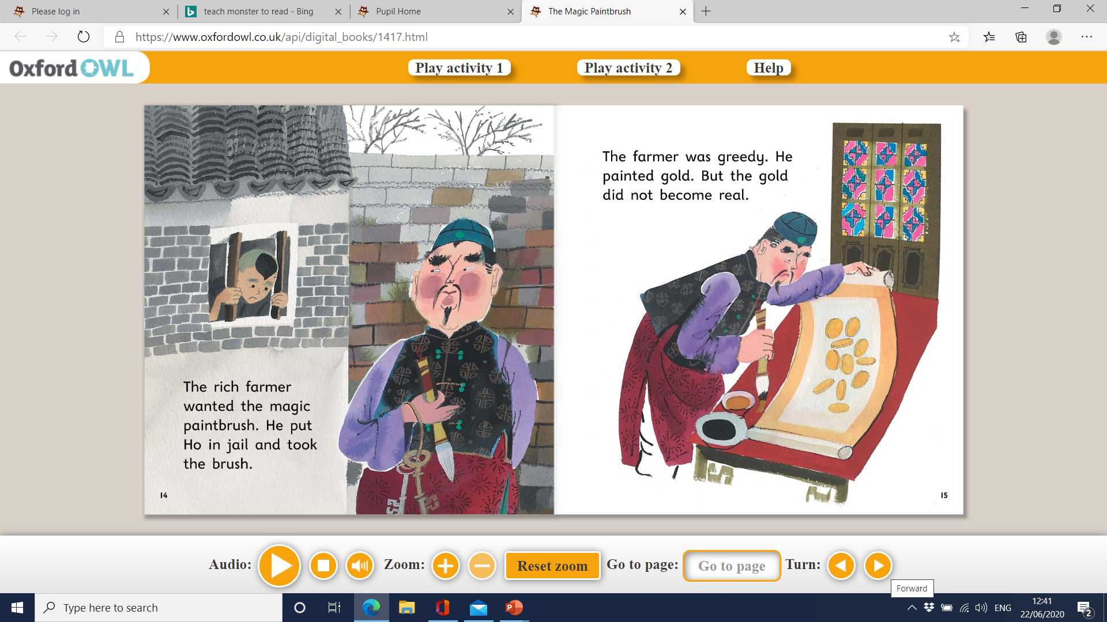

Slide 13
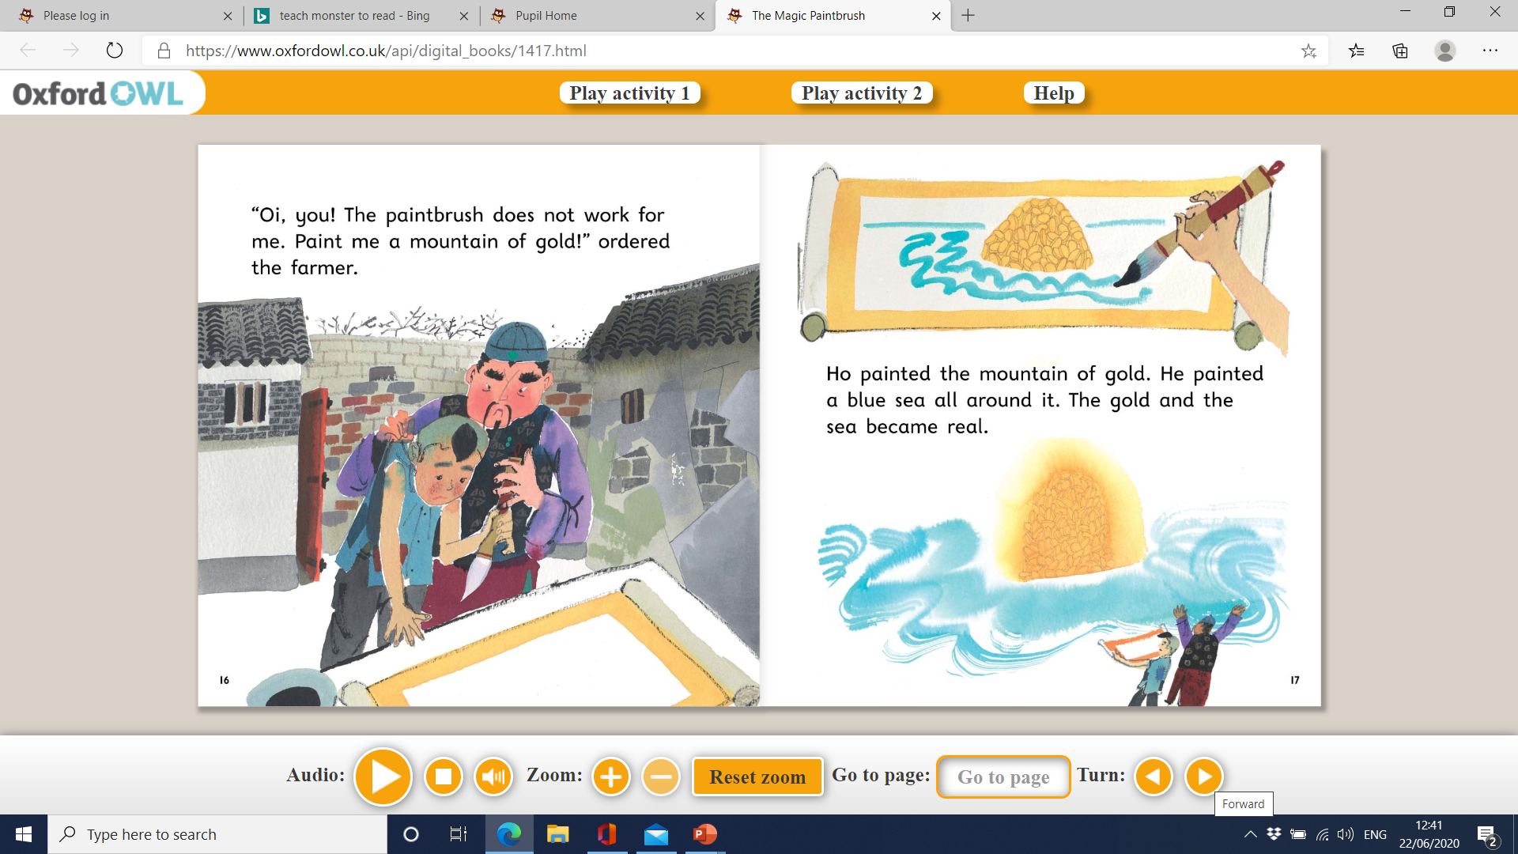

Slide 14
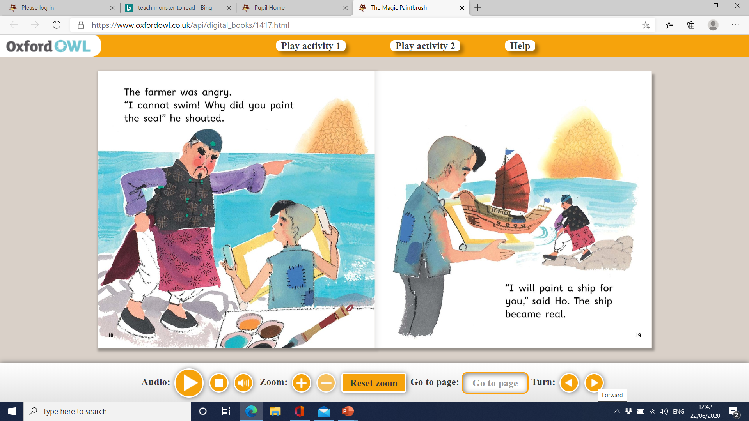

Slide 15
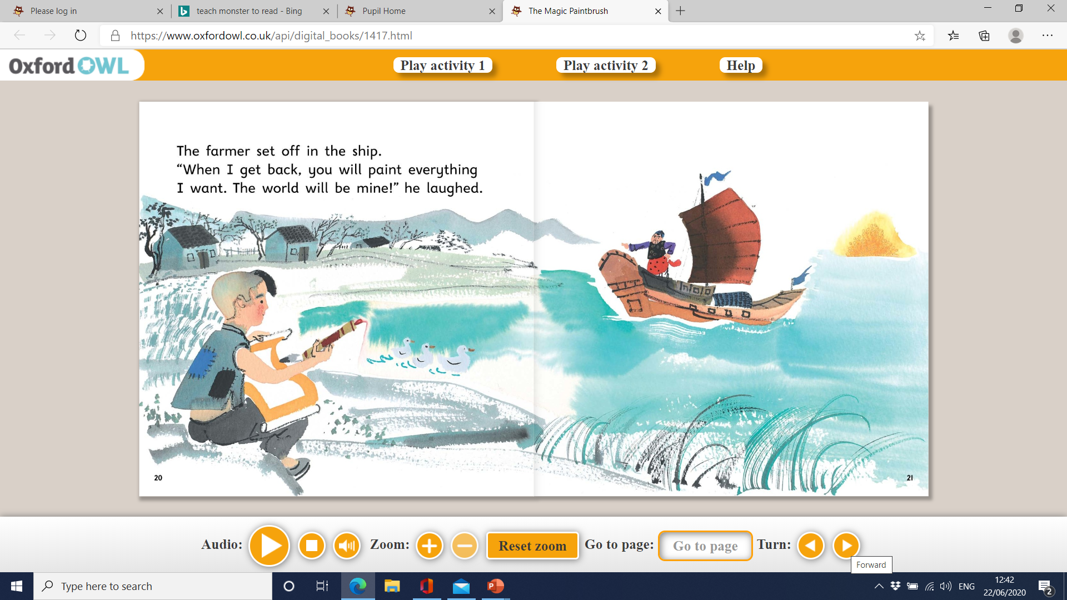

Slide 16
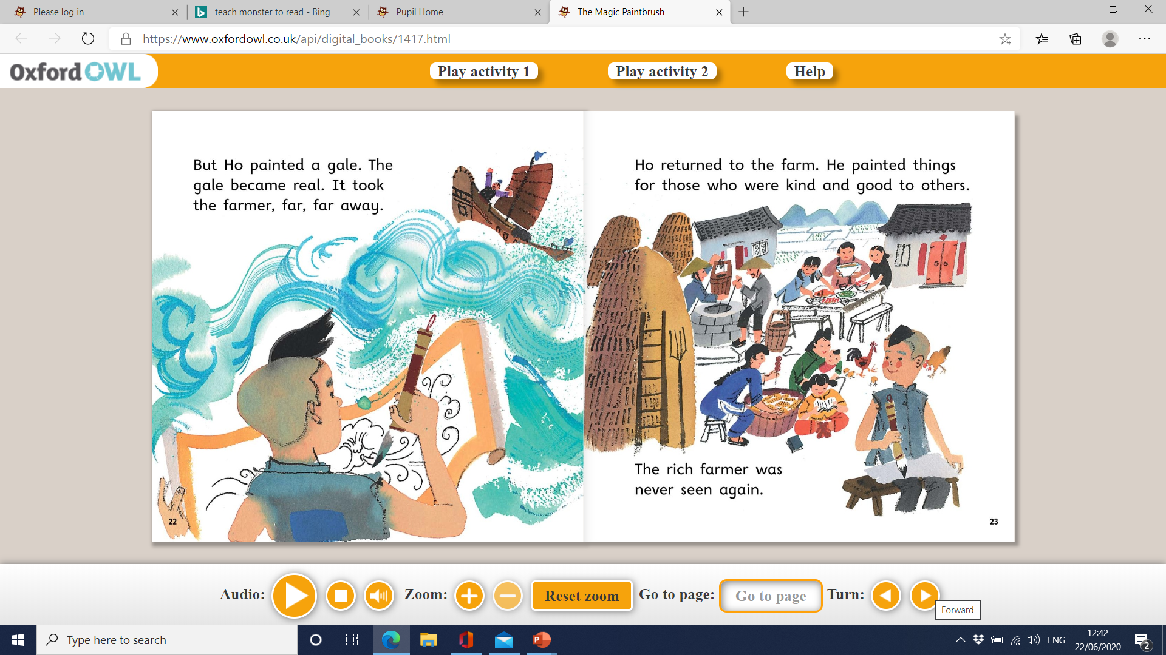

Slide 17
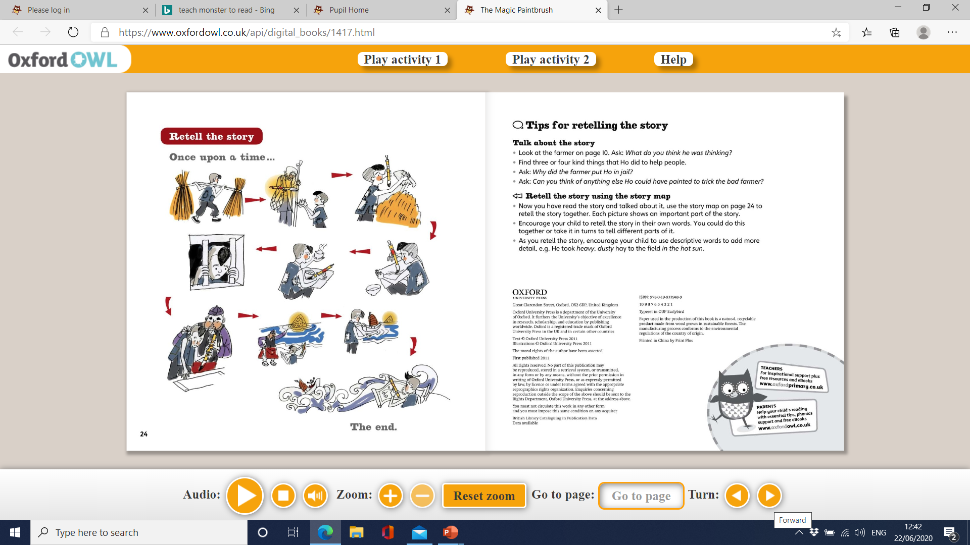

Slide 18
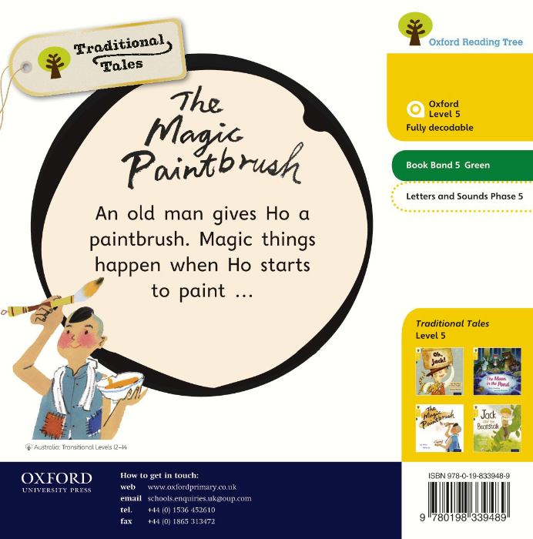

Slide 19
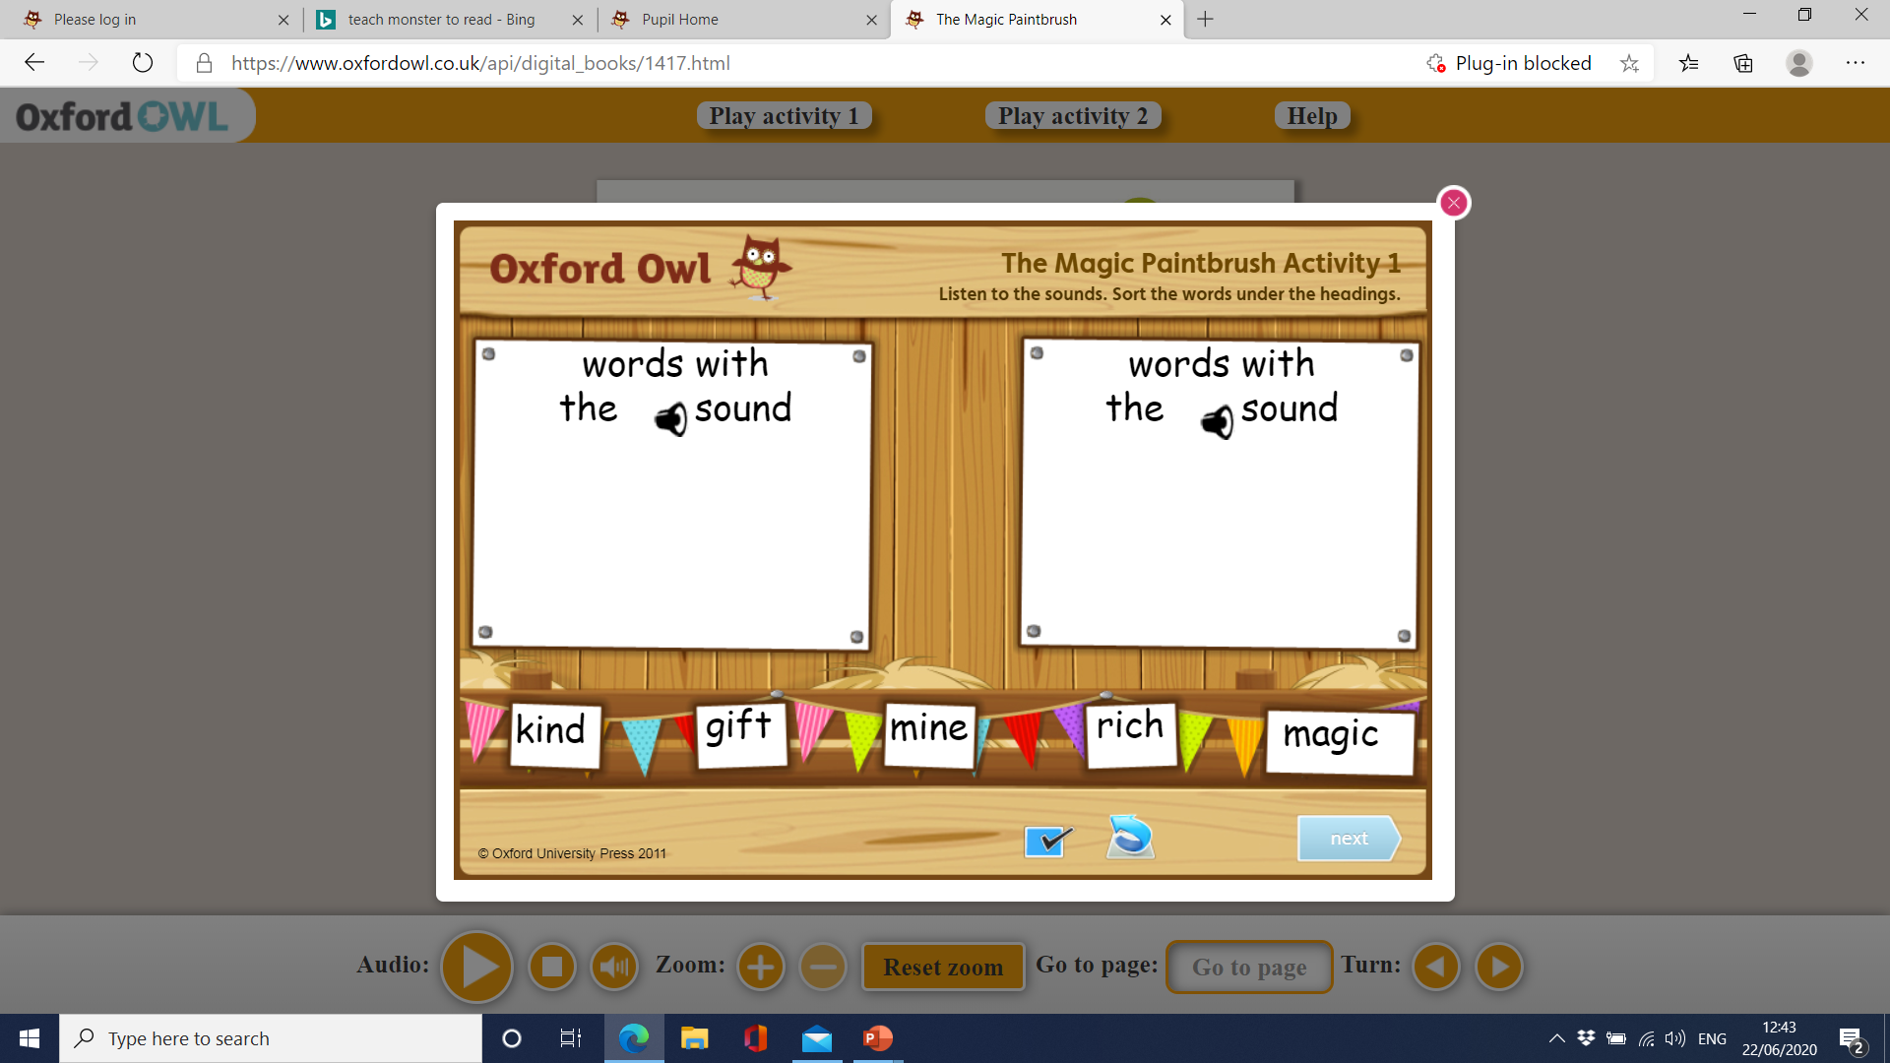

Slide 20
