Slide 1
Literacy Tasks: Phase 2
Practise saying all of the sounds using the sound mat.
Practise reading the tricky words.
Practise writing the sounds cursively.
Complete a fine motor activity from the practical ideas pack.
Read a part of the book.
Complete a follow up activity on the book.
Play phonics games online.
BBC bitesize phonics
Teach your monster to read
Phonics play phase

Slide 2

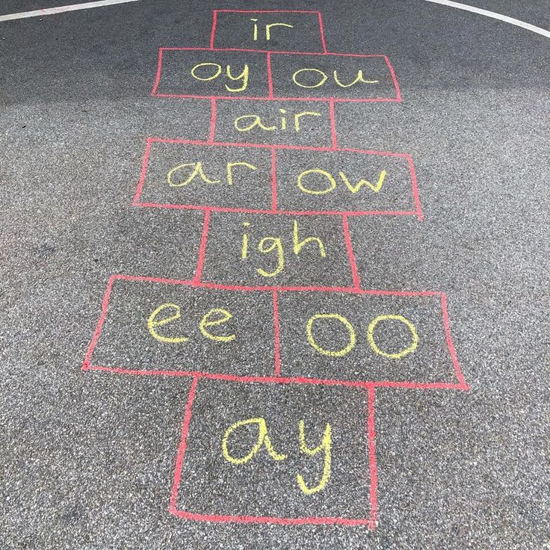
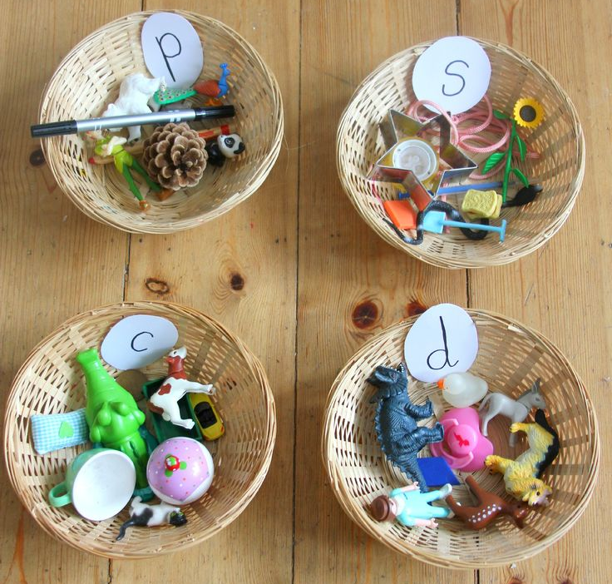
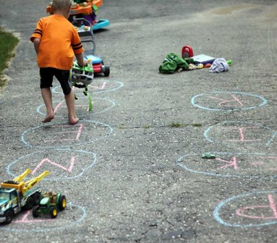
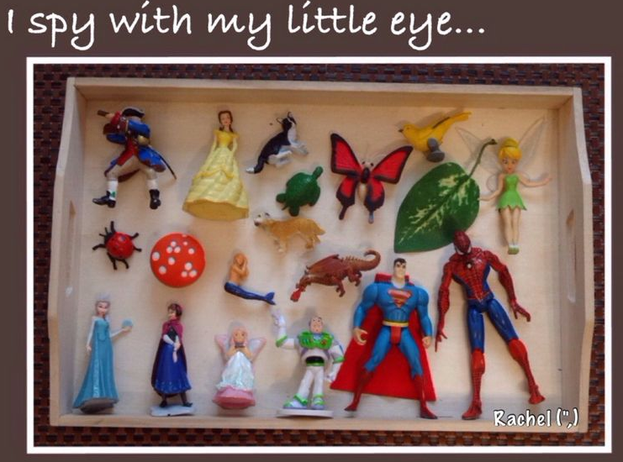
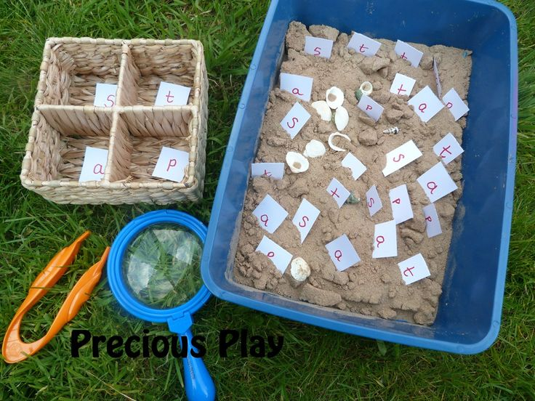
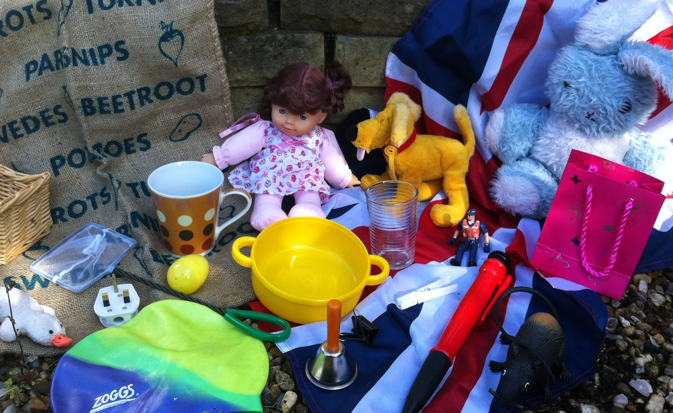
Example of practical ideas…
Go on a sound hunt around the house and outdoors. What objects can you find that starts with the sound ___?
Have a box of objects. Can you say initial and end sound of the objects? Play eye spy.
Practise writing your words and sound in messy play- sand, paint, flour, water, mud, sticks, chalk etc.
Write sounds using chalk on the floor. Play hopscotch on the sound's.
Play board games like scrabble, hangman and sound bingo.
Sing songs and rhymes. Use YouTube videos to learn your words.

Slide 3
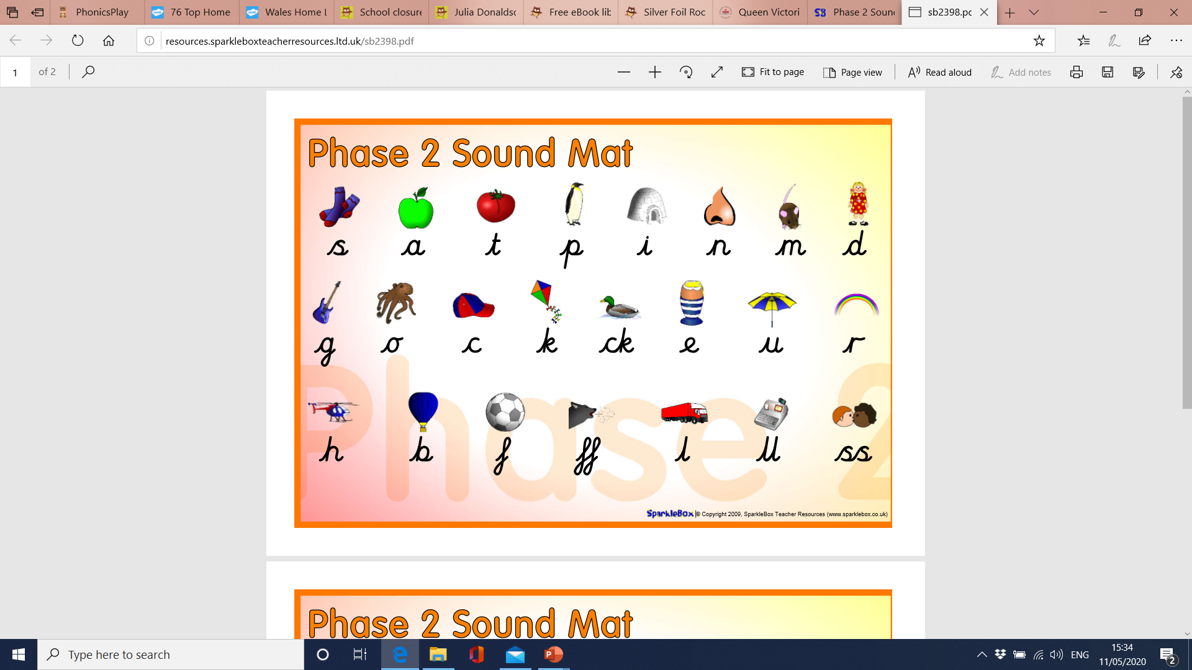

Slide 4
Tricky Words
the
to
I
no
go
into

Slide 5
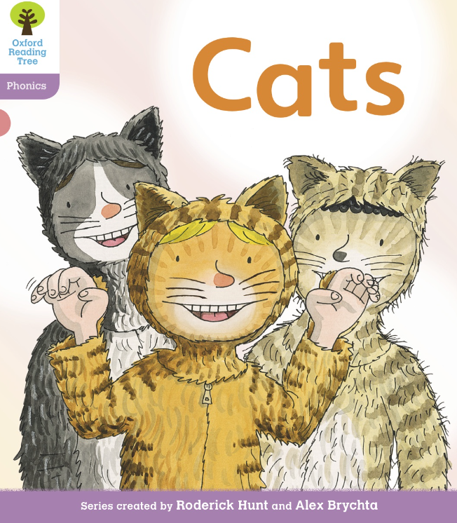

Slide 6
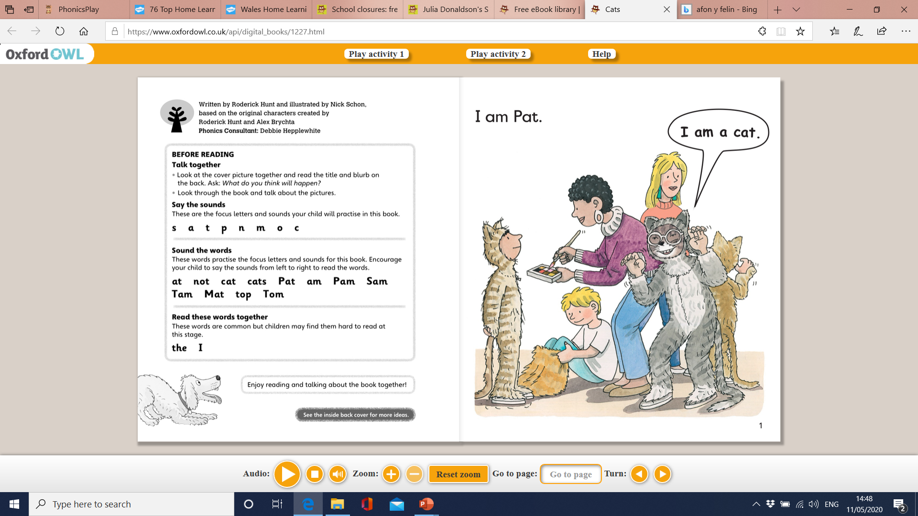

Slide 7
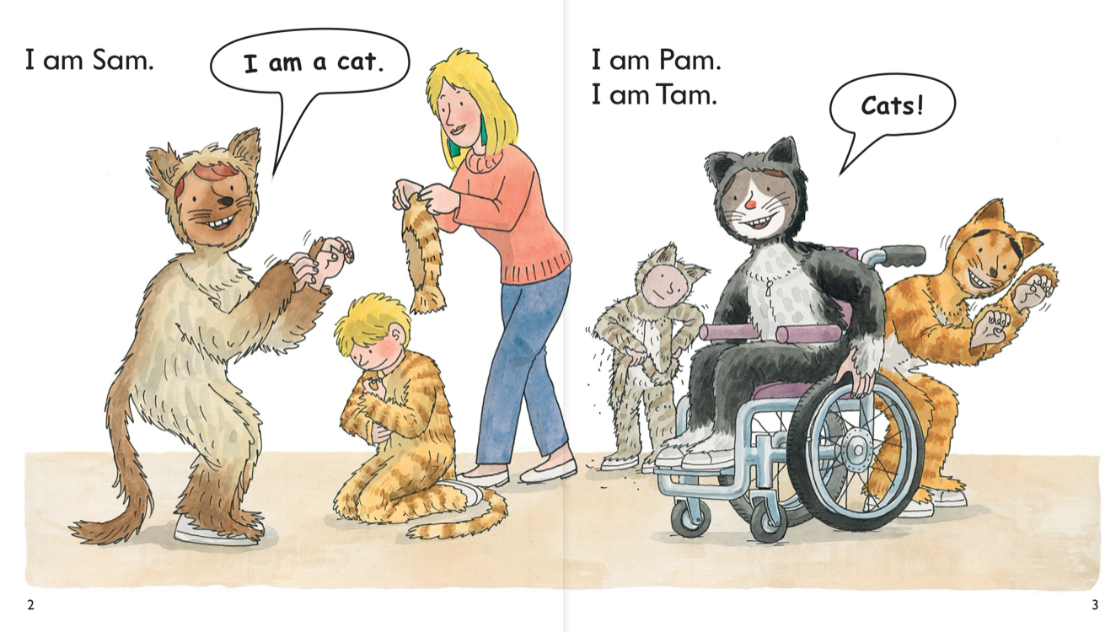

Slide 8
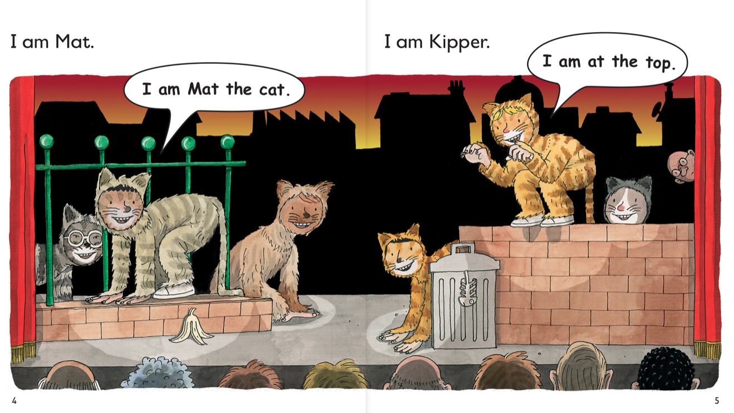

Slide 9
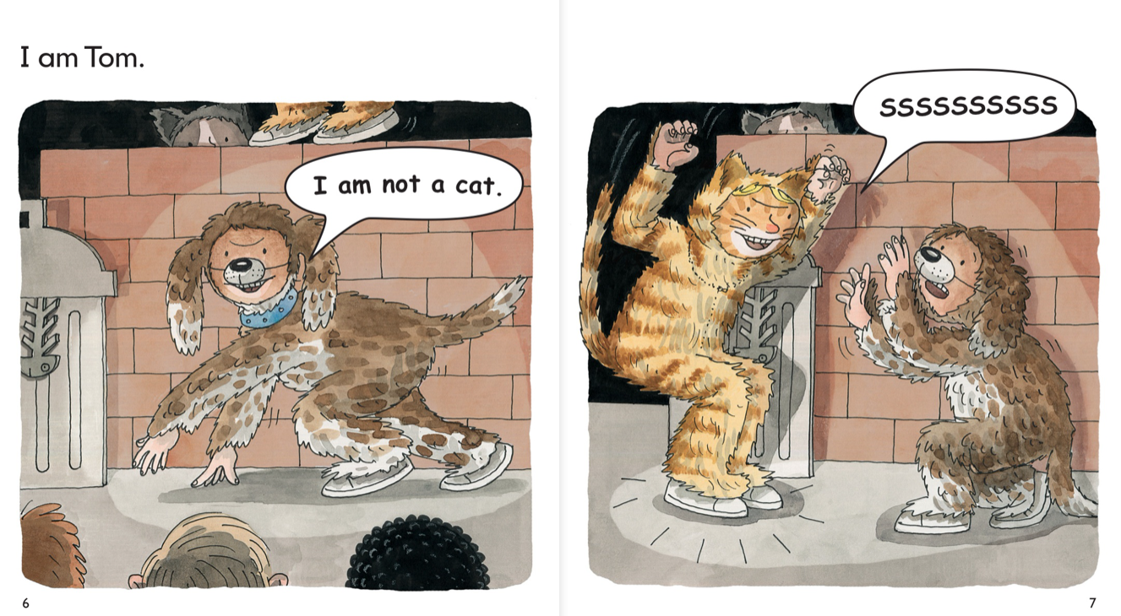

Slide 10
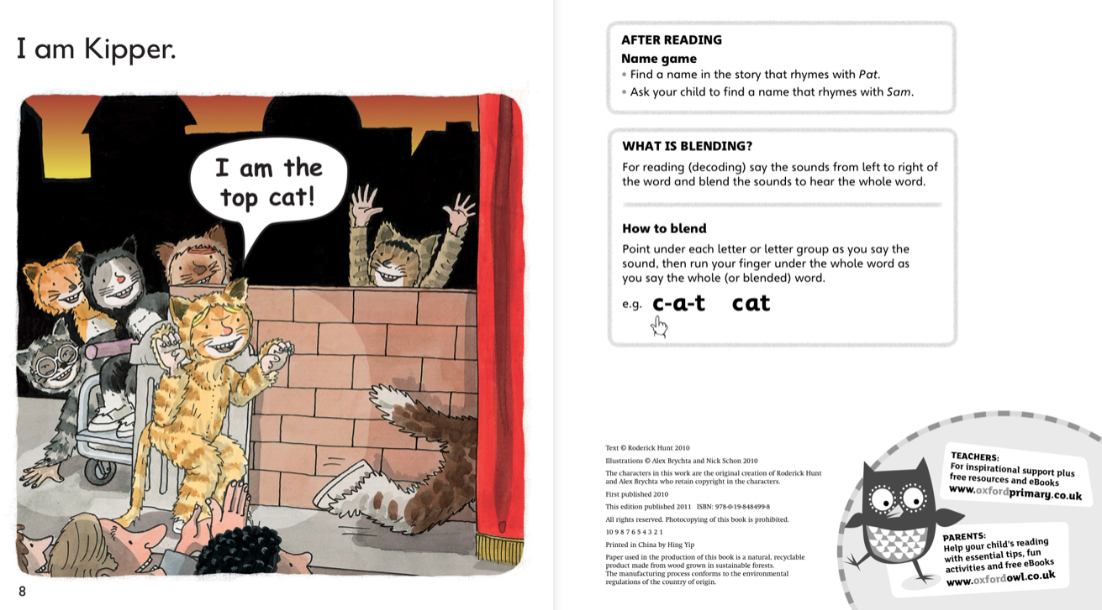

Slide 11
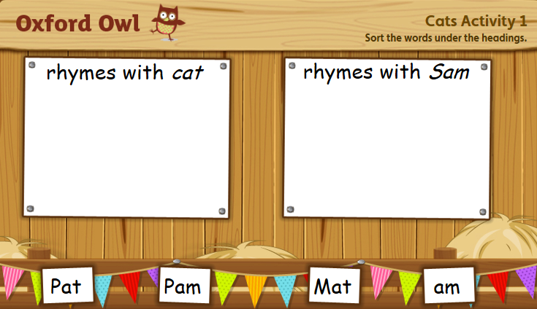

Slide 12
