Slide 2
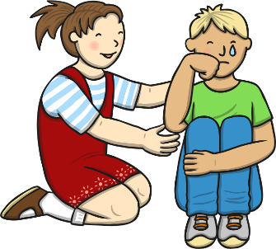
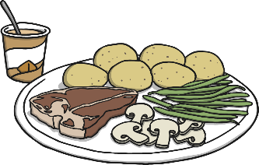
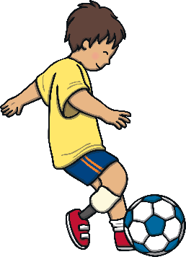
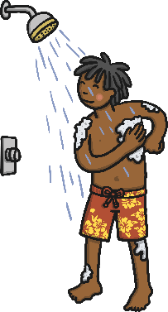
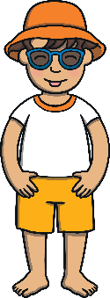
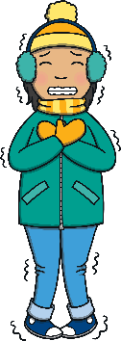
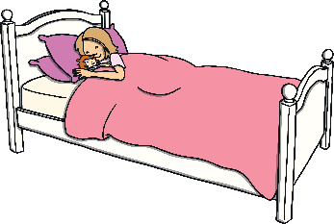
Looking after Yourself
Our bodies are really clever, but we need to look after ourselves to help us stay happy and healthy. There are lots of things we can do to help look after ourselves. We can…
talk to others about how we are feeling
eat a balanced diet
do some exercise
look after our personal hygiene
think about what we need to wear
have plenty of rest and sleep
End slide

Slide 3
Talking about How We Are Feeling
How do you feel today? Sometimes we feel happy, other times we may feel sad. By talking about how we are feeling, we can celebrate the happy and exciting things and support each other to feel better when we feel unhappy or worried.
You can talk to your family, friends and grown-ups. Other people can help you work out how to solve a problem, or sort out things you are worried about.
It is very important to tell a grown-up if your don’t feel well or if you hurt yourself so that they can help you to help better.
It is fun to share things that make you happy too! What makes you happy? Can you tell a friend how you are feeling? Try telling a grown-up too.
back

Slide 4
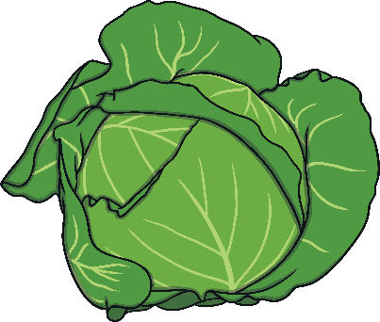
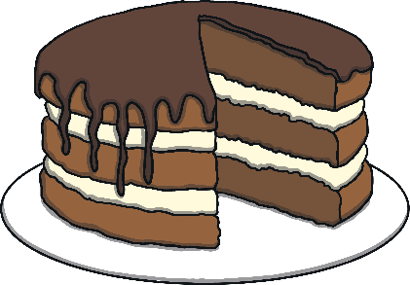
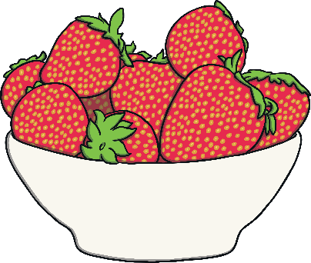


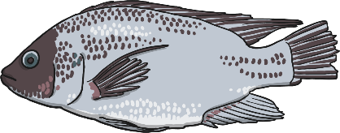
Eat a Balanced Diet
Eating a balanced diet means eating lots of different types of foods. We should eat healthy foods, such as fruit and vegetables. We can eat other foods like cakes and chocolate too, but we shouldn’t eat too many of these.
It is really important to have lots to drink too. Water is a good option, but you may like to drink milk, fruit juice, squash and hot drinks too.
What are your favourite foods? What do you like to drink?
back

Slide 5
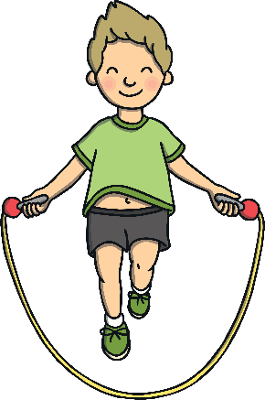
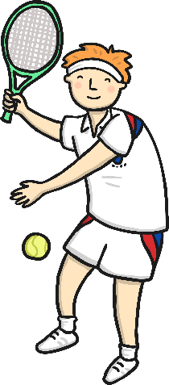
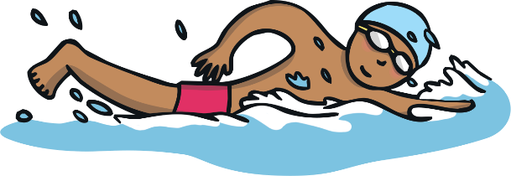
Do Some Exercise
Doing exercise helps our bones and muscles to grow strong. Exercise helps us to stay fit and healthy.
There are lots and lots of different types of exercise – you could play a sport, such as football, do some dancing, go for a walk or go swimming. You could play games with your friends that include running or moving in different ways, such as hopping or skipping.
What exercise do you like to do?
back

Slide 6
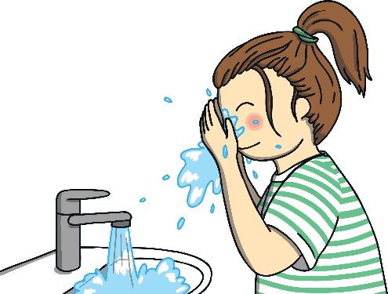
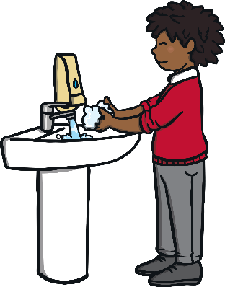
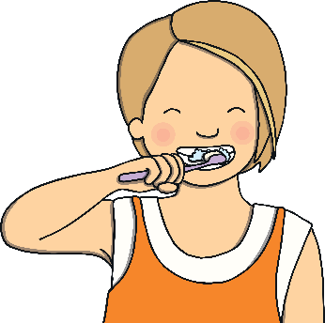
Look after Our Personal Hygiene
Looking after our personal hygiene means we need to keep ourselves clean. We need to wash and have baths or showers to keep our bodies clean. We need to wash our hair too.
We need to wash our hands lots of times throughout the day. Washing our hands after going to the toilet and before we have anything to eat and drink is particularly important. Don’t worry if your hands get dirty while you are playing, just give them a wash with some soap.
Brushing your teeth is very important to make sure your teeth are clean and healthy.
back

Slide 7
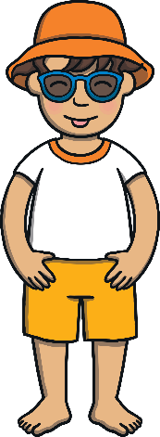
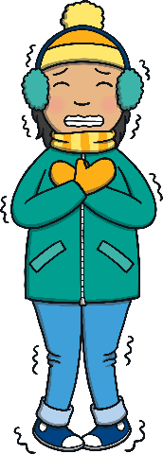



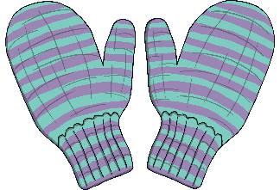

Think about What We Need to Wear
To look after ourselves in different types of weather, we need to wear different types of clothing.
When the weather is hot and sunny, we need to wear clothes that help to keep us cool. We also need to protect ourselves from the sun by wearing sun hats, sunglasses and sun cream.
When the weather is cold, we need to wear clothes that will help keep us warm – especially when we go outside. We need to wear woolly hats, gloves, coats and scarves.
What is your favourite type of weather? What do you need to wear to look after yourself?
back

Slide 8
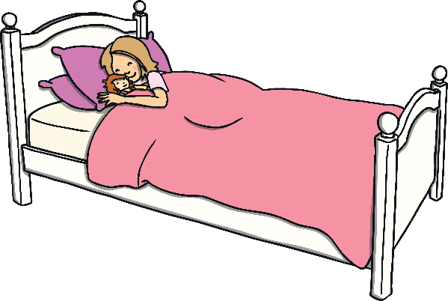


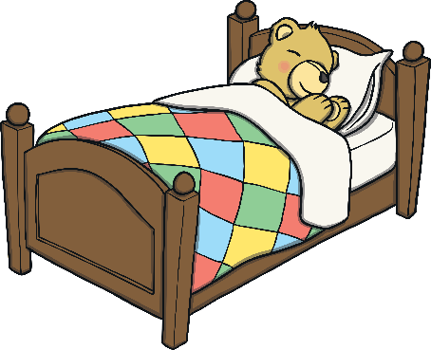
Have Plenty of Rest and Sleep
Our bodies will tell us when we need a rest. Sometimes when we are playing, we will need to stop for a rest – especially if we have been running around!
We need to get lots of rest and sleep at night time too. Getting a good night’s sleep helps our bodies to grow and makes us feel better. We will feel sleepy if we do not get enough sleep and this means we are not able to learn or play properly.
What do you do before you go to bed? Do you like having a bedtime story?
back

Slide 9
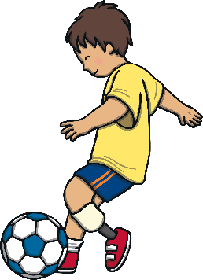
Can you remember some of the things you need to do to look after yourself?

Slide 10
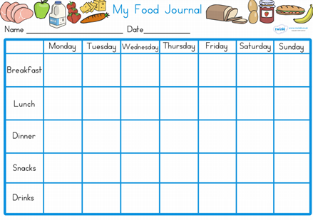
Walt: understand how to keep ourselves healthy
Can you create a food journal?

Slide 11
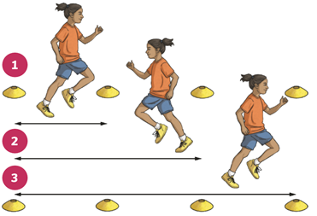
WALT: keep fit and healthy.
Raise your heart level and improve your stamina with shuttle runs. Place 4 objects from around the house in a line. Run to each object.
Can you time yourself?
Can you record your times in a table?
Can you beat your time?

Slide 12

WALT: be positive about yourself.
Write down five kind comments about yourelf, things your grateful for or things that make you happy.

