Slide 1
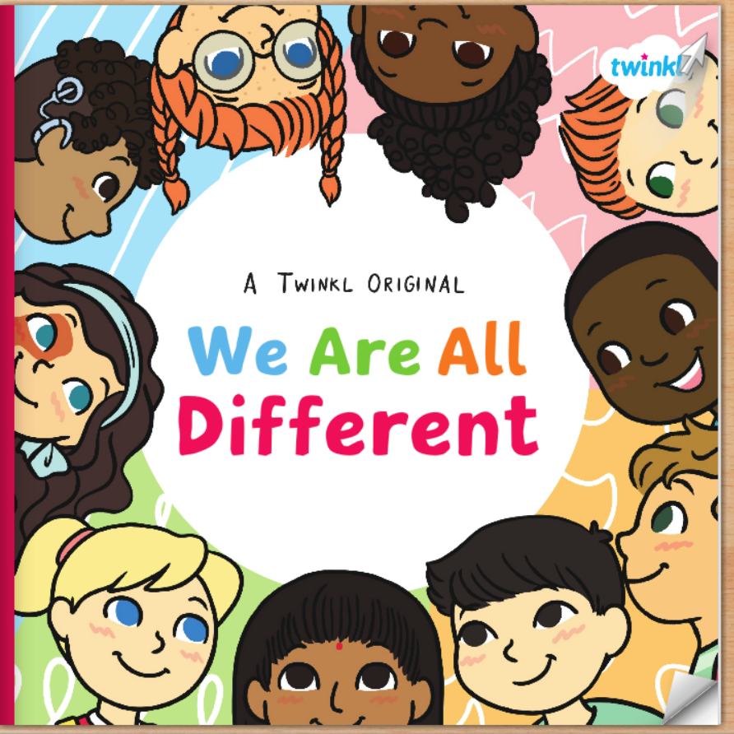

Slide 2
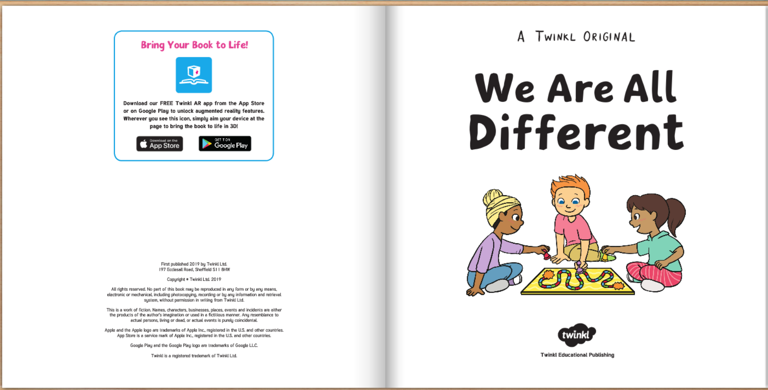

Slide 3
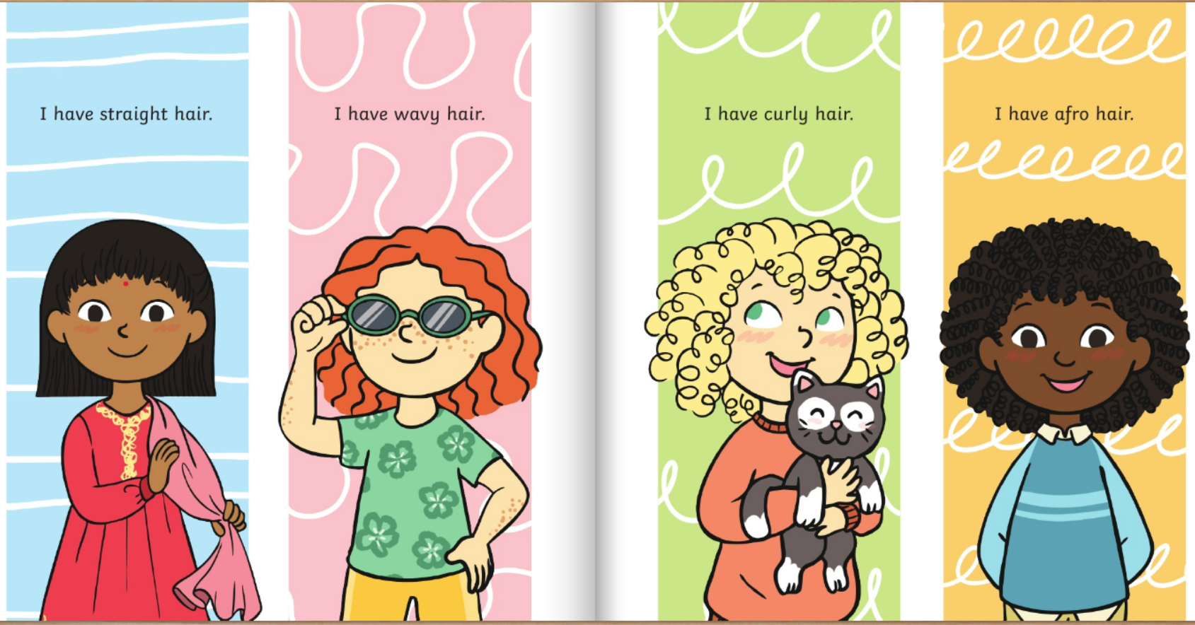

Slide 4
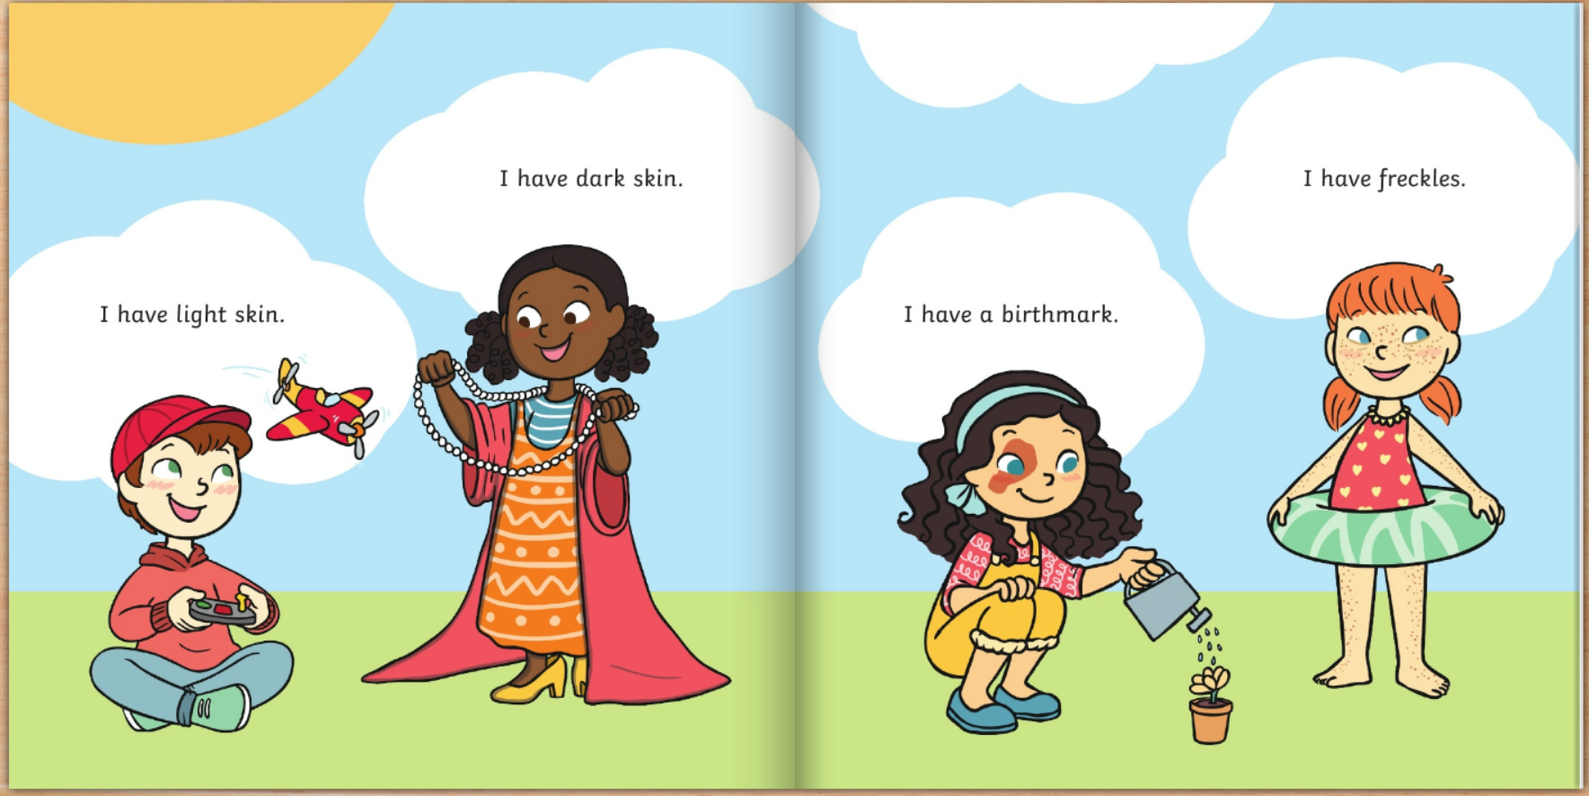

Slide 5
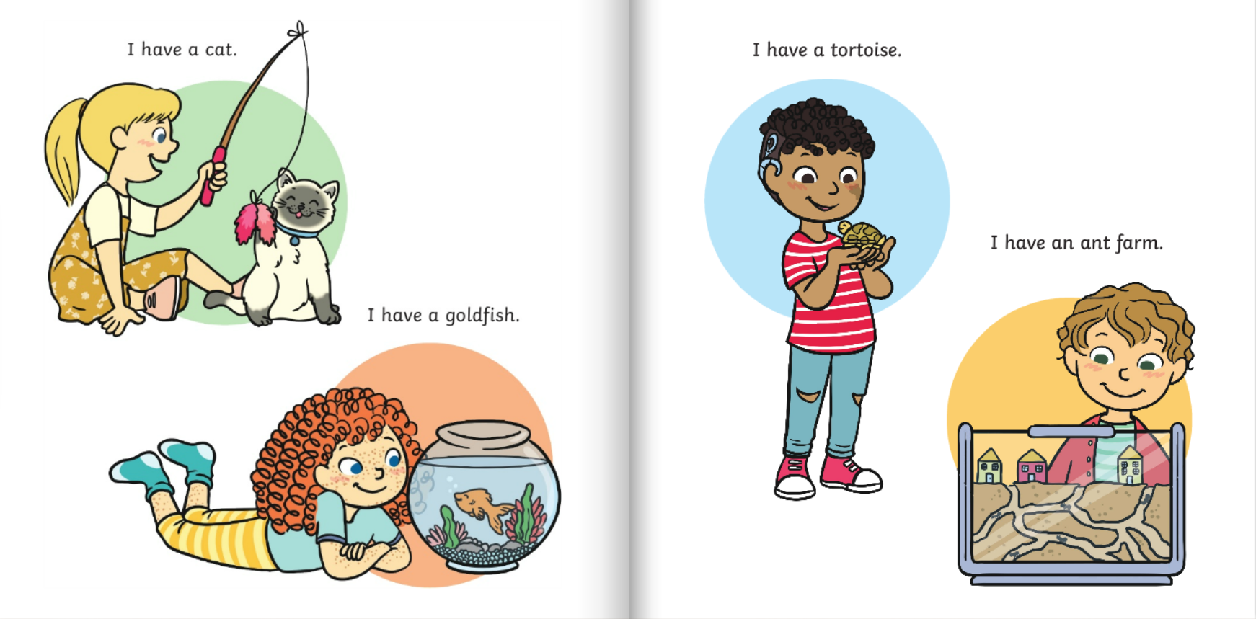

Slide 6
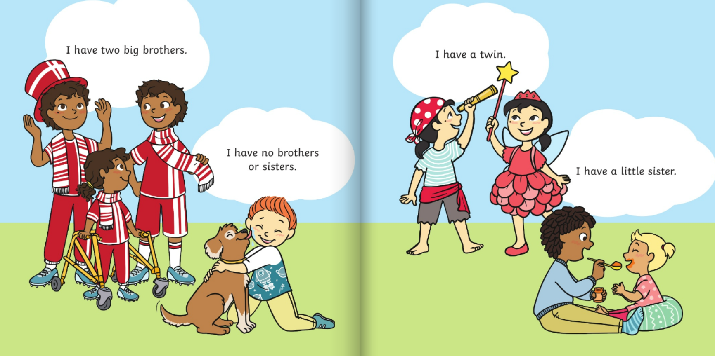

Slide 7
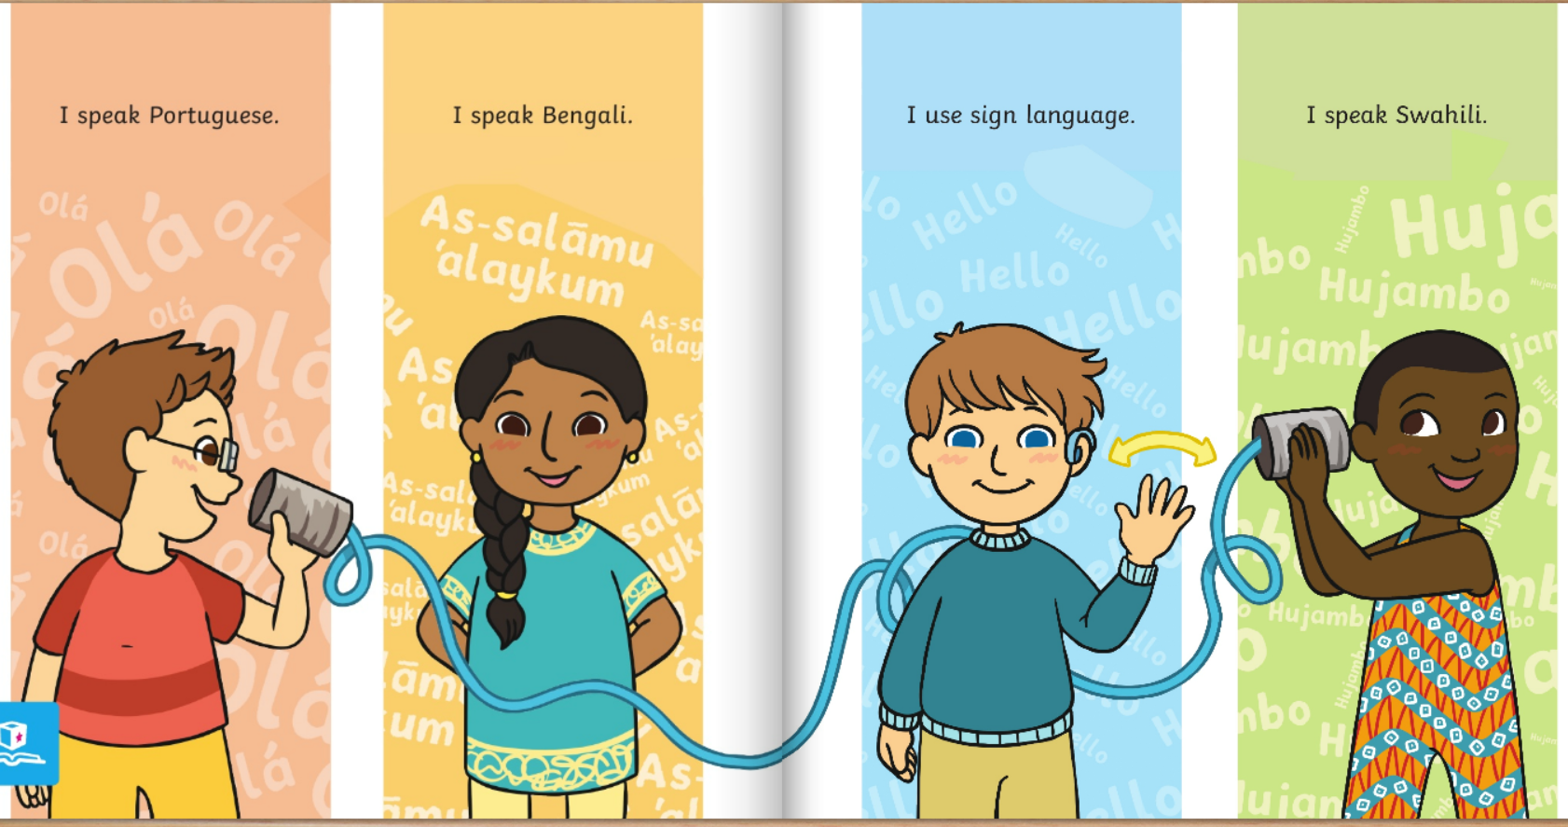

Slide 8
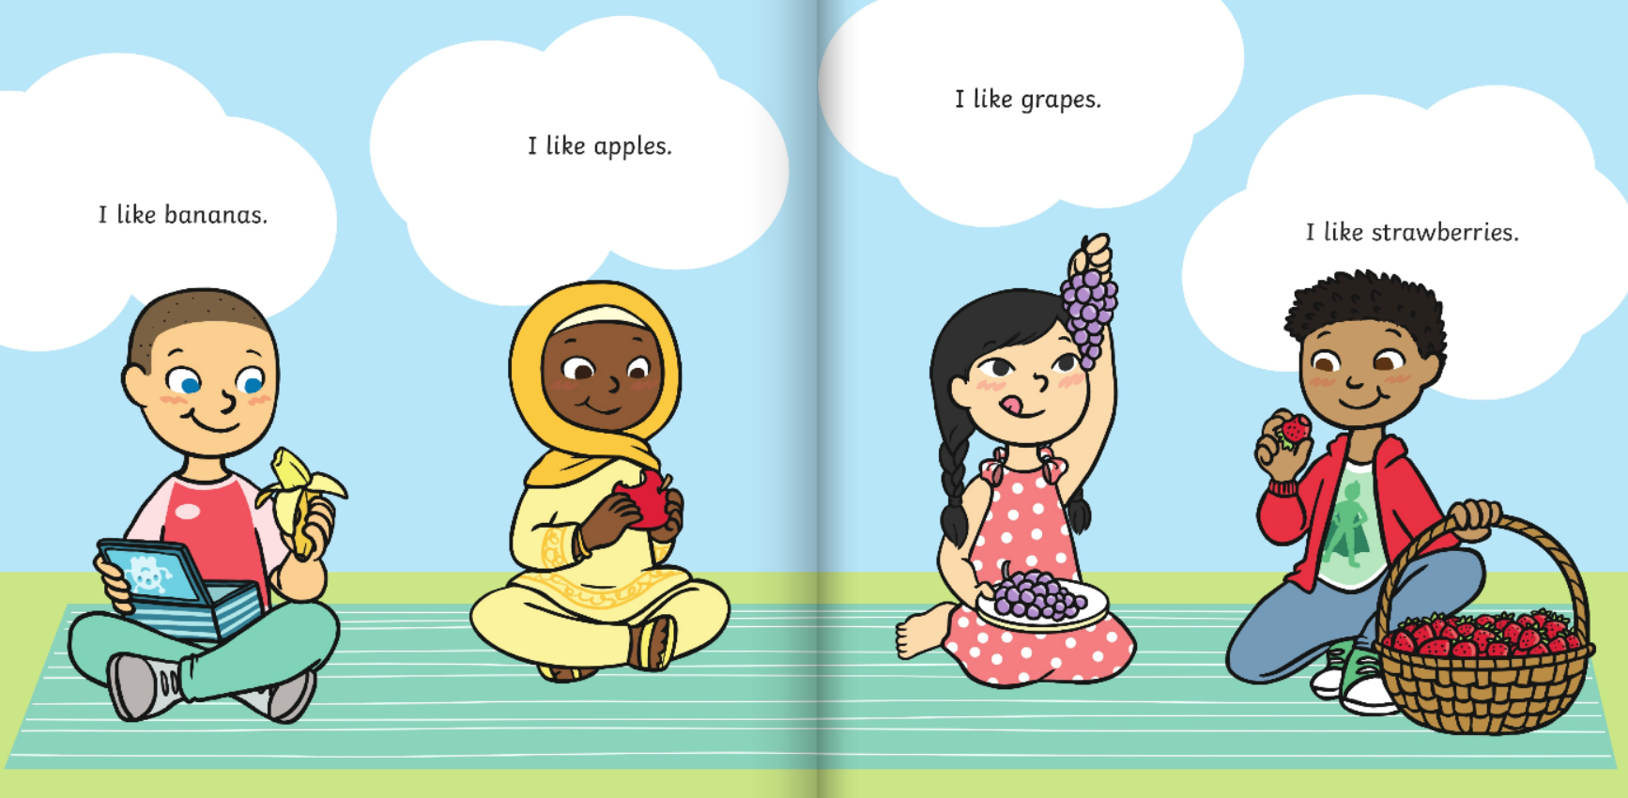

Slide 9
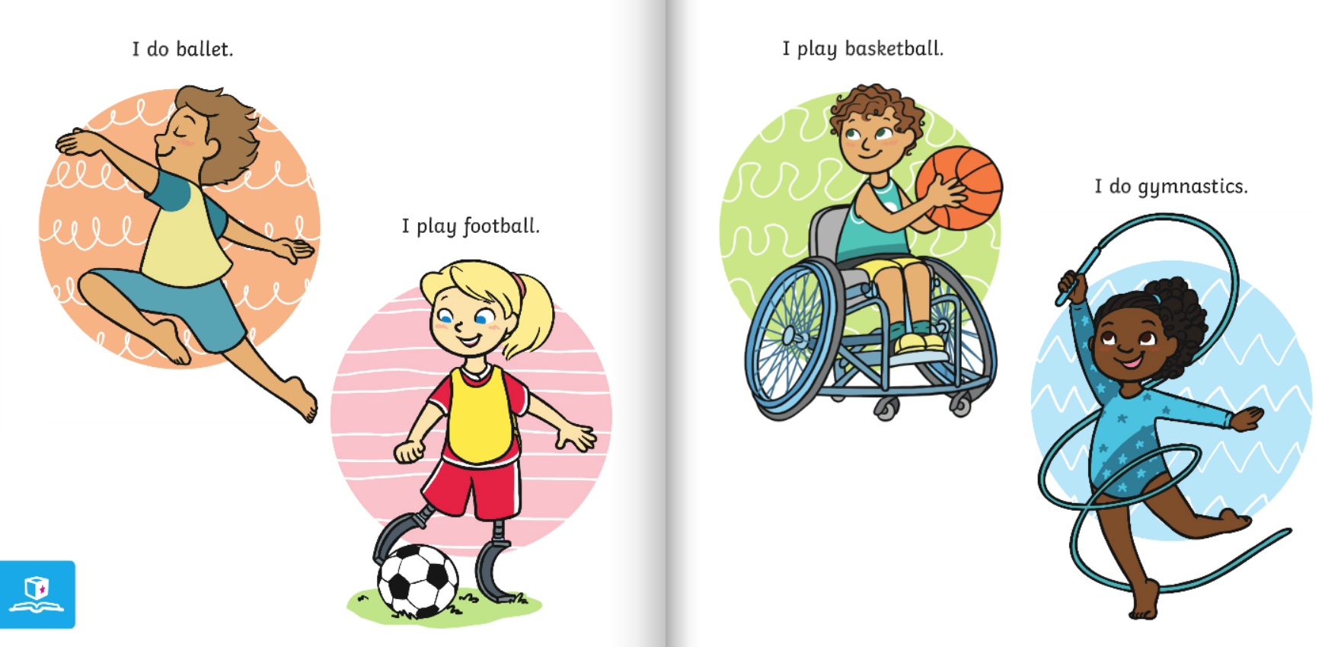

Slide 10
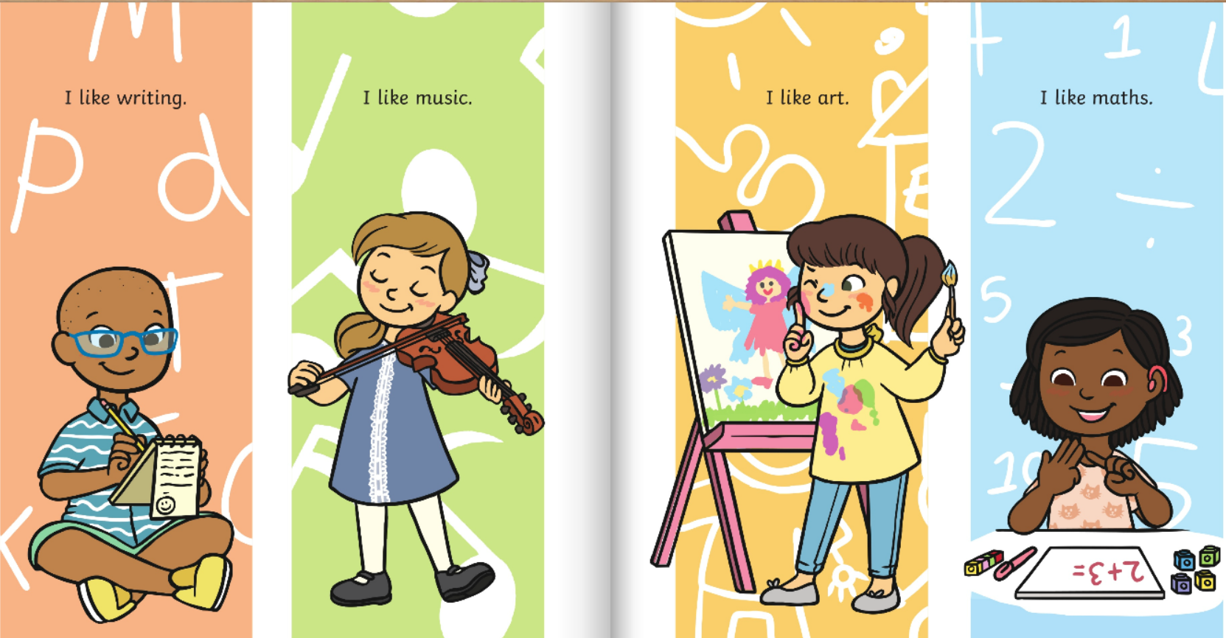

Slide 11
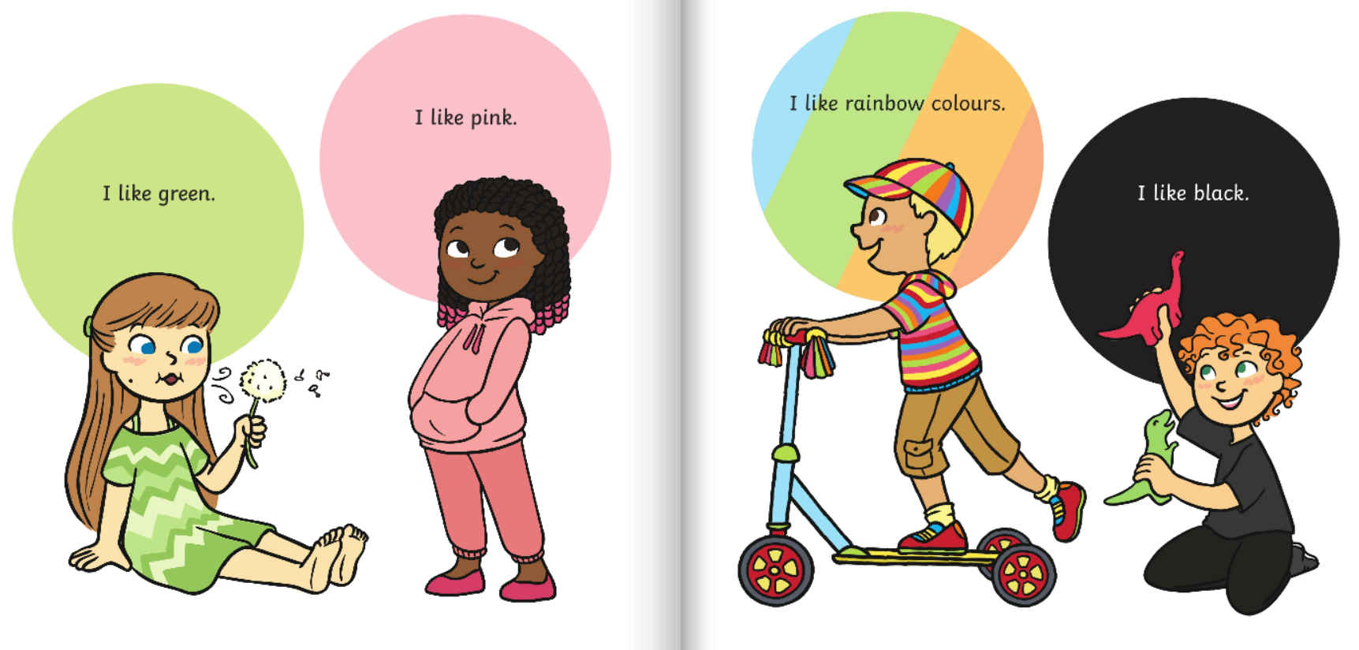

Slide 12
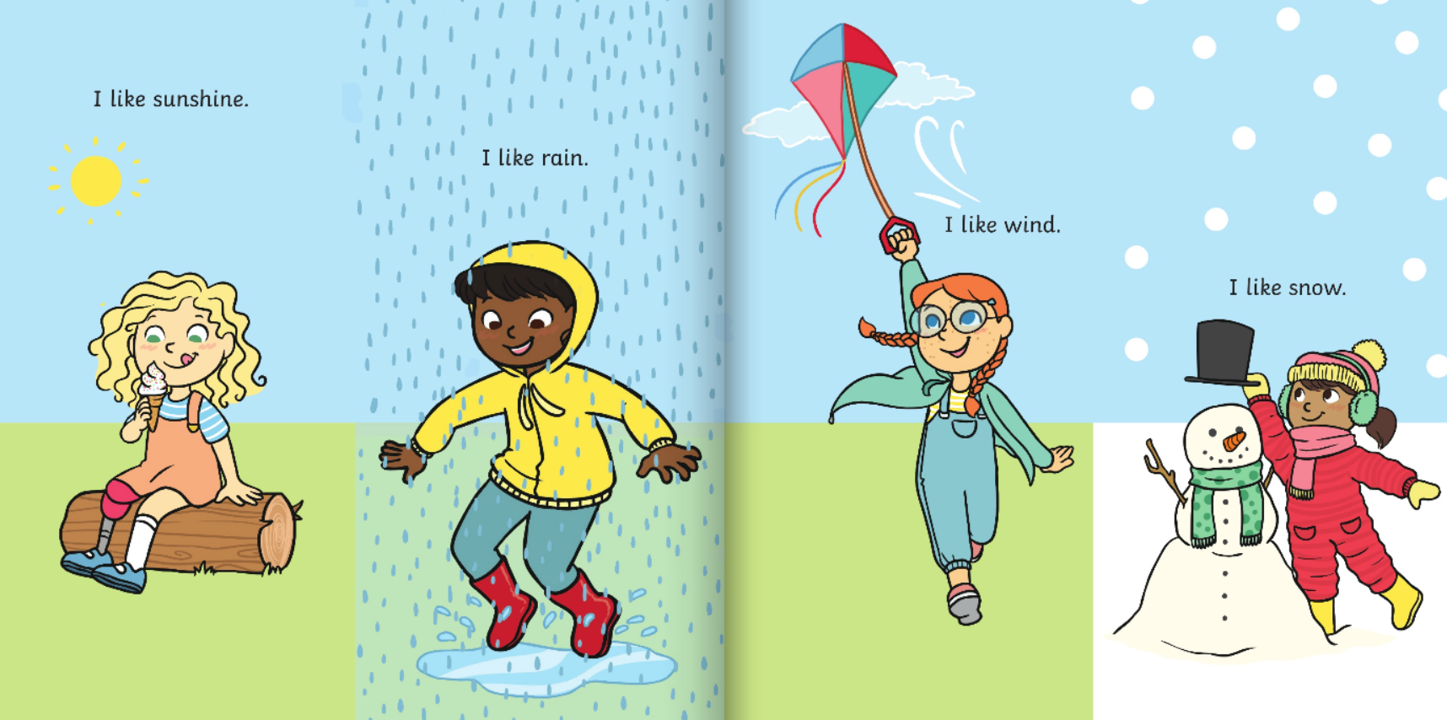

Slide 13
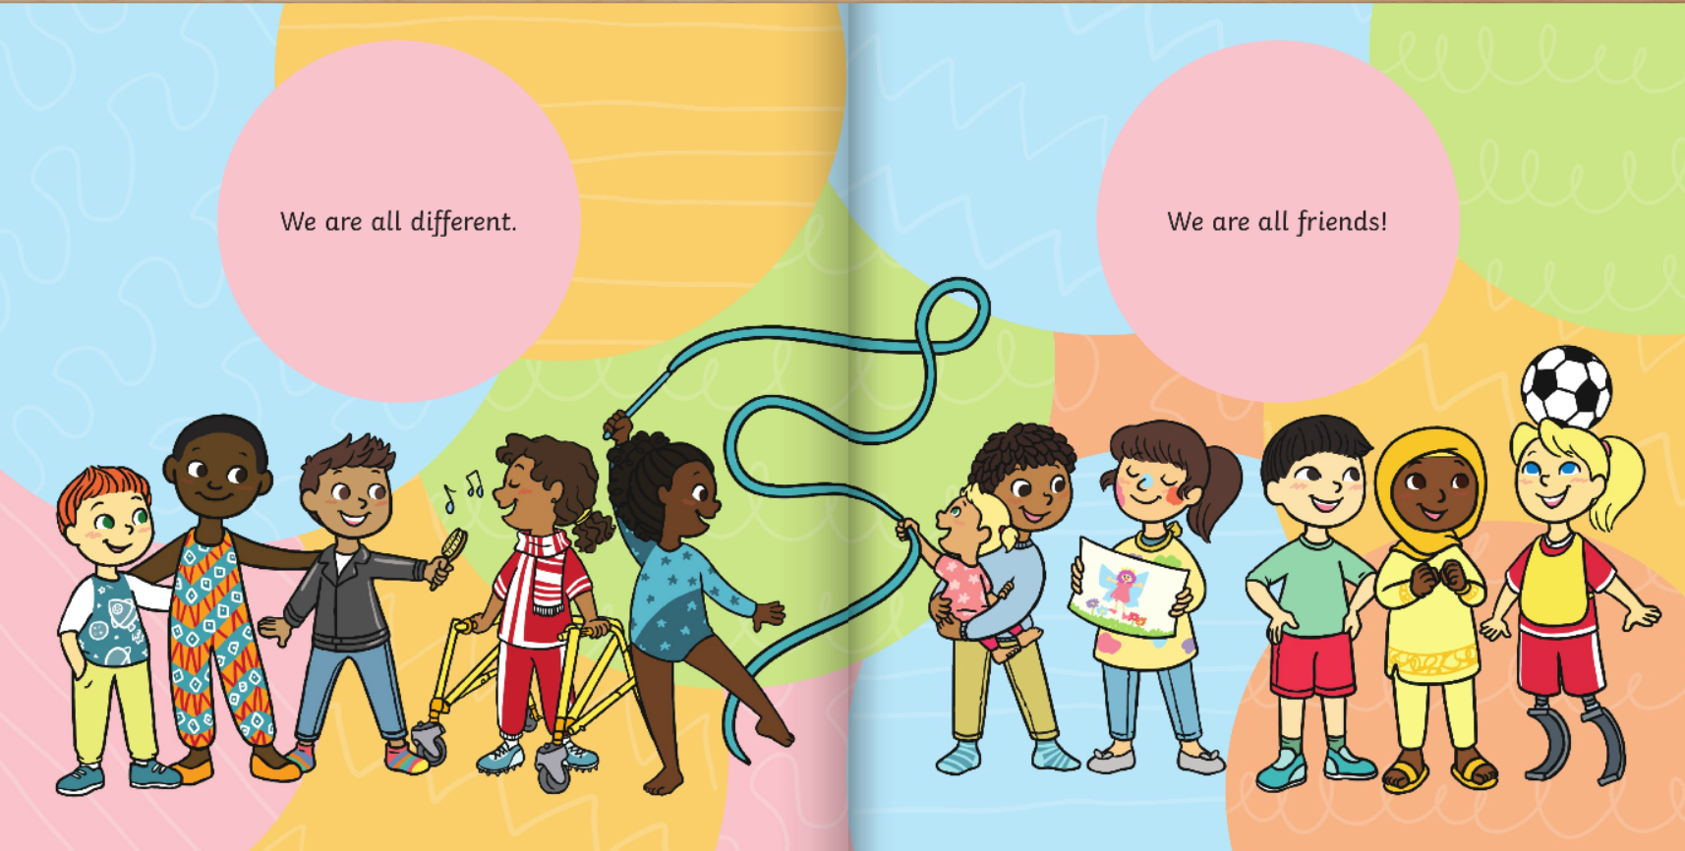

Slide 14
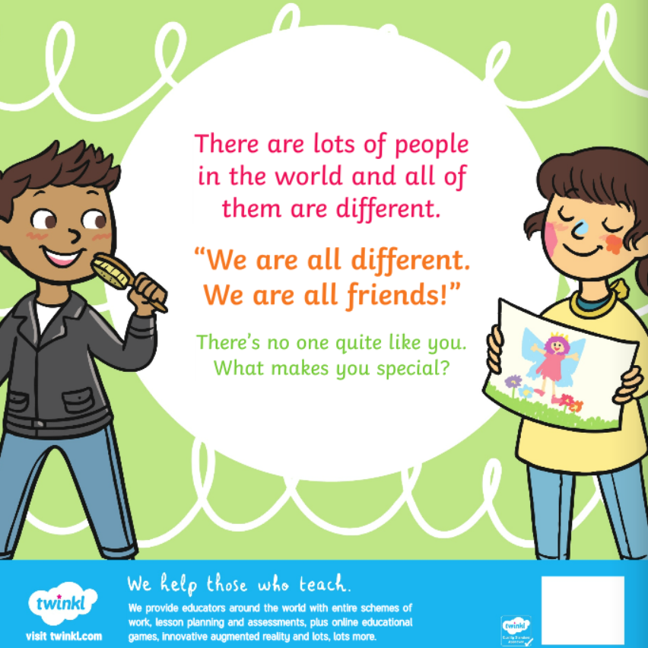

Slide 15
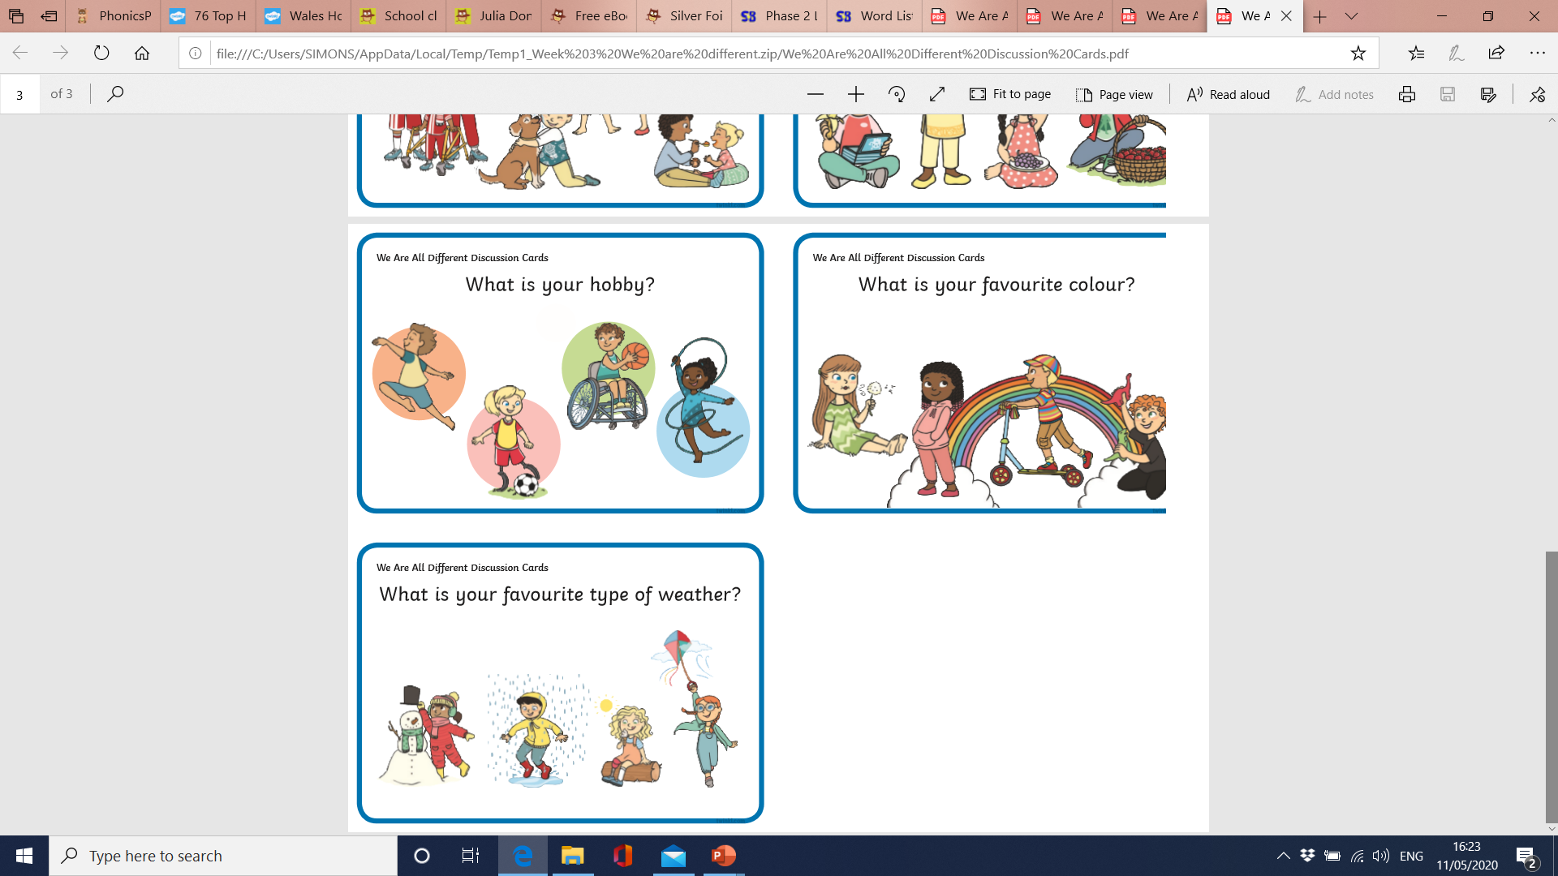
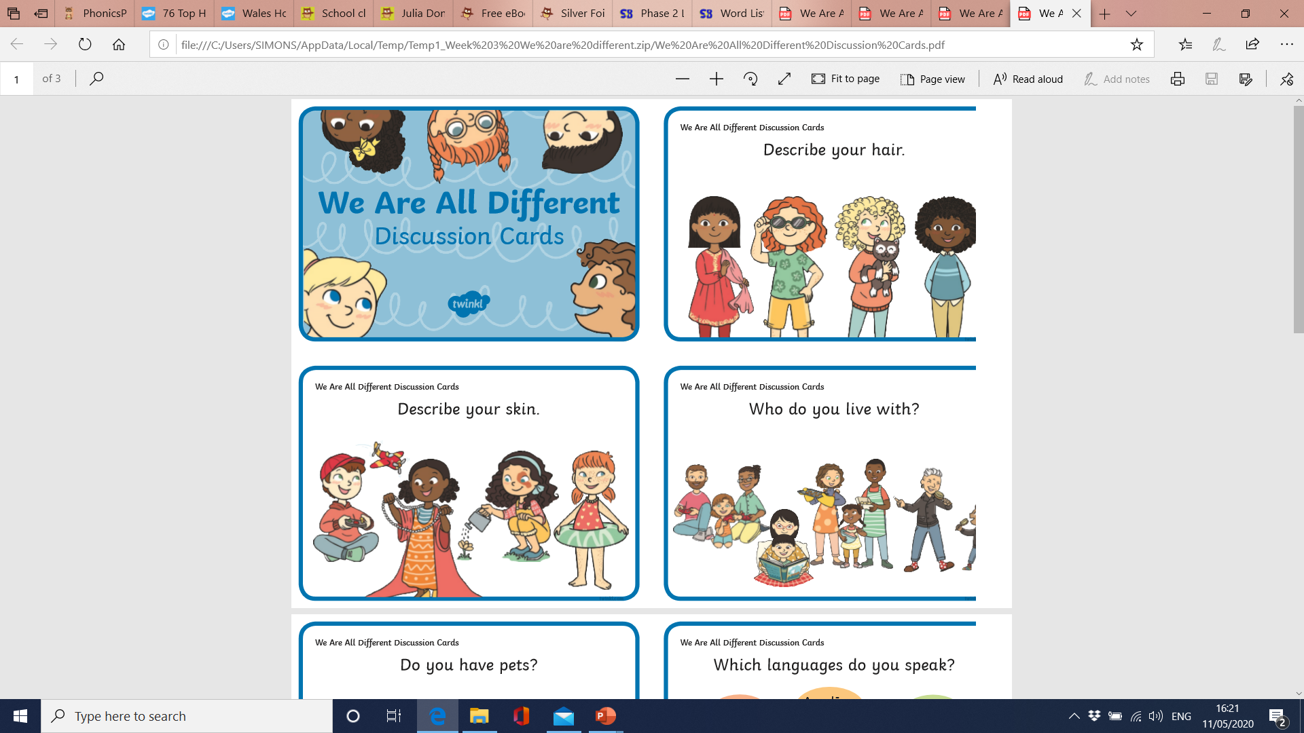
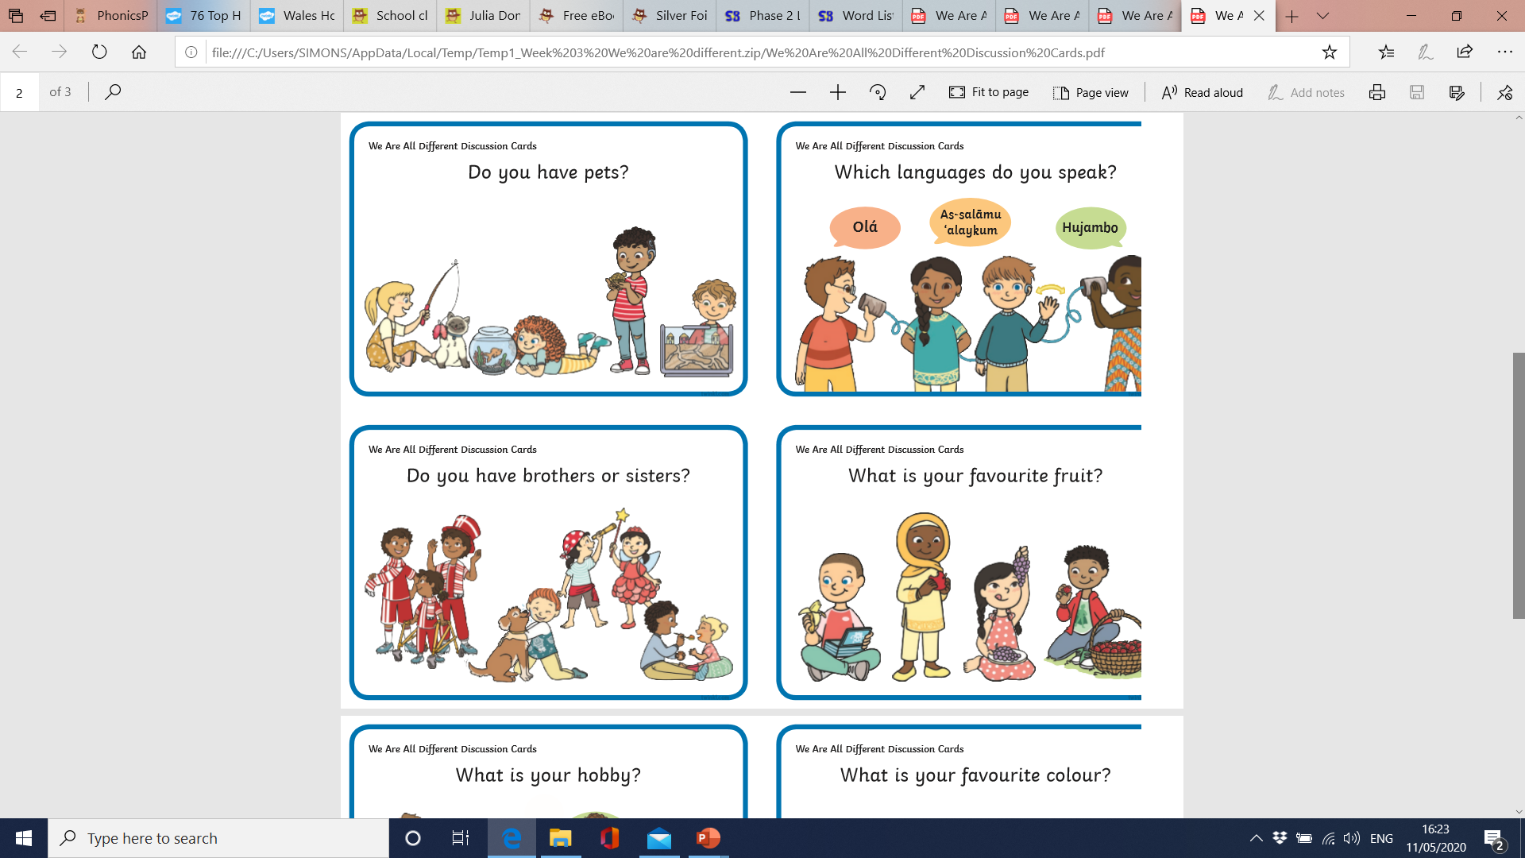
Read the eBook and discuss these questions with a family member.
Challenge… Can you explain how you are different?

Slide 16

Draw a picture of yourself and write sentences underneath to tell us your favourite things.
How are you different to your family members?
Remember… capital letters, finger spaces and a full stop.
Challenge… Can read your work back to your family?

Slide 17
Names | Favourite colour | Favourite subject | Number of brothers and sisters | Hair colour
Collect data about your favourite things. Can you ask all of your family members in your household.
Challenge… Can you talk about what you have found out?

Slide 18
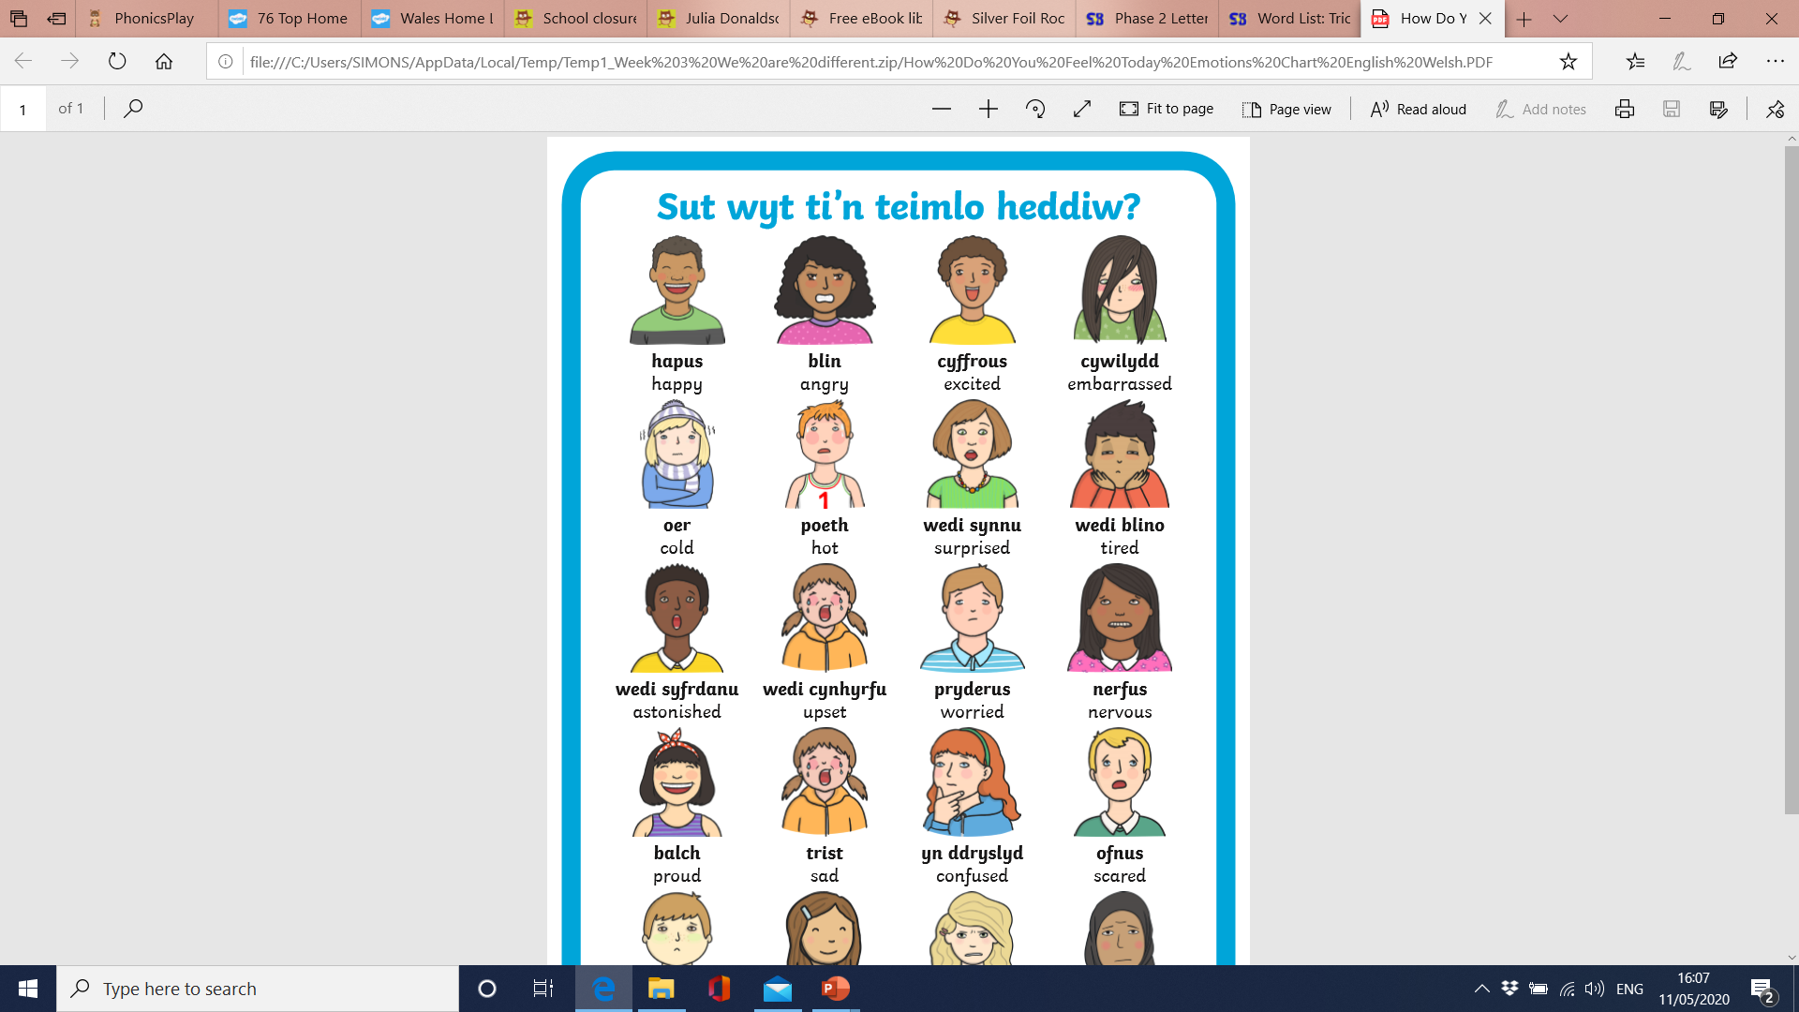
Ask your family members
Sut wyt ti?
How are you?
Dwi’n …
I’m…
Challenge…Can you draw each of your family members and write how they are feeling?

Slide 19
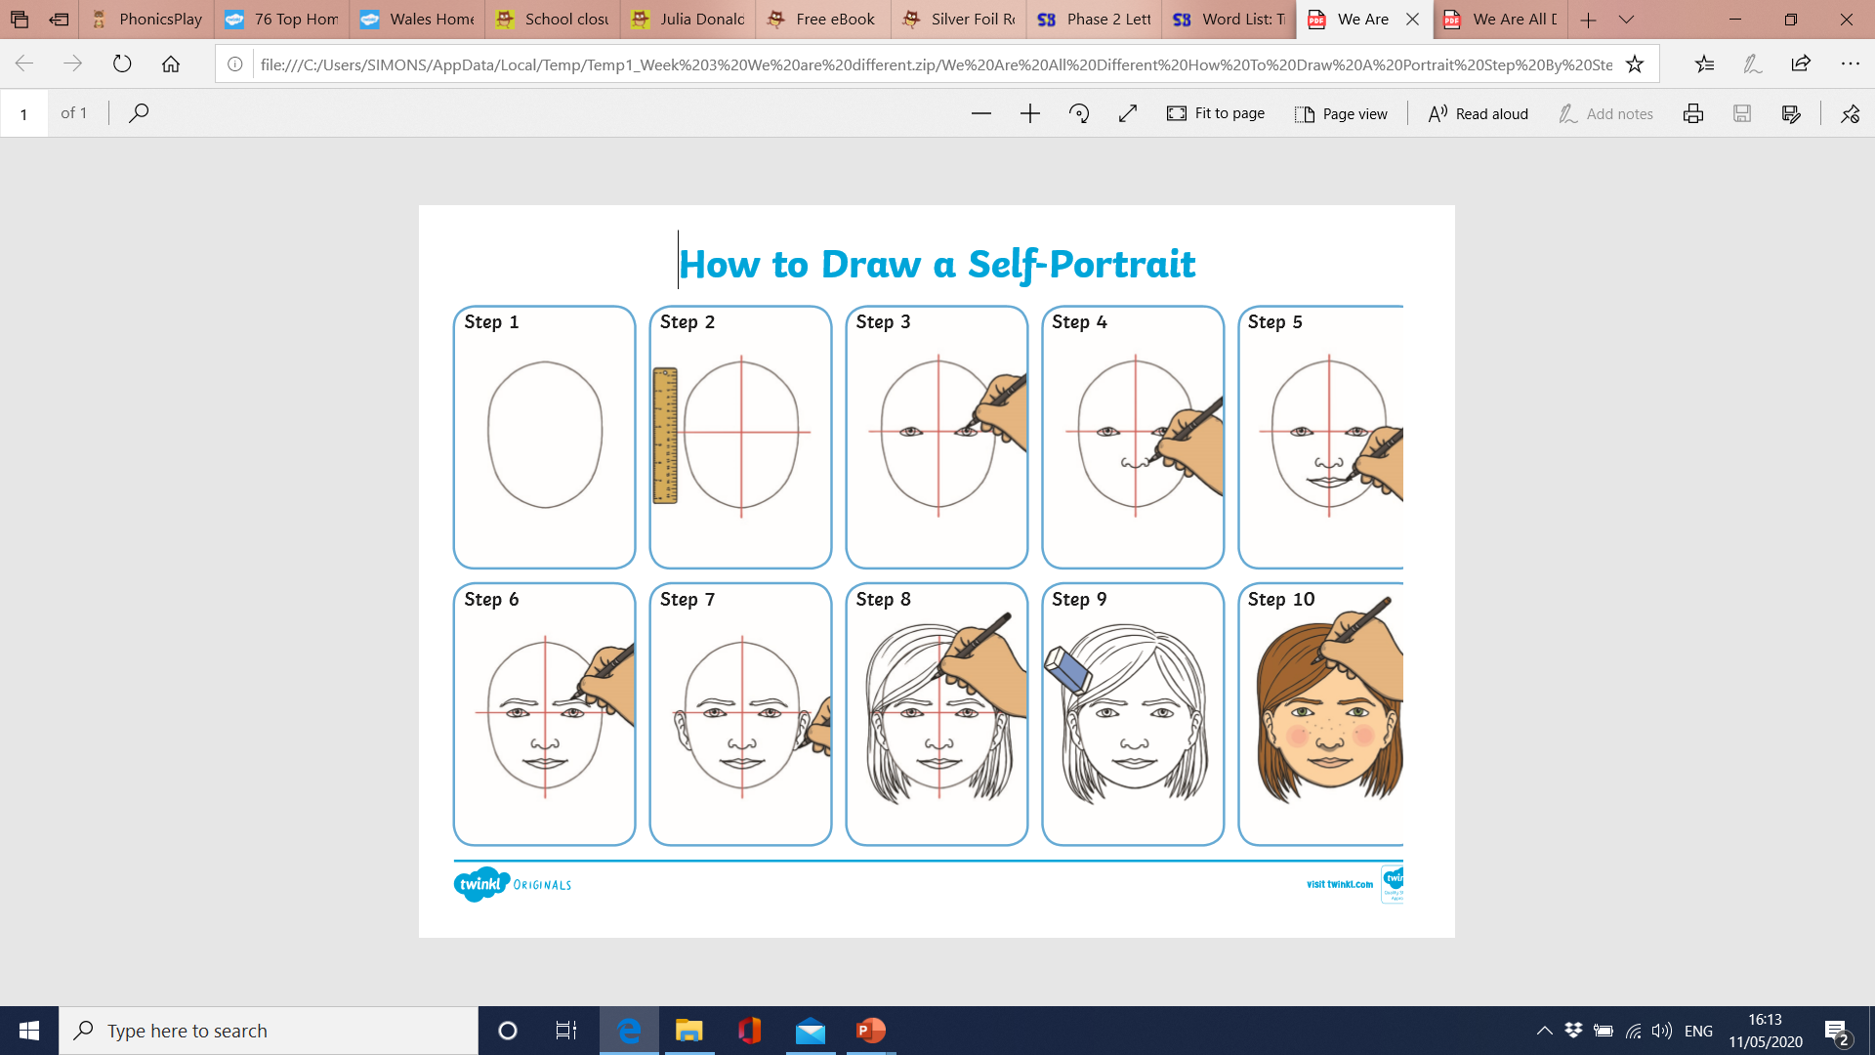
Follow the instructions to draw a self portrait.
Challenge… Can you talk about your artwork? What do you like about your artwork?

Slide 20
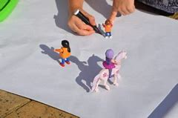
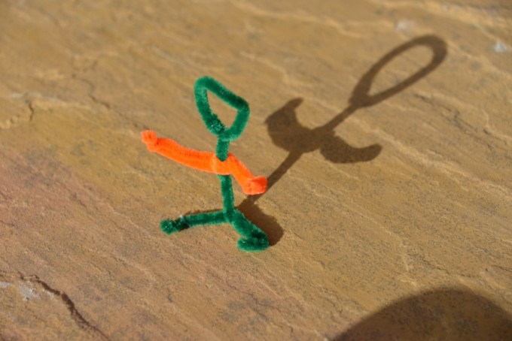
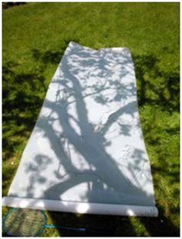
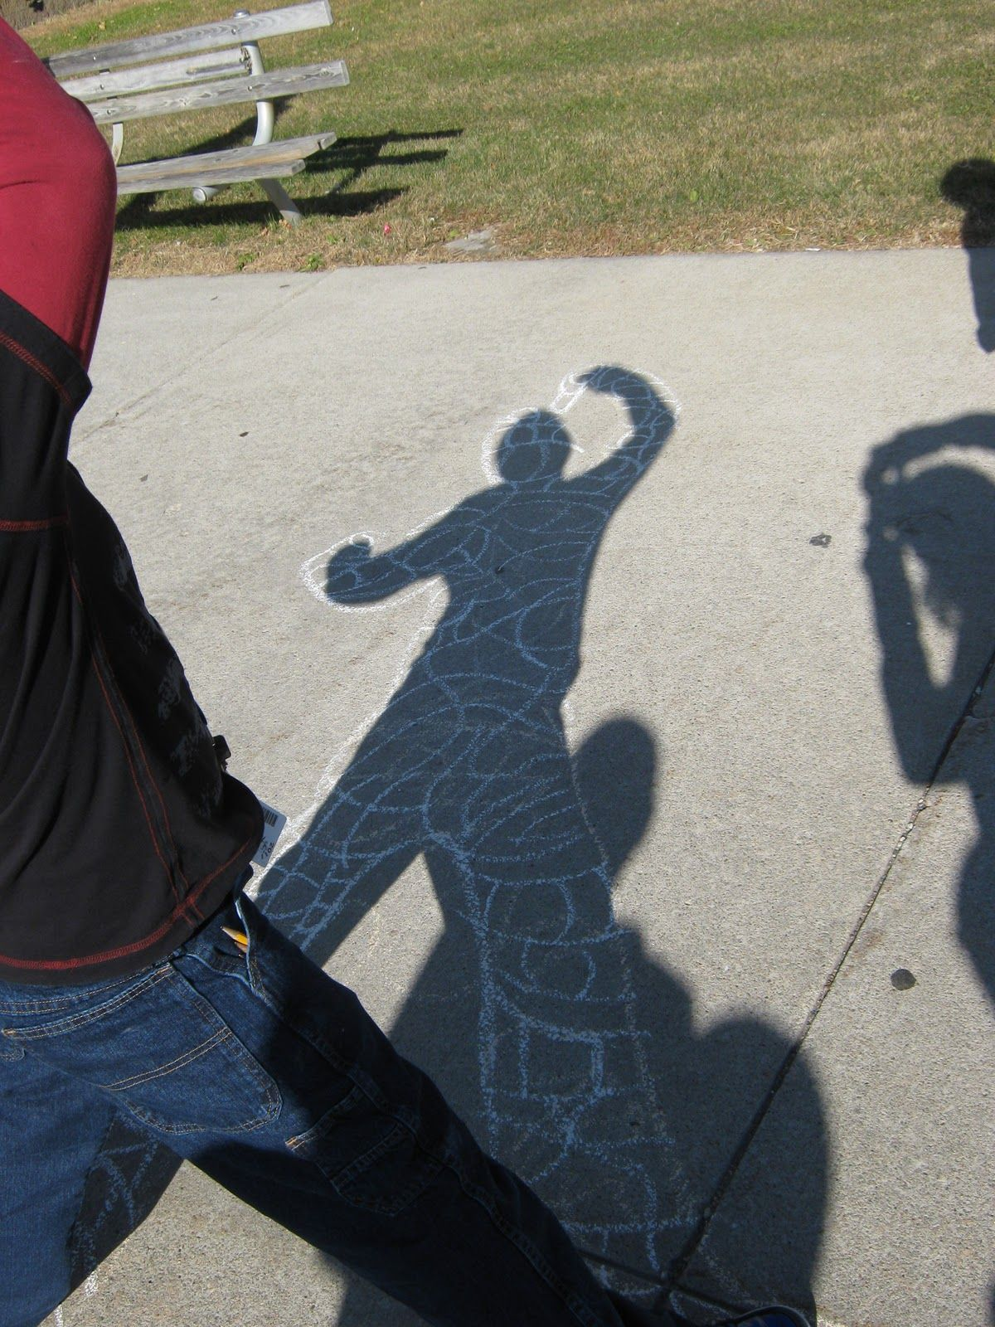
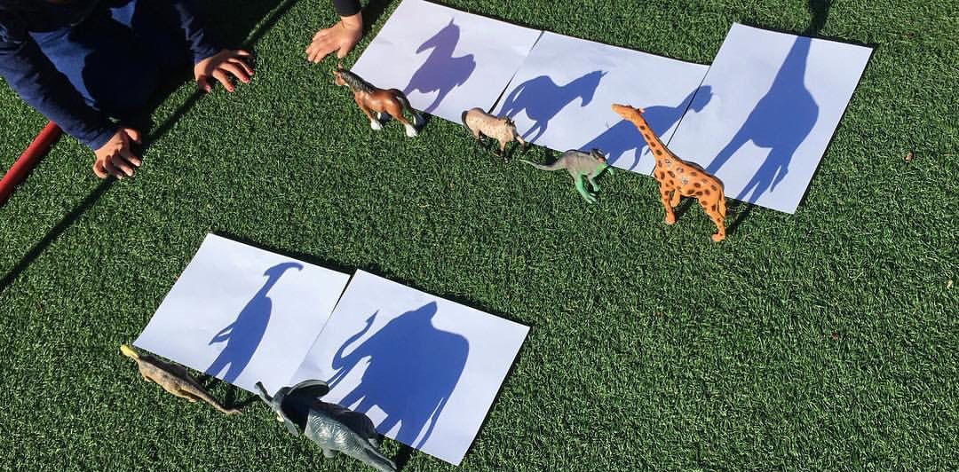
Create a shadow drawing.
Challenge…Can you draw a shadow at mid-day and at 4pm? How are the shadows different?

Slide 21
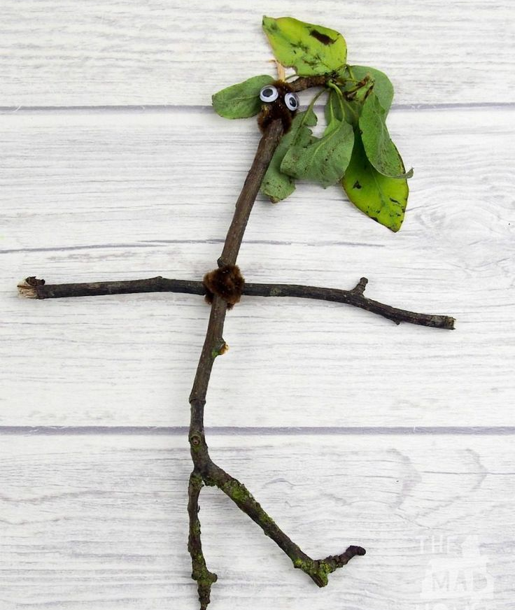
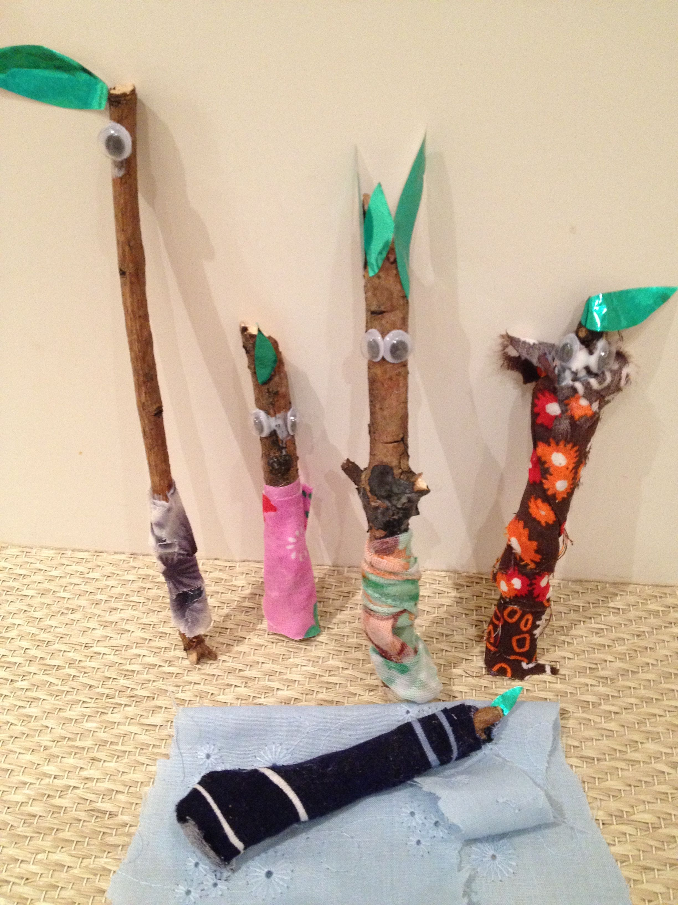
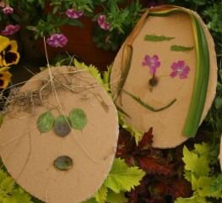
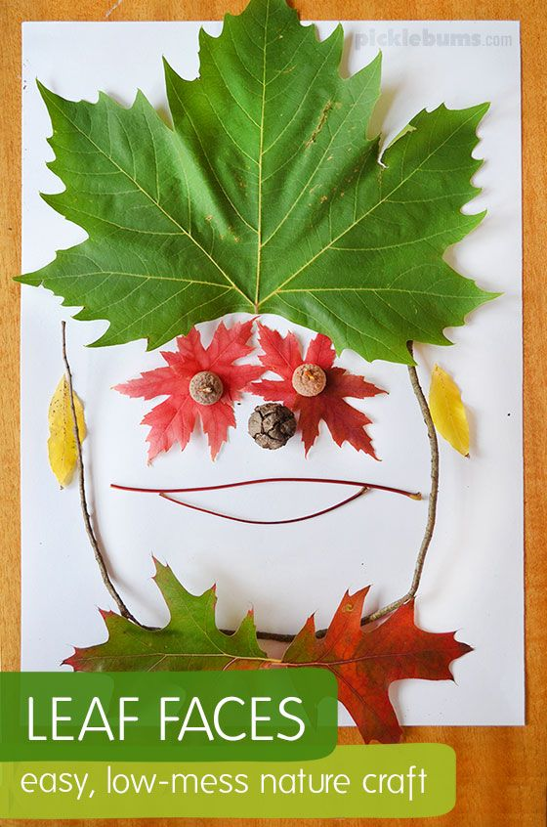
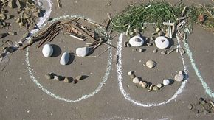
Go on a walk and collect natural resources. Make a natural version of yourself.
Challenge…Can you create your family in natural resources? Can your family guess who is who?

